Slide 1
Brief Introduction of
A27Plex STR Detection Kit
May 2023
Jiangsu Superbio Biomedical (Nanjing) Co.,Ltd.

Slide 2
Features of A27Plex

Slide 3
1.1 Features of A27Plex STR Detection Kit
1. A27Plex is a 6-color fluorescence detection product which is applicable for detecting 27 loci including 24 autosomal STR loci, 1 Y chromosome STR locus, 1 Y-indel, and 1 Amelogenin
2. The loci contained conform to global databasing loci standards. A27Plex includes all the
loci of expanded CODIS, European Standard Set, UK Core Loci, and German Core Loci.
3. High discrimination power (DP) and paternity probability exclusion (PE). A27Plex contains loci featuring a high discrimination power (DP), namely, SE33, Penta D, Penta E, D6S1043, etc.
4. The optimized PCR system has enhanced the sensitivity of A27Plex which is suited best for degraded specimens. The inclusion of 11 mini-STRs (amplification length＜220bp) allows A27Plex to maximize results from degraded specimens.
5. A27Plex is a reliable single-amplification STR multiplex kit optimized for use with the extracted DNA samples, and also suitable for the direct amplification of various specimen types, such as oral epithelial cells, blood, blood spots and hairs without DNA extraction.
6. Rapid amplification.The whole PCR process using A27Plex takes 70min.

Slide 4
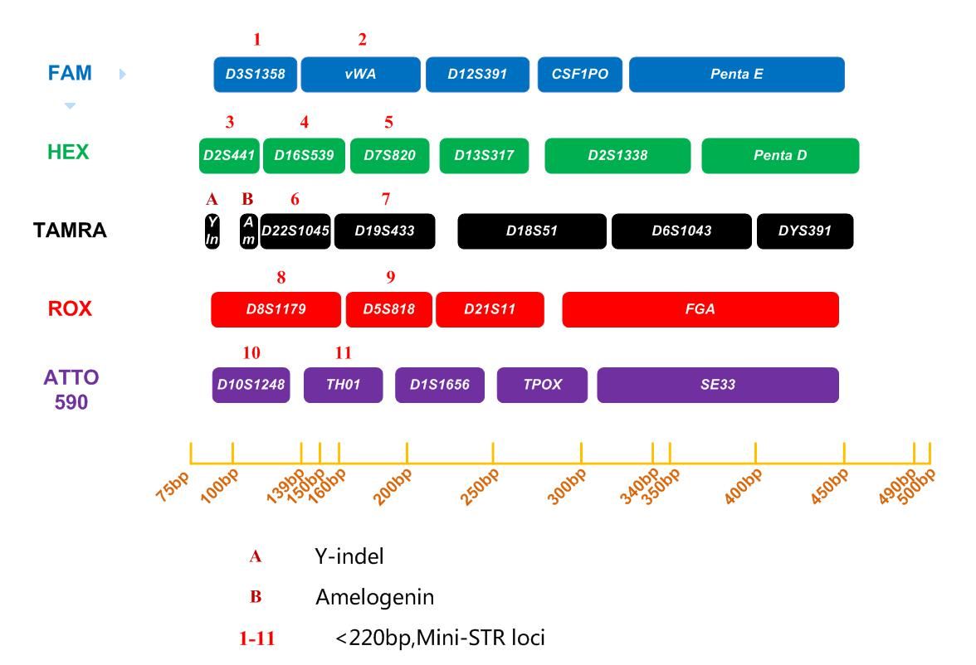
1.2 Loci Arrangement Diagram of A27Plex

Slide 5
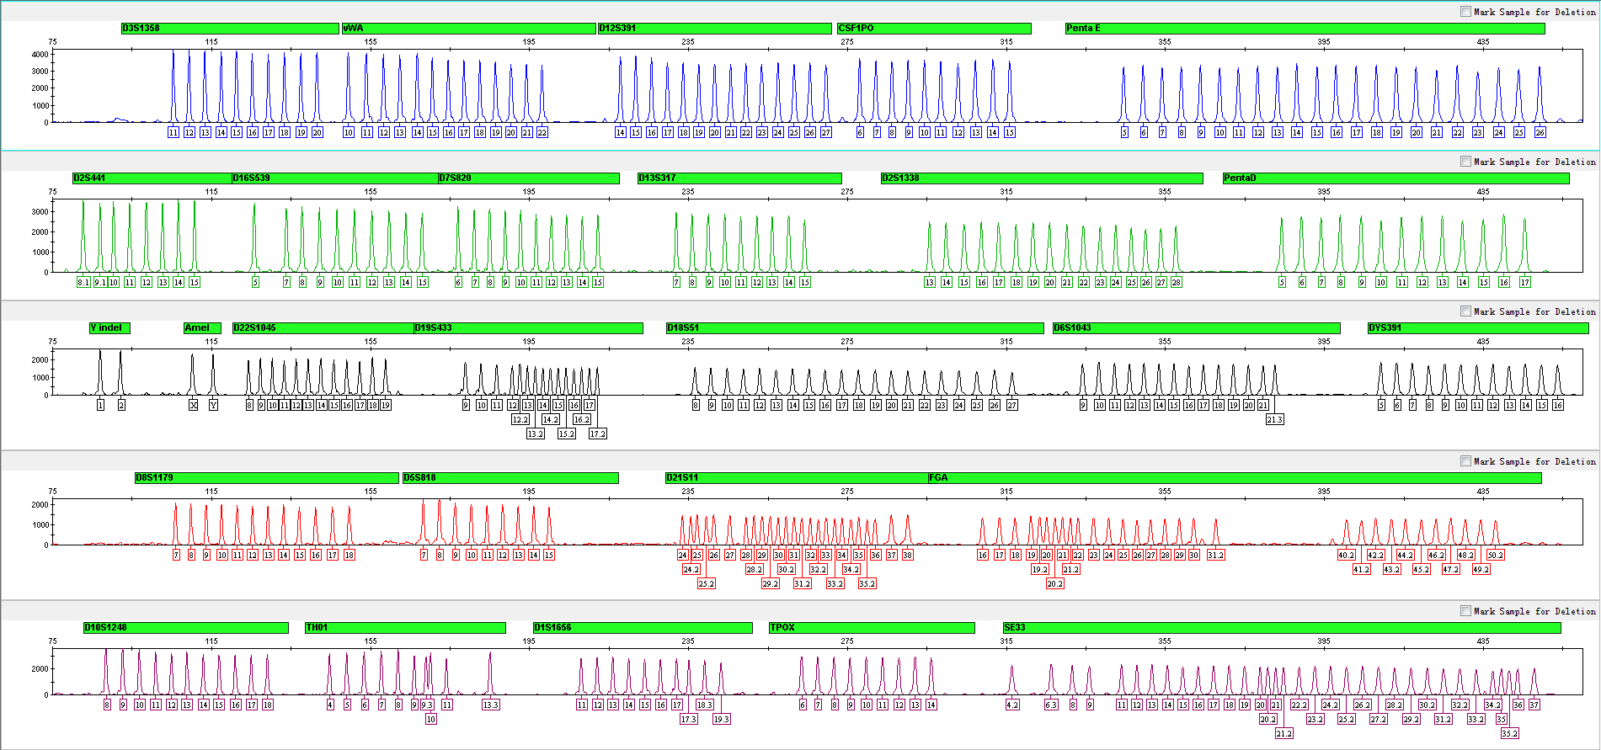
1.3 Electrophoretic Diagram of A27Plex Allelic Ladder
A27Plex Allelic Ladder contains 362 alleles

Slide 6
General Information of A27Plex

Slide 7
2.1 Components of A27Plex STR Detection Kit (25µL× 200 RXN/Kit)
 | Component | Content | Description
Pre-amplification Kit | 2.5× PCR Mix | 1,000μL× 2 | Contains dNTPs, bovine serum albumin, and 0.05% sodium azide, etc.
 | A27Plex Primers | 1,000μL× 1 | Contains forward and reverse primers to amplify human DNA targets
 | PCR Grade Water | 1,000μL× 2 | Nuclease-free deionized ultrapure water
 | Control DNA 9948 (0.5ng/µL) | 20μL× 1 | Contains 0.5ng/μL human male genomic DNA from cell line
 | Taq DNA Polymerase | 200μL× 1 | Hot-start DNA Polymerase
Post-amplification Kit | A27Plex Allelic Ladder | 25μL× 1 | Contains amplified alleles
 | Orange-500 | 120μL× 1 | Internal lane standards with fluorescent markers
Matrix Kit | 6 Dye Matrix | 50μL×1 | Used for spectral calibration

Slide 8
2.2 Reaction System and Procedures of A27Plex STR Detection Kit
Component | 25µL System (µL)
2.5× PCR Mix | 10.0
A27Plex Primers | 5.0
PCR Grade Water | 8.0
Control DNA 9948 (0.5ng/µL) | 1.0
Taq DNA Polymerase | 1.0
Total Volume | 25.0

Slide 9
Amplification Results of A27Plex

Slide 10
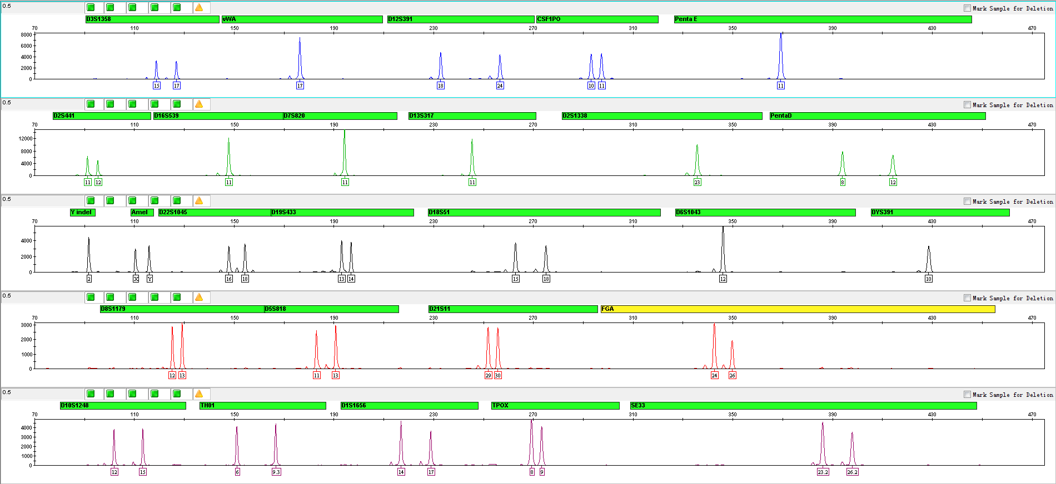
3.1 Amplification Results of Positive Control 9948 Analyzed on 3500

Slide 11
Performance Measurement of A27Plex

Slide 12
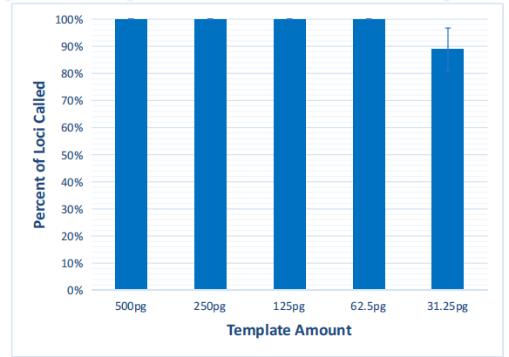
4.1 Sensitivity Test
4.1.1 Content of Extracted DNA
• 500pg, 250pg, 125pg, 62.5pg, 31.25pg
• Repeat the experiment 3 times for all samples
30 cycles
25μL PCR system
3500 (1.2kV, 18sec sampling time)
Baseline threshold 50RFU

Slide 13
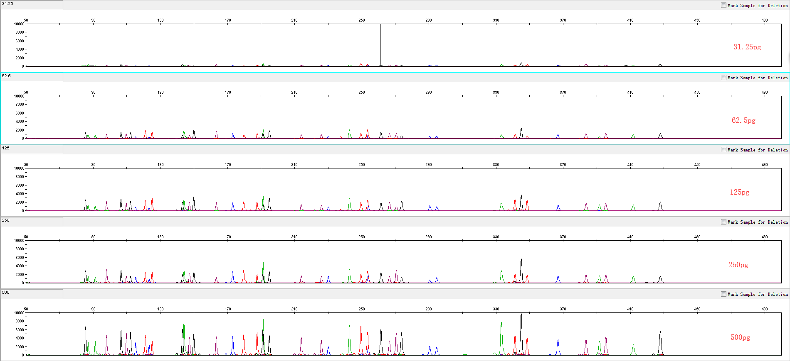
4.1 Sensitivity Test

Slide 14
4.2 Inhibition Test
Three kinds of inhibitors:
4.2.1 Hematin
• 0, 300, 450, 600 and 900µM
4.2.2 Hemoglobin
• 0, 150, 300, 600 and 900µM
4.2.3 Humic Acid
• 0, 10, 20, 40 and 50ng/µL
4.2.4 Indigo
• 0, 5, 8, 10 and 15mM
4.2.5 EDTA
• 0, 0.2, 0.4, 0.8 and 1.0mM
Repeat the experiment 3 times for all samples

Slide 15
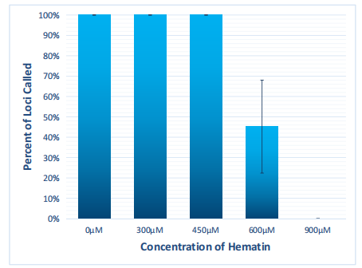
4.2.1 Hematin
30 cycles
25μL PCR system
3500 (3kV, 10sec sampling time)
Baseline threshold 50RFU

Slide 16
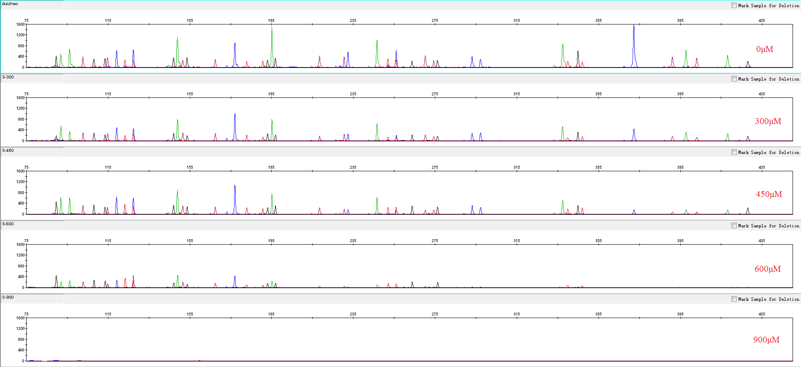
4.2.1 Hematin

Slide 17
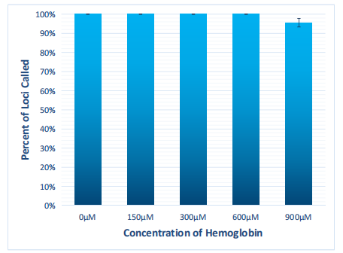
4.2.2 Hemoglobin
30 cycles
25μL PCR system
3500 (1.2kV, 18sec sampling time)
Baseline threshold 50RFU

Slide 18
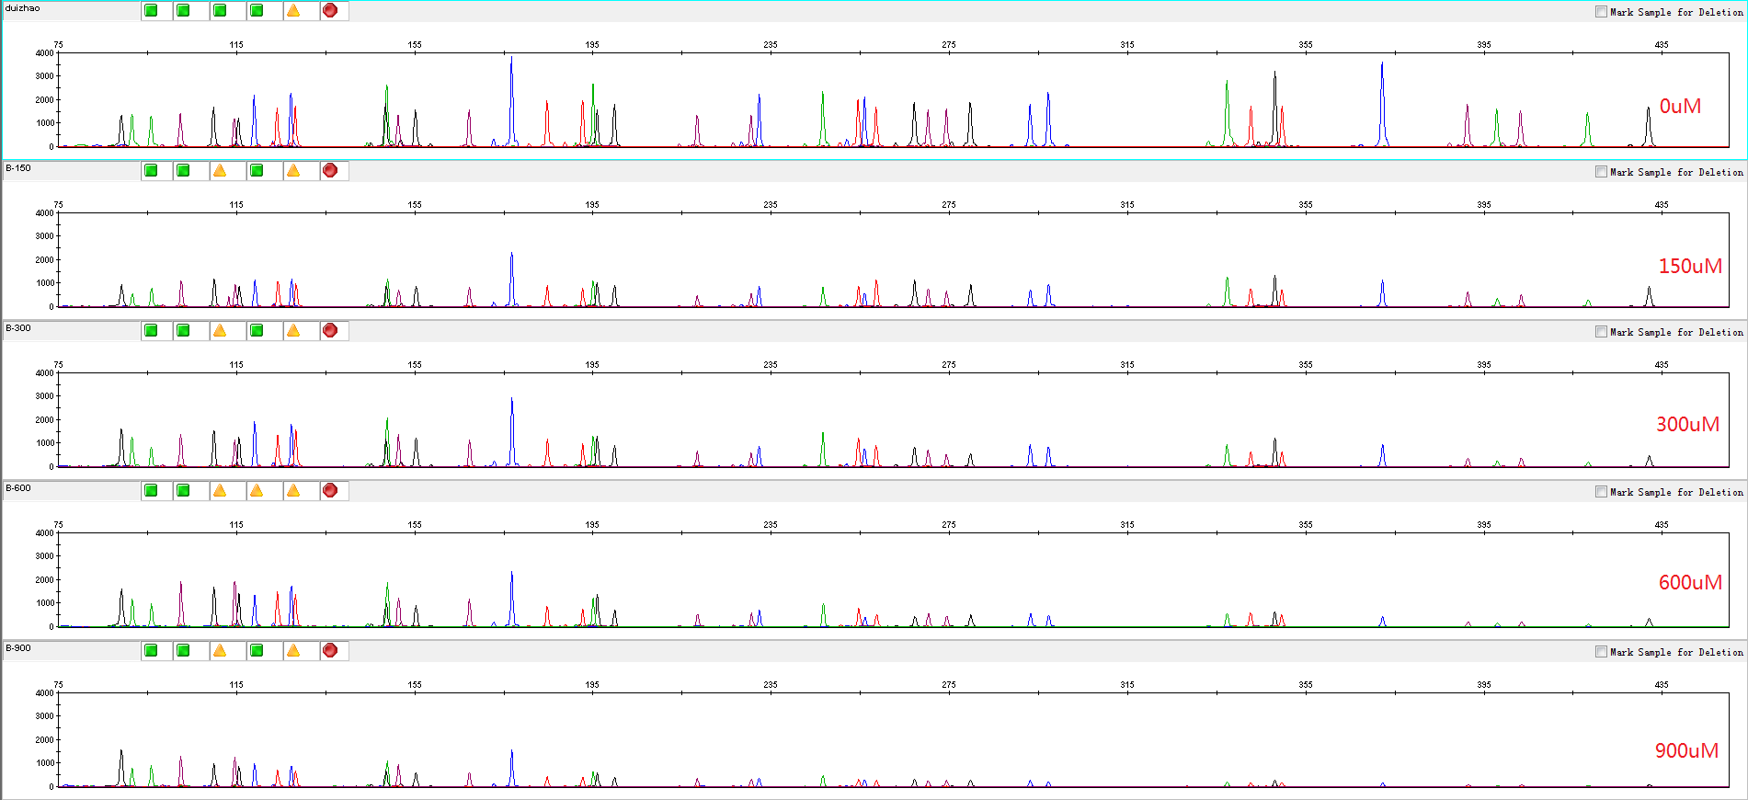
4.2.2 Hemoglobin

Slide 19
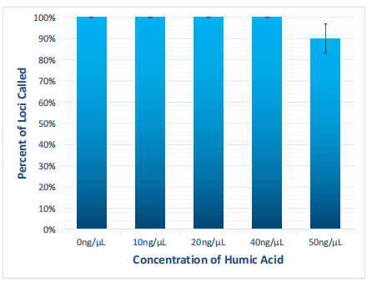
4.2.3 Humic Acid
30 cycles
25μL PCR system
3500 (1.2kV, 18sec sampling time)
Baseline threshold 50RFU

Slide 20
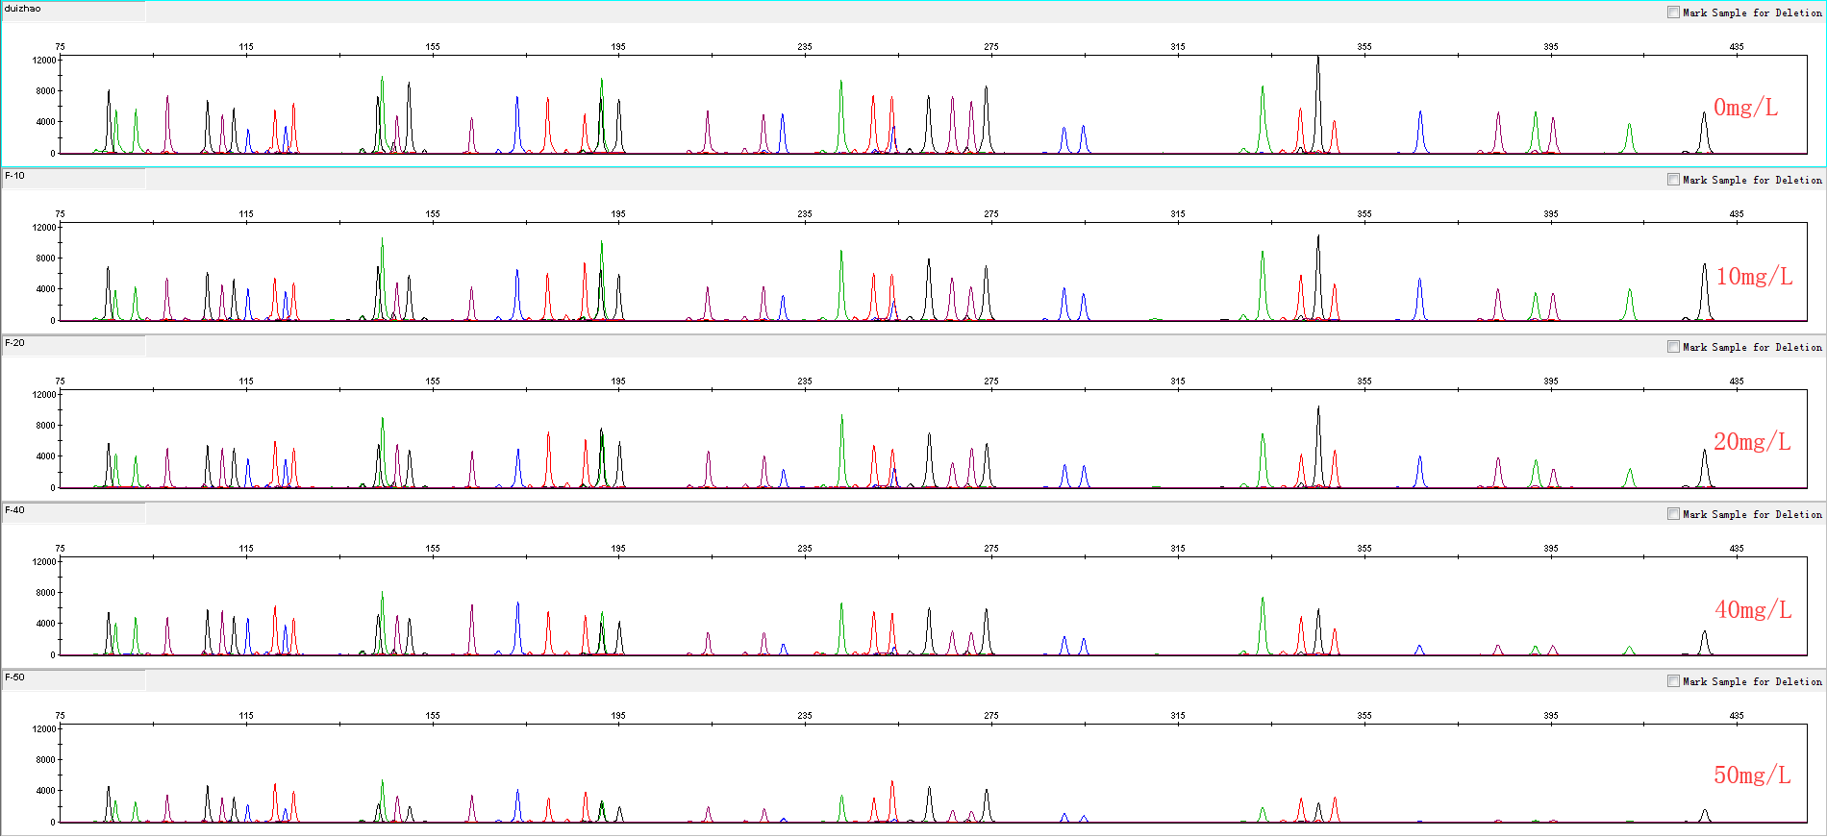
4.2.3 Humic Acid

Slide 21
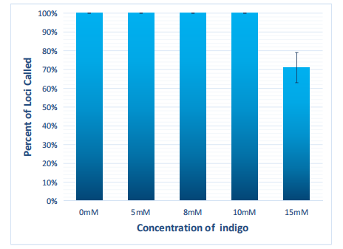
4.2.4 Indigo
30 cycles
25μL PCR system
3500 (1.2kV, 18sec sampling time)
Baseline threshold 50RFU

Slide 22
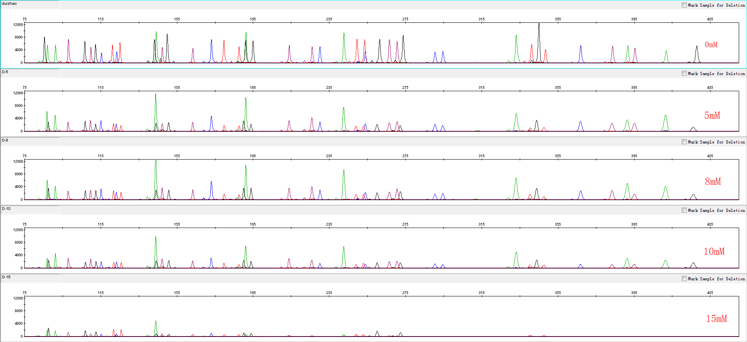
4.2.5 EDTA

Slide 23
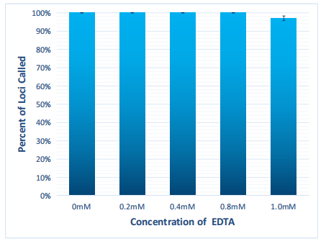
4.2.5 EDTA
30 cycles
25μL PCR system
3500 (1.2kV, 18sec sampling time)
Baseline threshold 50RFU

Slide 24
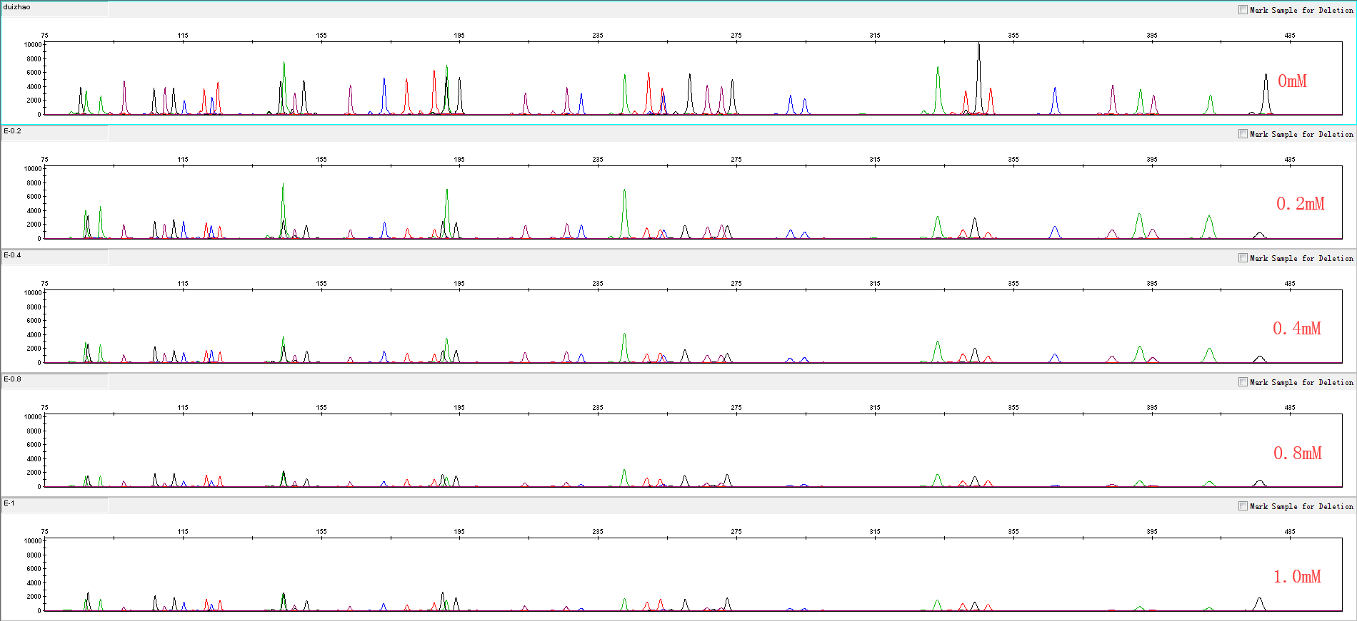
4.2.5 EDTA

Slide 25
Service & Cooperation

Slide 26
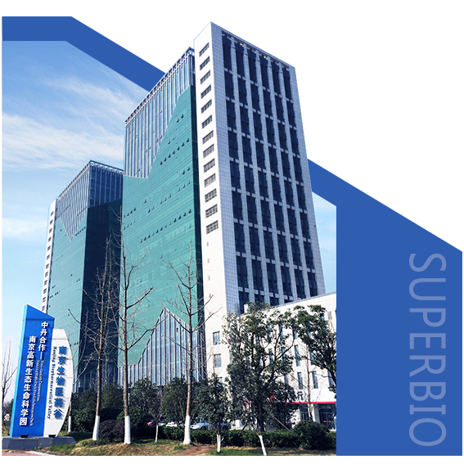
Service & Cooperation
Jiangsu Superbio Biomedical Co. Ltd., founded in 2011, is a cutting-edge technology enterprise owning the Practice License of Medical Institution, which specializes in the research and testing of gene sequencing industry, and integrates R&D, production and sales. The company's products and services cover forensic testing, medical testing, food/environment/medicine testing, instrumentation and software.
We are willing to provide clients with scientific research services related to forensic DNA testing, such as research projects and papers publication, solving all the difficulties encountered in the experiment for you.
We sincerely look forward to cooperate with you in developing products and researching projects.

Slide 27
THANKS!
Contact Us
Address: Sino-Danish Ecological Life Science Industrial Park, No.3-1 Xinjinxhu Road, Pukou District, Nanjing
Tel: 400-616-2676
Website: http://www.superbio.cn/

