Slide 1
Brief Introduction of
A33Plex STR Detection Kit
May 2023
Jiangsu Superbio Biomedical (Nanjing) Co.,Ltd.

Slide 2
Features of A33Plex

Slide 3
1.1 Features of A33Plex STR Detection Kit
1. A33Plex is a 6-color fluorescence detection kit which is applicable for detecting 33 autosomal STR loci, 1 Y chromosome STR locus, 1 Y-indel, and 1 Amelogenin, including anti-trafficking loci D8S1132, D6S477, D19S253, D3S3045, D15S659 and D10S1435, as well as highly polymorphic loci such as SE33, Penta D, Penta E, FGA and D6S1043.
2. As A33Plex has strong discrimination power (DP), it is applicable for anti-trafficing database building. A33Plex contains 12 mini STRs (loci within 220bp of amplification length), which facilitates typing and alignment of difficult specimens such as highly degraded specimens.
3. A33Plex uses FRET primers for higher sensitivity. The provided internal positive control (IPC) helps to judge sample quality and if PCR program is successful.
4. Good specimen compatibility. A33Plex can directly amplify a variety of test materials and extracted template DNA.
5. Rapid amplification.The whole PCR process using A33Plex takes 70min.

Slide 4
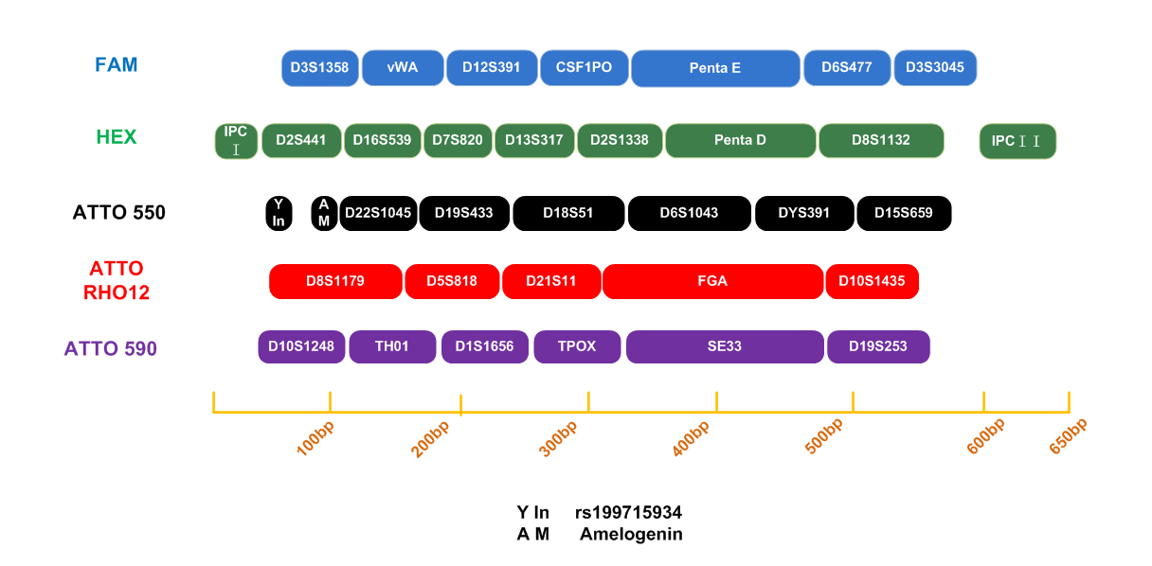
1.2 Loci Arrangement Diagram of A33Plex

Slide 5
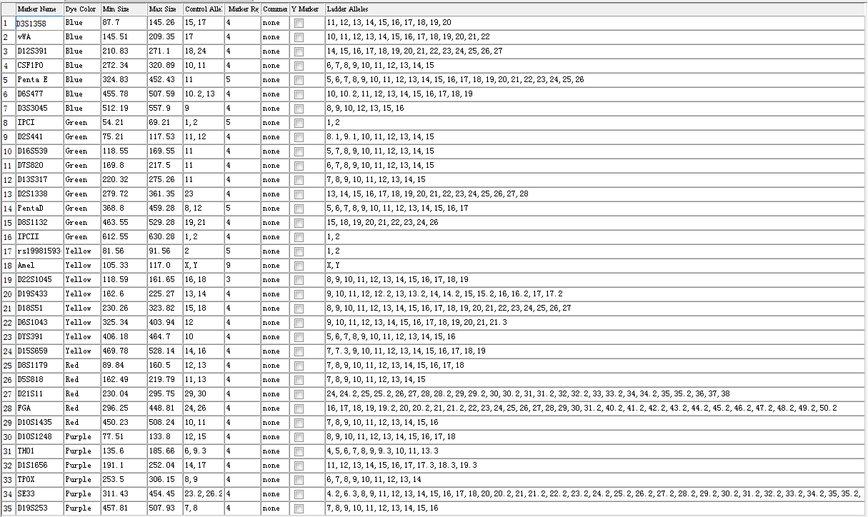
1.3 Analysis Software Loci Information Table of A33Plex

Slide 6
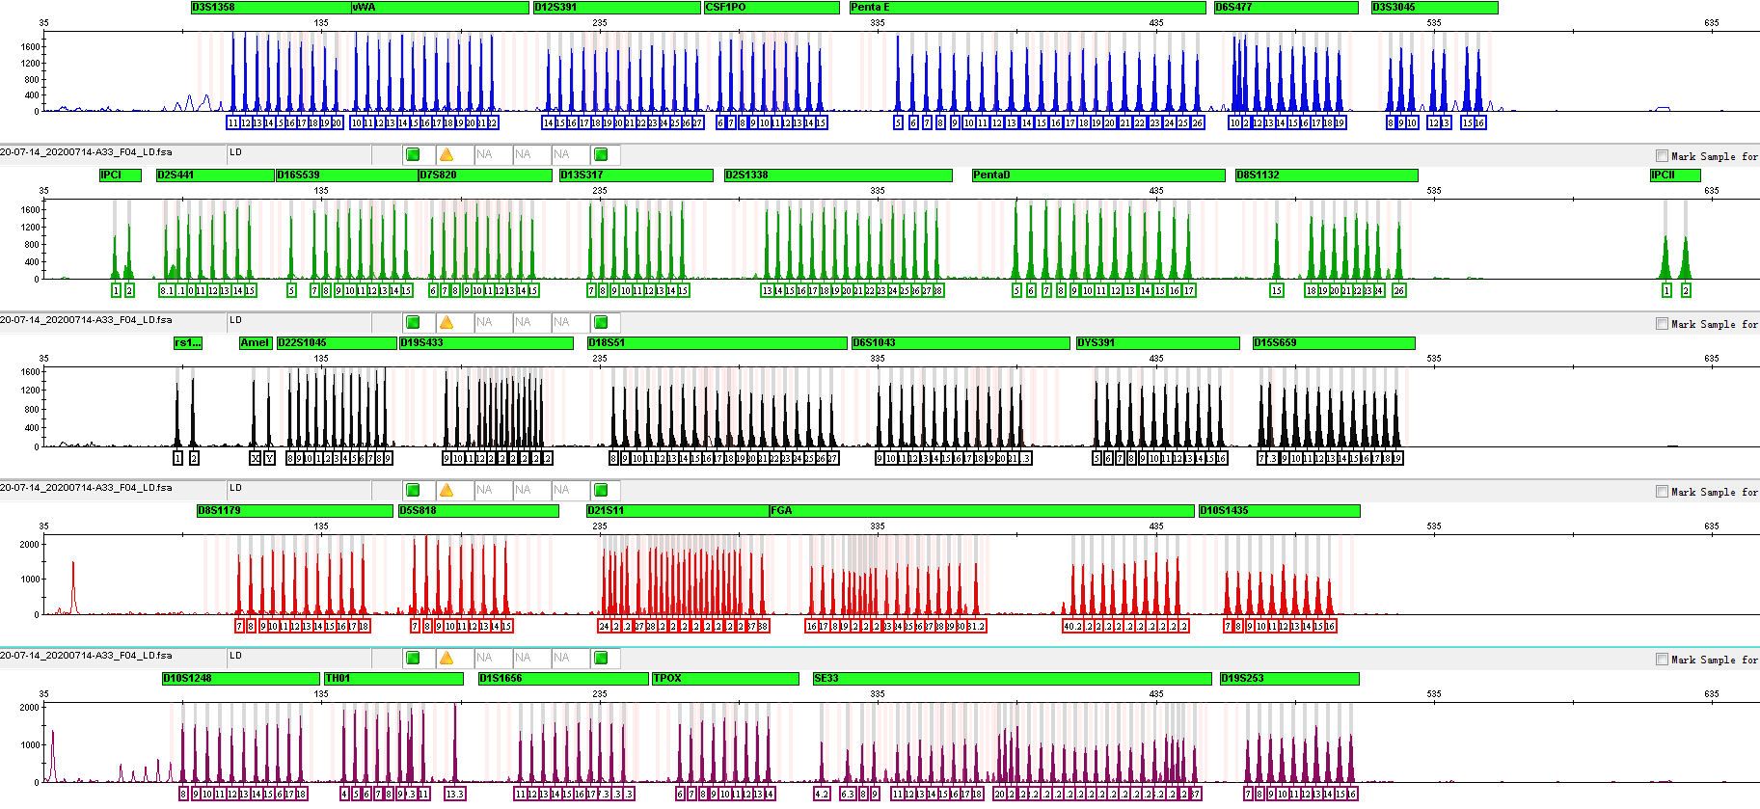
1.4 Electrophoretic Diagram of A33Plex Allelic Ladder

Slide 7
General Information of A33Plex

Slide 8
2.1 A33Plex STR Detection Kit (100 RXN/Kit)
Pre-amplification Kit | 100 RXN
2.5× PCR Mix | 1,000µL× 1
A33Plex Primers | 500µL× 1
PCR Grade Water | 1,000µL× 1
Control DNA 9948 (0.5ng/µL) | 20µL× 1
Taq DNA Polymerase | 100µL× 1
Matrix Kit | Free for first use
6 Dye Matrix | 50µL× 1
Post-amplification Kit | 100 RXN
Allelic Ladder | 25µL× 1
Orange-640 | 50µL× 1

Slide 9
2.2 Reaction System and Procedures of A33Plex STR Detection Kit
Component | 25µL System | 10µL System
2.5× PCR Mix | 10.0 | 4.0
A33Plex Primers | 5.0 | 2.0
PCR Grade Water | 8.0 | 2.6
Control DNA 9948 (0.5ng/µL) | 1.0 | 1.0
Taq DNA Polymerase | 1.0 | 0.4
Total Volume | 25.0 | 10.0
A33Plex
95℃/3min 94℃/10sec 60℃/1.5min 60℃/20min
Reaction time: ~70min
∗The number of cycles in the reaction program depends on the actual situation
28-30 cycles

Slide 10
Amplification Results of A33Plex

Slide 11
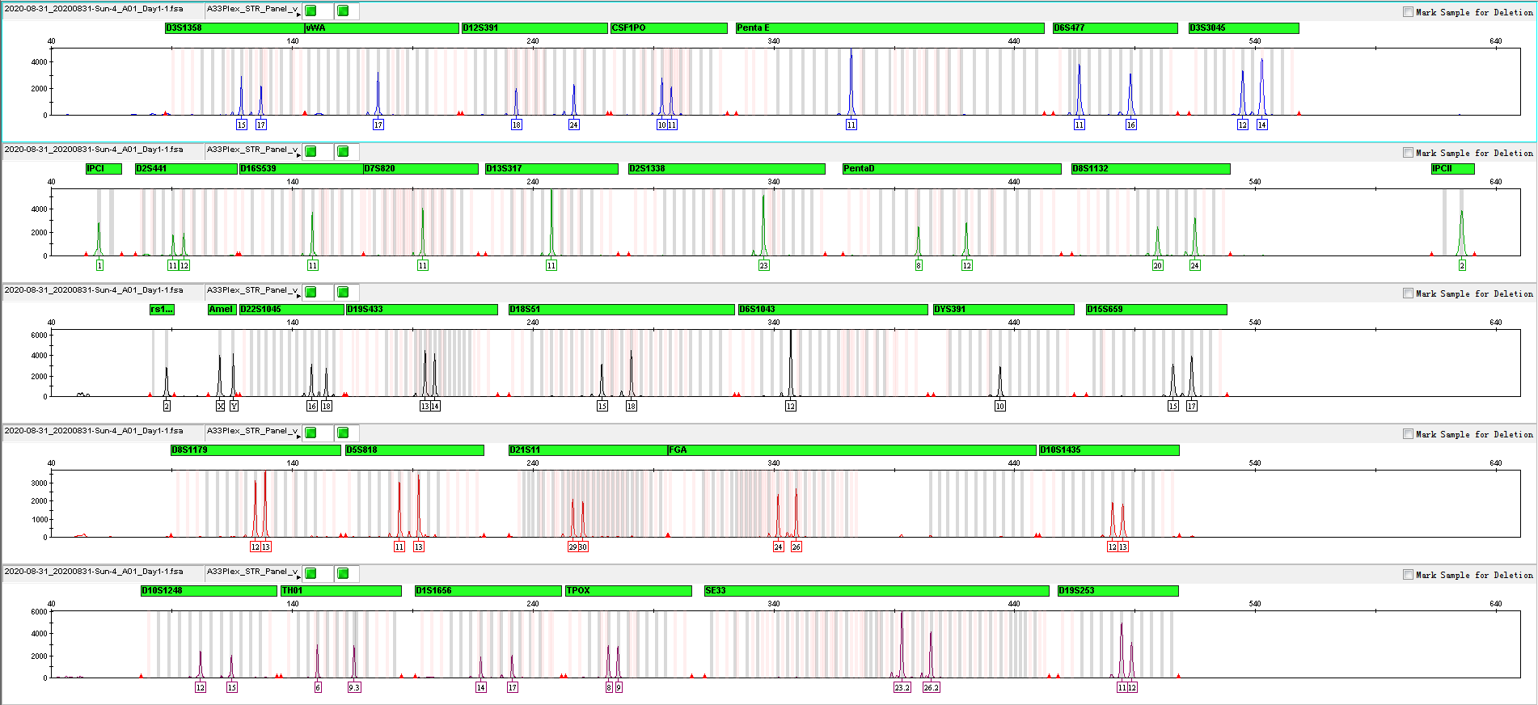
3.1 Amplification Results of Positive Control 9948 Analyzed on 3130xl

Slide 12
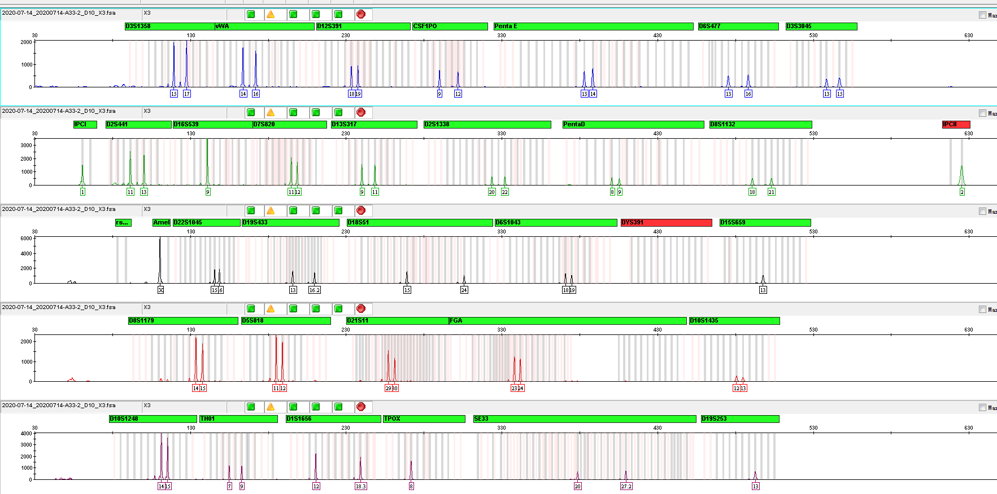
3.2 Amplification Results of Blood on FTA Analyzed on 3130xl

Slide 13
Service & Cooperation

Slide 14
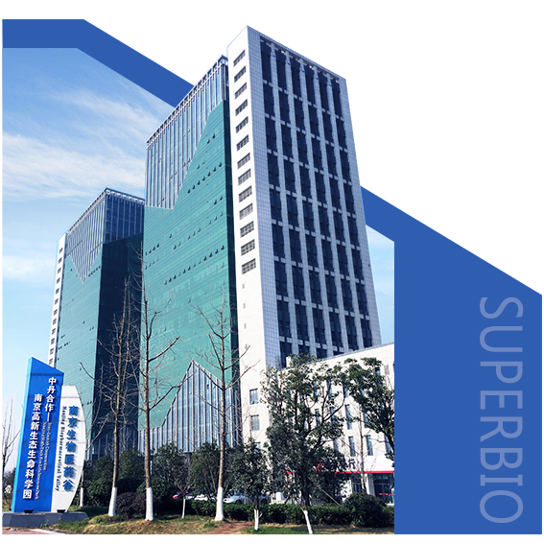
Service & Cooperation
Jiangsu Superbio Biomedical Co. Ltd., founded in 2011, is a cutting-edge technology enterprise owning the Practice License of Medical Institution, which specializes in the research and testing of gene sequencing industry, and integrates R&D, production and sales. The company's products and services cover forensic testing, medical testing, food/environment/medicine testing, instrumentation and software.
We are willing to provide clients with scientific research services related to forensic DNA testing, such as research projects and papers publication, solving all the difficulties encountered in the experiment for you.
We sincerely look forward to cooperate with you in developing products and researching projects.

Slide 15
THANKS!
Contact Us
Address: Sino-Danish Ecological Life Science Industrial Park, No.3-1 Xinjinxhu Road, Pukou District, Nanjing
Tel: 400-616-2676
Website: http://www.superbio.cn/

