Slide 1
Brief Introduction of
Y62Plex STR Detection Kit
May 2023
Jiangsu Superbio Biomedical (Nanjing) Co.,Ltd.

Slide 2
Features of Y62Plex

Slide 3
1.1 Features of Y62Plex STR Detection Kit
1. Y62Plex adopts the world's first 8-color fluorescence and fluorescence resonance energy transfer (FRET) technology. This kit includes all 35 loci that are core and selected in the Y library building standard, 27 candidate loci, and 3 Y indels with extremely low mutation rate.
2. Y62Plex is applicable for Y-STR library building, especially suitable for male family investigation. In paternity testing or missing population alignments, to avoid the occurrence of false positive calls, adjunctive multiple kits are often required in combination to meet the accuracy of detection. Y62Plex has strong discrimination power (DP) and high accuracy.
3. Y62Plex contains 16 mini STRs (loci within 220bp of amplification length), which facilitates typing and alignment of difficult specimens such as highly degraded specimens. The kit contains 3 Y-indel sites close to zero mutation rate, which is more conducive to rapid alignment for male pedigree screening.
4. Good specimen compatibility. Y62Plex can directly amplify a variety of test materials such as blood cards, saliva cards, hemofilter paper, FTA cards, and cotton swabs without extraction and purification, and can also amplify and detect extracted template DNA.
5. Rapid amplification.The whole PCR process using Y62Plex takes 70min.

Slide 4
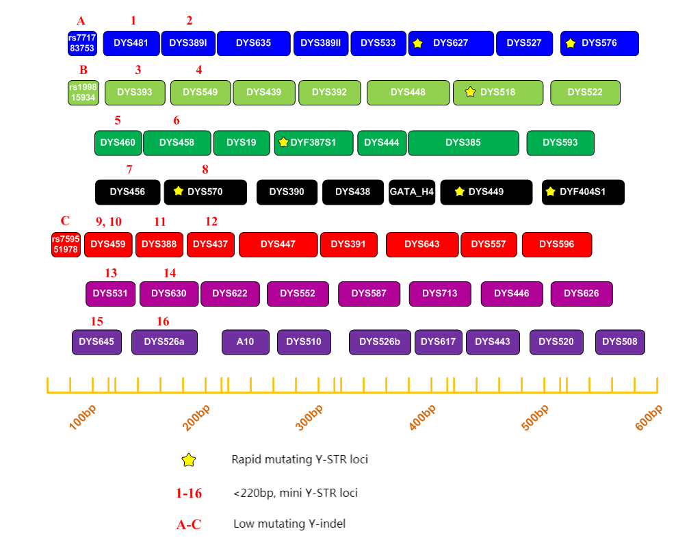
1.2 Loci Arrangement Diagram of Y62Plex

Slide 5
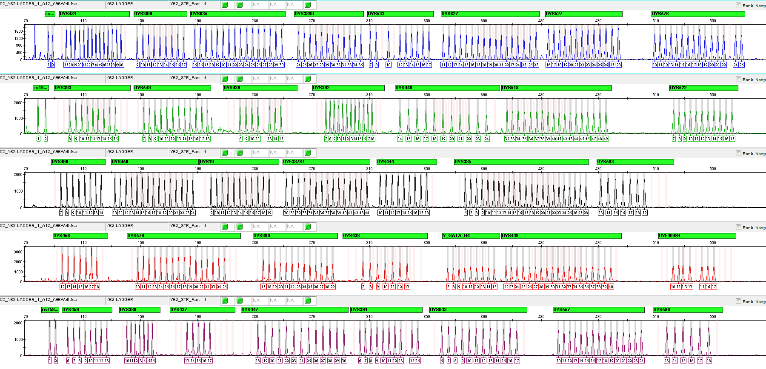
1.3 Electrophoretic Diagram of Y62Plex Allelic Ladder

Slide 6
General Information of Y62Plex

Slide 7
2.1 Y62Plex STR Detection Kit (100 RXN/Kit)
Pre-amplification Kit | 100 RXN
2.5× PCR Mix | 1000µL× 1
5× Primers | 500µL× 1
PCR Grade Water | 1000µL× 1
Control DNA 9948 (0.5ng/µL) | 20µL× 1
Taq DNA Polymerase | 100µL× 1
Post-amplification Kit | 100 RXN
Allelic Ladder | 25µL× 1
Orange-640 | 120µL× 1
Matrix Kit | Free for first use
8 Dye Matrix | 50µL× 1

Slide 8
2.2 Reaction System and Procedures of Y62Plex STR Detection Kit
Component | 25µL System | 10µL System
2.5× PCR Mix | 10.0 | 4.0
5×Primers | 5.0 | 2.0
PCR Grade Water | 8.0 | 2.6
Control DNA 9948 (0.5ng/µL) | 1.0 | 1.0
Taq DNA Polymerase | 1.0 | 0.4
Total Volume | 25.0 | 10.0
Y62Plex
95℃/3min 95℃/5sec 61℃/1.5min 60℃/20min
Reaction time: ~70min
∗The number of cycles in the reaction program depends on the actual situation
27-30
cycles

Slide 9
Amplification Results of Y62Plex

Slide 10
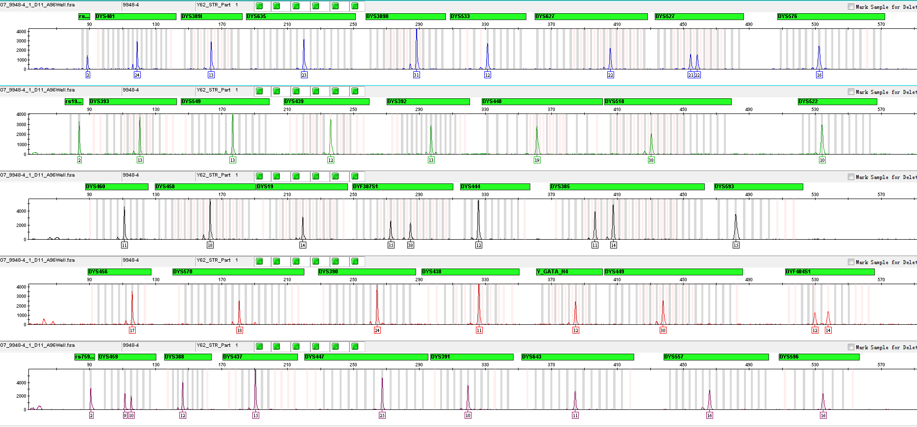
3.1 Amplification Results of Positive Control 9948

Slide 11
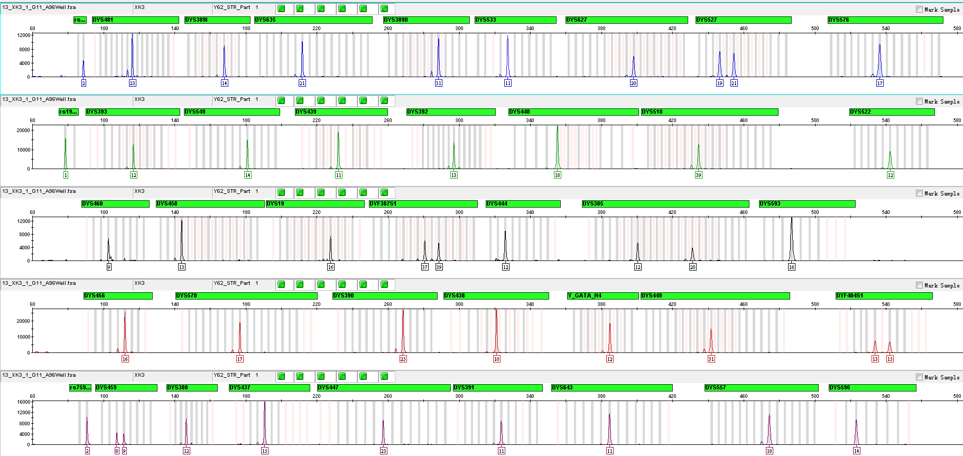
3.2 Amplification Results of Blood on FTA

Slide 12
Service & Cooperation

Slide 13
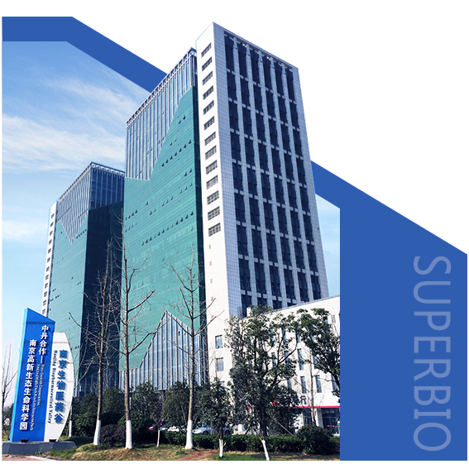
Service & Cooperation
Jiangsu Superbio Biomedical Co. Ltd., founded in 2011, is a cutting-edge technology enterprise owning the Practice License of Medical Institution, which specializes in the research and testing of gene sequencing industry, and integrates R&D, production and sales. The company's products and services cover forensic testing, medical testing, food/environment/medicine testing, instrumentation and software.
We are willing to provide clients with scientific research services related to forensic DNA testing, such as research projects and papers publication, solving all the difficulties encountered in the experiment for you.
We sincerely look forward to cooperate with you in developing products and researching projects.

Slide 14
THANKS!
Contact Us
Address: Sino-Danish Ecological Life Science Industrial Park, No.3-1 Xinjinxhu Road, Pukou District, Nanjing
Tel: 400-616-2676
Website: http://www.superbio.cn/

