Slide 1
Brief Introduction of
Y27Plex STR Detection Kit
May 2023
Jiangsu Superbio Biomedical (Nanjing) Co.,Ltd.

Slide 2
Features of Y27Plex

Slide 3
1.1 Features of Y27Plex STR Detection Kit
1. Y27Plex is a 5-color fluorescence detection product which is applicable for performing multiple amplification and detection on 27 Y-STR loci.
2. Y27Plex features better compatibility and higher accuracy. The detected loci include 20 low-mutating STRs (mutating rate<1%) and 7 rapid-mutating loci (mutating rate>1%).
3. Y27Plex is suitable for male family investigation, featuring high discrimination power (DP).
4. Y27Plex is suited best for Y-STR library building, as it contains all mainstream loci that are required.
5. Strong compatibility. Y27Plex is compatible with the direct amplification of various samples and the amplification of purified DNA.
6. Rapid amplification.The whole PCR process using Y27Plex takes less than 120min.
7. Applicable for forensic analysis, kinship detection and scientific research for human genetic identification.

Slide 4
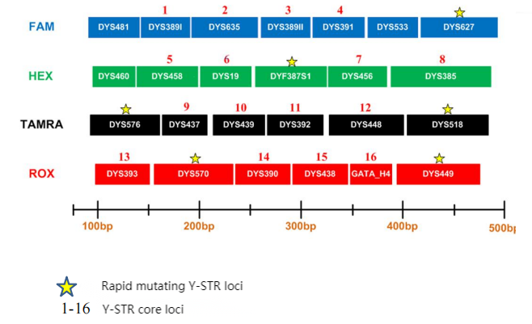
1.2 Loci Arrangement Diagram of Y27Plex

Slide 5
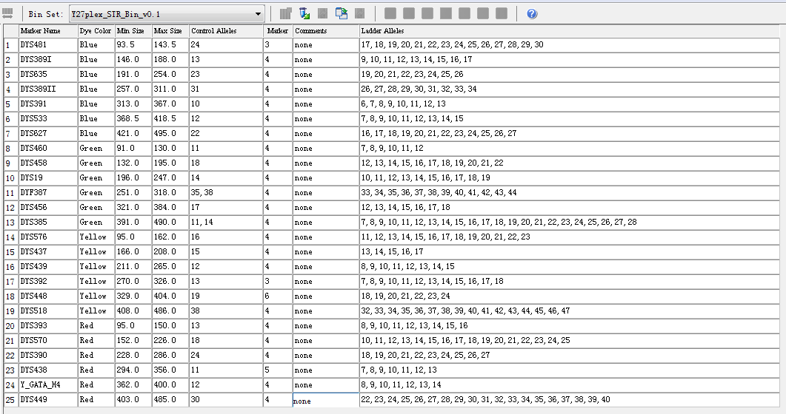
1.3 Analysis Software Loci Information Table of Y27Plex
GeneMapper ID-X version 1.3

Slide 6
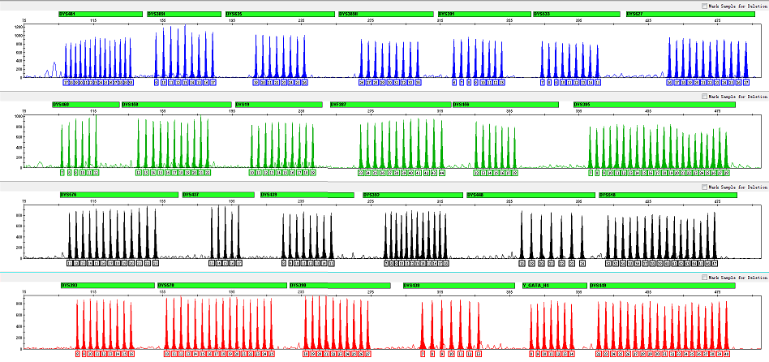
1.4 Electrophoretic Diagram of Y27Plex Allelic Ladder
Y27Plex Allelic Ladder contains 266 alleles

Slide 7
General Information of Y27Plex

Slide 8
2.1 Y27Plex STR Detection Kit (25µL× 100 RXN/Kit)
 | Component | Content | Description
Pre-amplification Kit | 2.5× PCR Mix | 1,000μL× 1 | Buffer containing anti-inhibition components such as MgCl₂
 | Y27Plex Primers | 500μL× 1 | Primer mixtures for amplifying 27 loci
 | PCR Grade Water | 1,000μL× 1 | Nuclease-free deionized ultrapure water
 | Control DNA 9948 (0.5ng/µL) | 20μL× 1 | Standard positive control
 | Control DNA 9947A (0.5ng/µL) | 20μL× 1 | Standard negative control
 | Taq DNA Polymerase | 100μL× 1 | Hot-start DNA Polymerase
Post-amplification Kit | Y27Plex Allelic Ladder | 20μL× 1 | Contains amplified alleles
 | Orange-500 | 75μL× 1 | Internal lane standards with fluorescent markers
Matrix Kit | 5 Dye Matrix | 50μL×1 | Used for spectral calibration

Slide 9
2.2 Reaction System and Procedures of Y27Plex STR Detection Kit
Component | 25µL System (µL)
2.5× PCR Mix | 10.0
Y27Plex Primers | 5.0
PCR Grade Water | 8.0
Control DNA 9948 (0.5ng/µL) | 1.0
Taq DNA Polymerase | 1.0
Total Volume | 25.0
95℃
94℃
2min
72℃
20sec
59℃
1min
60℃
1min
30min
30 Cycles
16℃
∞

Slide 10
Amplification Results of Y27Plex

Slide 11
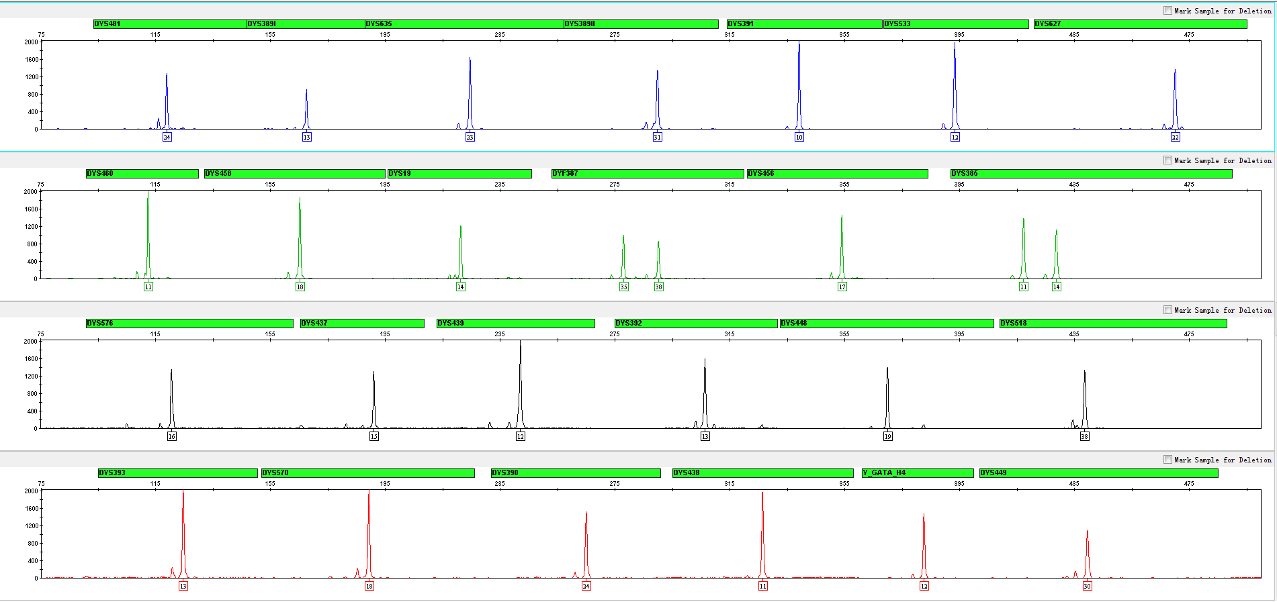
3.1 Amplification Results of Positive Control 9948 Analyzed on 3130xl

Slide 12
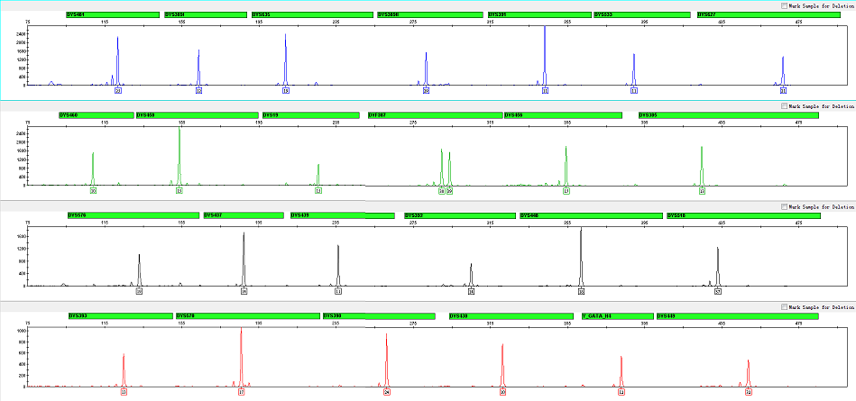
3.2 Amplification Results of Blood on FTA Analyzed on 3130xl

Slide 13
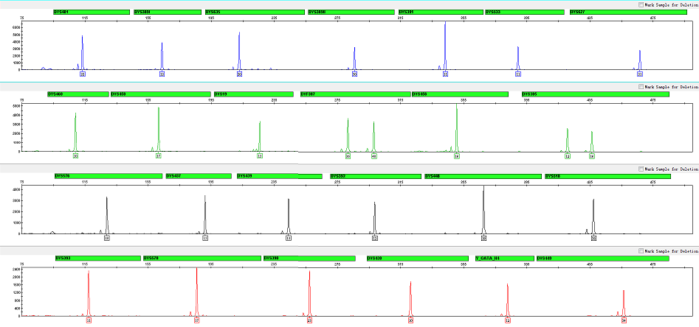
3.3 Amplification Results of Blood on Filter Paper Analyzed on 3130xl

Slide 14
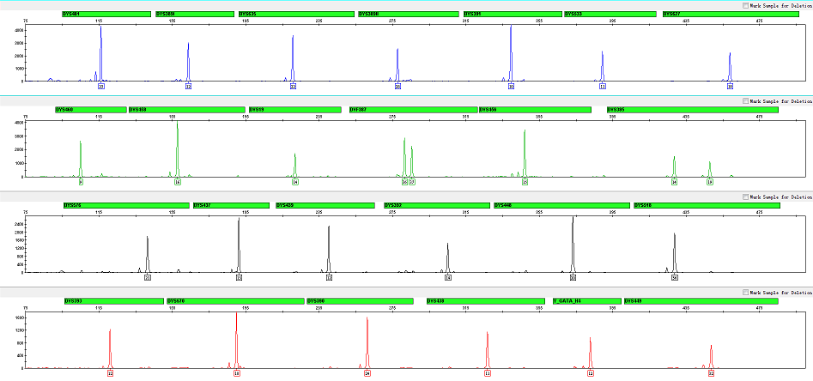
3.4 Amplification Results of Saliva on FTA Analyzed on 3130xl

Slide 15
Performance Measurement of Y27Plex

Slide 16
4.1 Sensitivity Test
4.1.1 Content of Extracted DNA
• 1ng, 500pg, 250pg, 125pg, 62.5pg, 31.25pg
• Repeat the experiment 3 times for all samples
4.1.2 Number of Direct Amplification Samples
FTA Blood Card
• 1, 2 or 3 slices - 1.2mm aperture
• Repeat the experiment 3 times for all samples
FTA Saliva Card
• 1, 2 or 3 slices - 1.2mm aperture
• Repeat the experiment 3 times for all samples

Slide 17
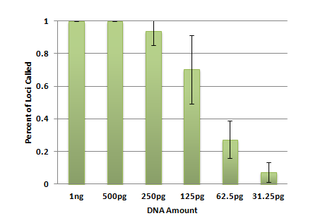
4.1.1 Extracted DNA
30 cycles
25μL amplification system
3130xl (3kV, 10sec sampling time)
Baseline threshold 50RFU

Slide 18
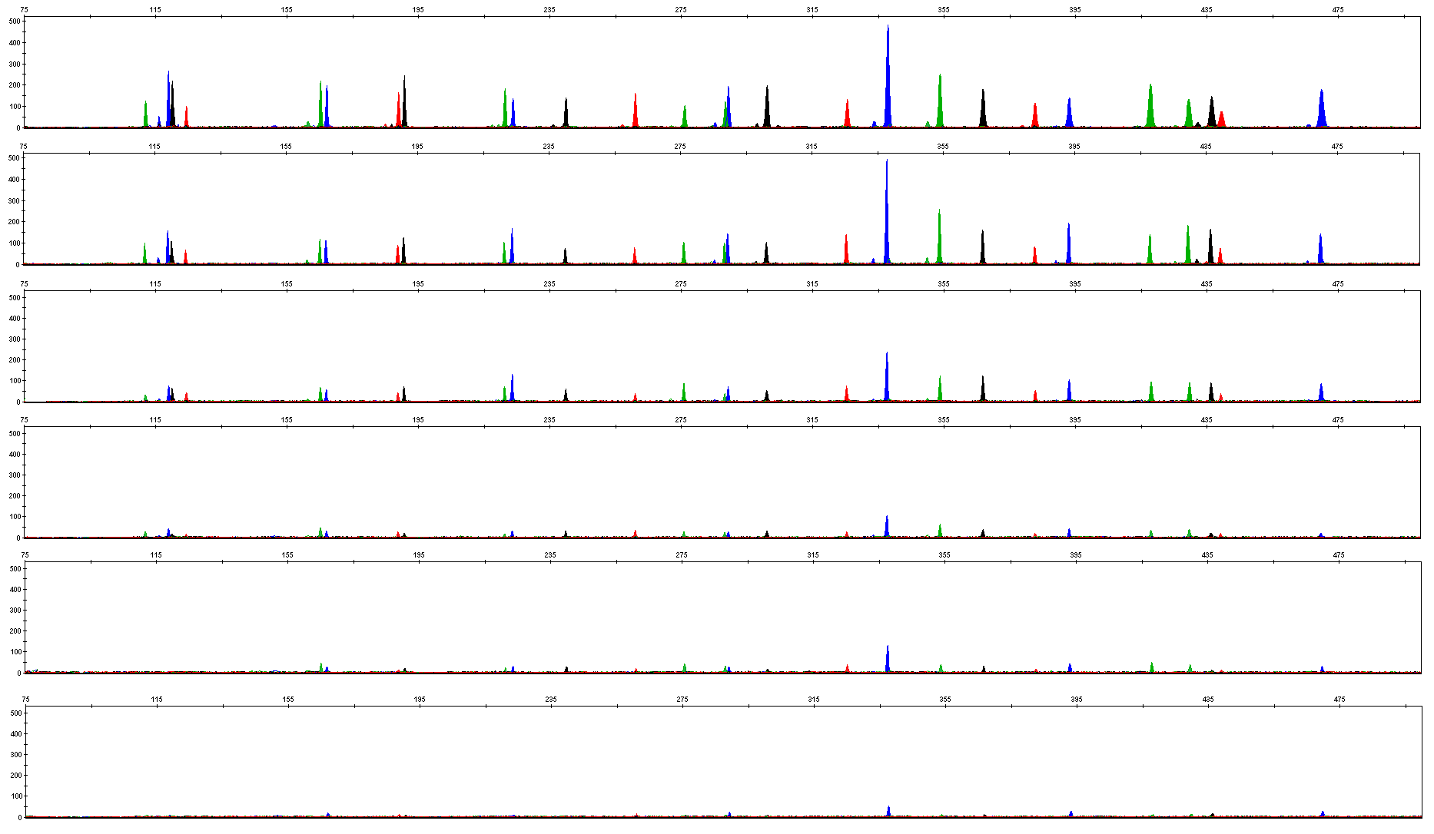
4.1.1 Extracted DNA
1ng
500pg
250pg
125pg
62.5pg
31.25pg

Slide 19
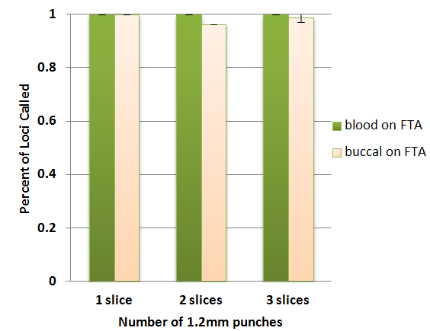
4.1.2 Number of Direct Amplified Samples -- FTA Blood Card & FTA Saliva Card
30 cycles
25μL amplification system
3130xl (3kV, 10sec sampling time)
Baseline threshold 50RFU

Slide 20
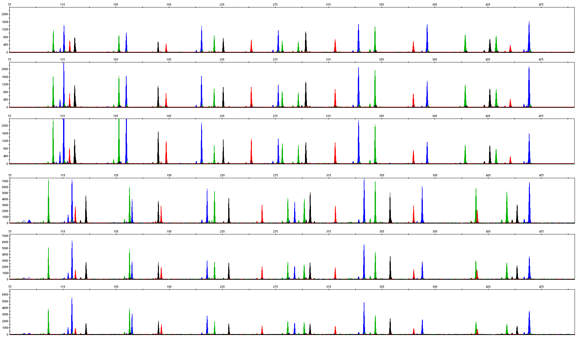
4.1.2 Number of Direct Amplified Samples -- FTA Blood Card & FTA Saliva Card
1 – 1.2mm punch, Blood
2 – 1.2mm punches, Blood
3 – 1.2mm punches, Blood
1 – 1.2mm punch, Buccal
2 – 1.2mm punches, Buccal
3 – 1.2mm punches, Buccal

Slide 21
4.2 Tolerance Test
4.2.1 Mix Concentration
• 0.75 x, 1 x, 1.25 x
4.2.2 Primer Concentration
• 0.75 x, 1 x, 1.25 x
4.2.3 Annealing Temperature
• 55℃, 57 ℃, 59 ℃, 61 ℃
4.2.4 Cycles Number
• 28, 29, 30, 31
4.2.5 Reaction Volume
• 25µl and 10µl

Slide 22
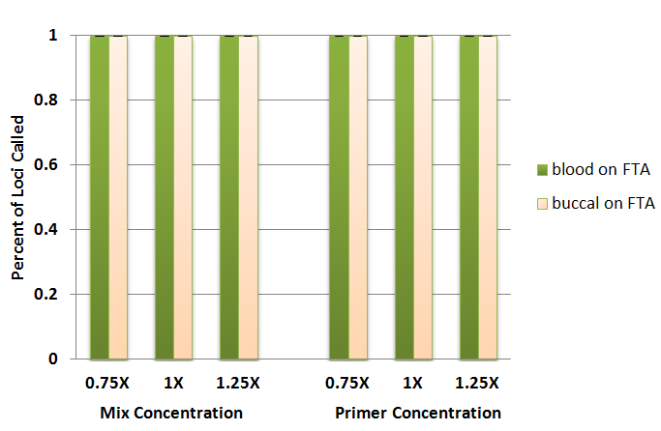
4.2.1 Concentrations of Mix and Primer
30 cycles
25μL amplification system
3130xl (3kV, 10sec sampling time)
Baseline threshold 50RFU

Slide 23
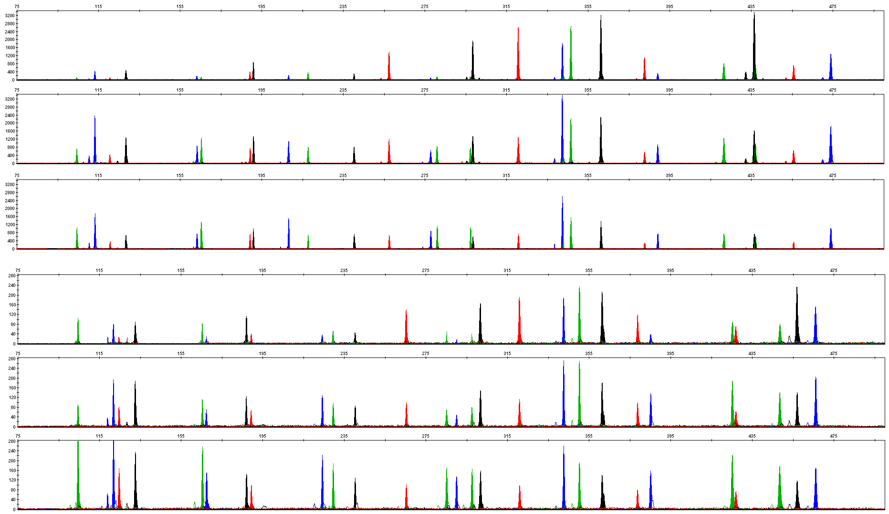
4.2.1 Mix Concentration
0.75 X, Blood
1.00 X, Blood
1.25 X, Blood
0.75 X, Buccal
1.00 X, Buccal
1.25 X, Buccal

Slide 24
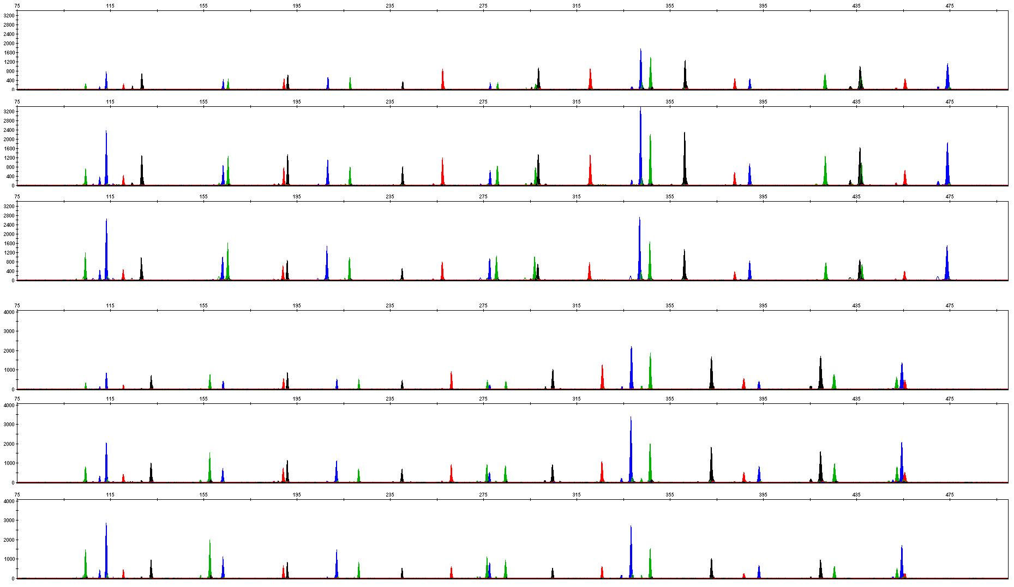
4.2.2 Primer Concentration
0.75 X, Blood
1.00 X, Blood
1.25 X, Blood
0.75 X, Buccal
1.00 X, Buccal
1.25 X, Buccal

Slide 25
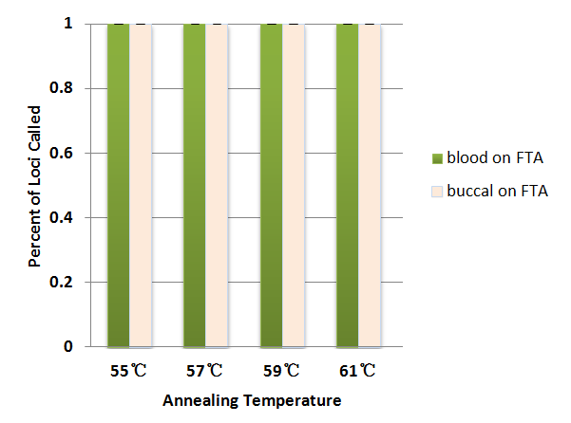
4.2.3 Annealing Temperature
30 cycles
25μL amplification system
3130xl (3kV, 10sec sampling time)
Baseline threshold 50RFU

Slide 26
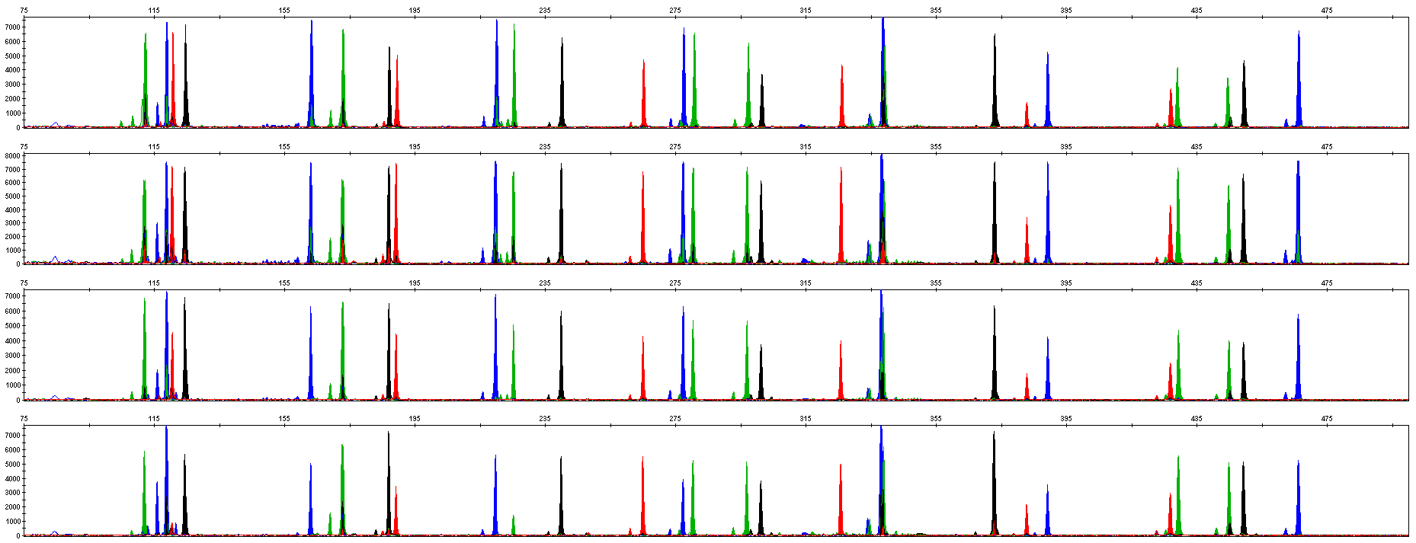
4.2.3 Annealing Temperature — FTA Blood Card
55℃, Blood
57 ℃, Blood
59℃, Blood
61 ℃, Blood

Slide 27
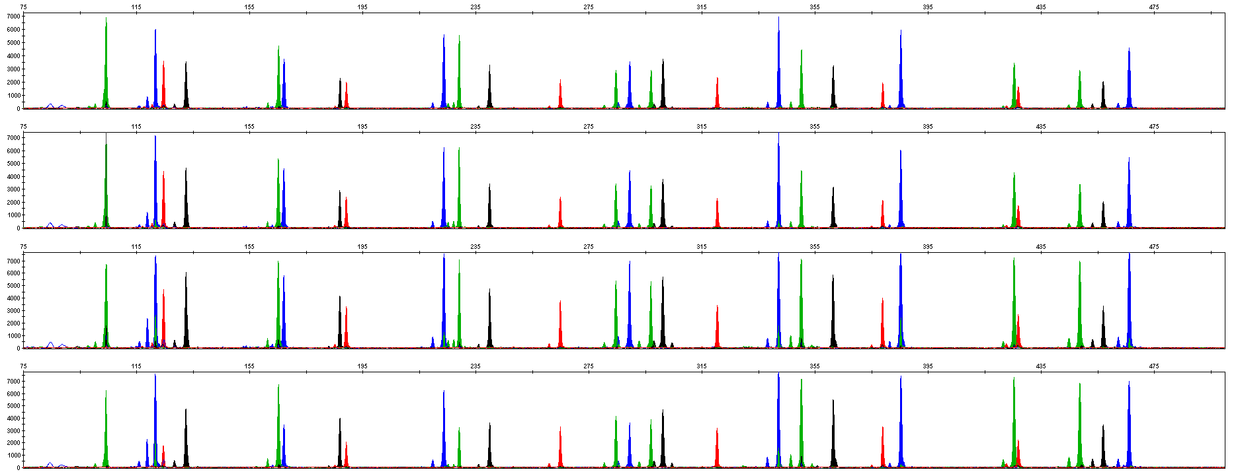
4.2.3 Annealing Temperature — FTA Saliva Card
55℃, Buccal
57 ℃, Buccal
59℃, Buccal
61 ℃, Buccal

Slide 28
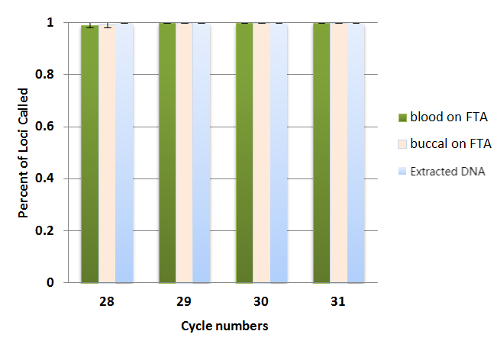
4.2.4 Cycles Number — 28-31 (25 μL)
25μL Reaction Volume

Slide 29
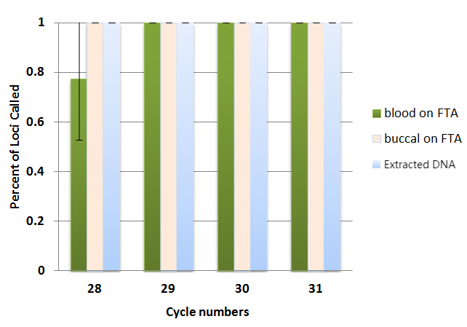
4.2.4 Cycles Number — 28-31 (10 μL)
10μL Reaction Volume

Slide 30
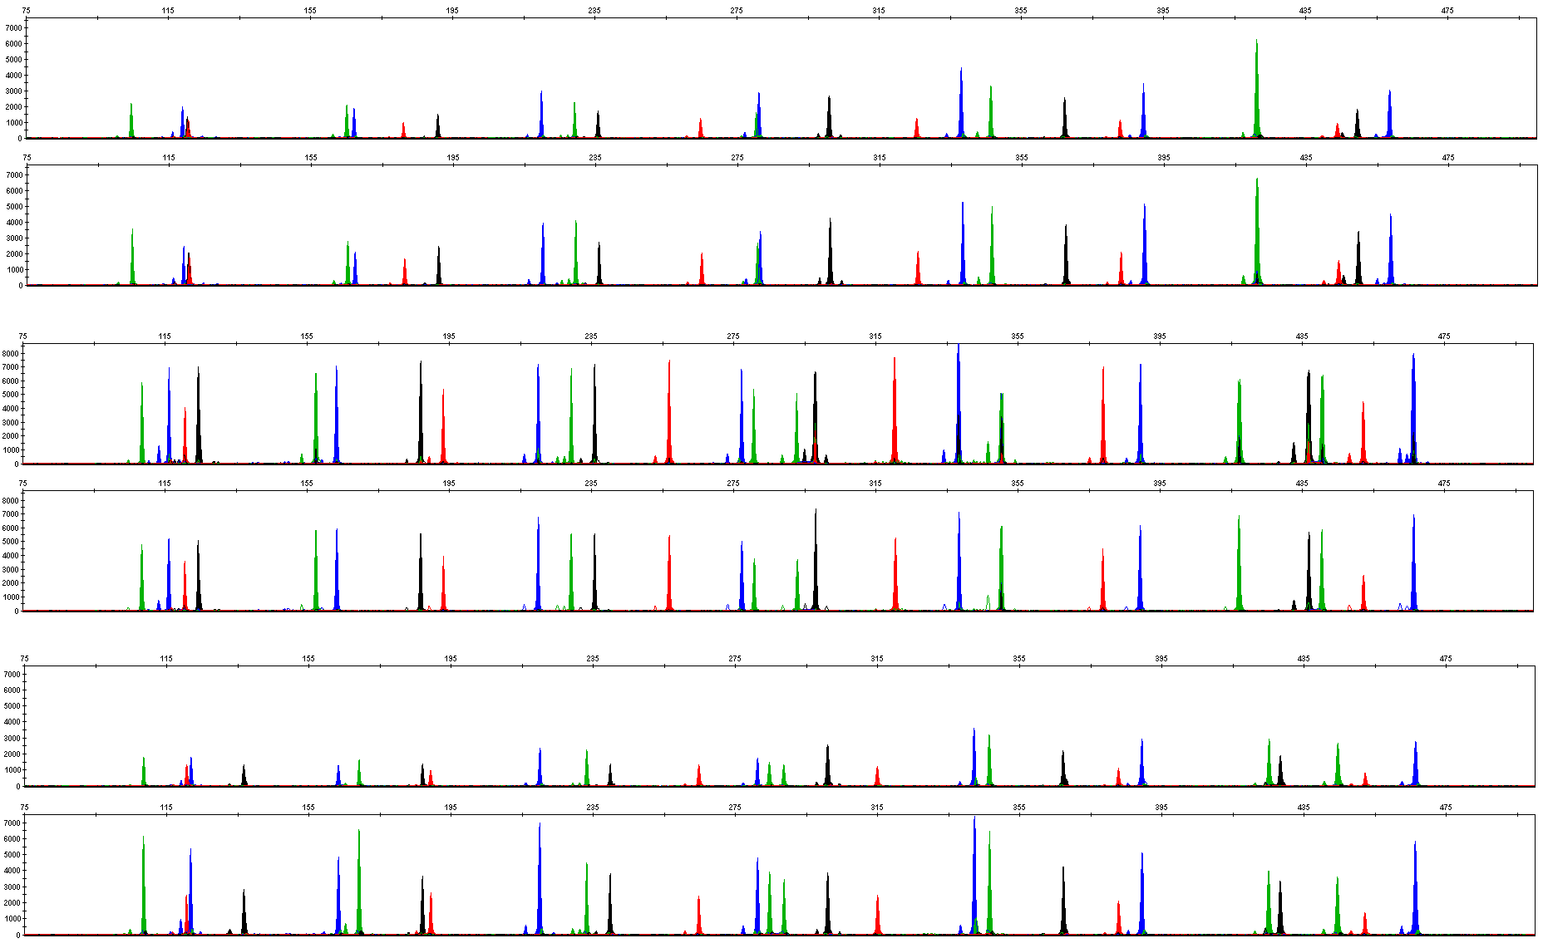
4.2.5 Reaction Volume
25μL, extracted DNA
10μL, extracted DNA
25μL, Blood
10μL, Blood
25μL, Buccal
10μL, Buccal

Slide 31
4.3 Inhibition Test
Three kinds of inhibitors:
4.3.1 Hematin
• 0.1, 0.2, 0.3 and 0.4mM
4.3.2 Hemoglobin
• 80, 100, 200 and 300µM
4.3.3 Humic Acid
• 10, 30, 50 and 100ng/µL

Slide 32
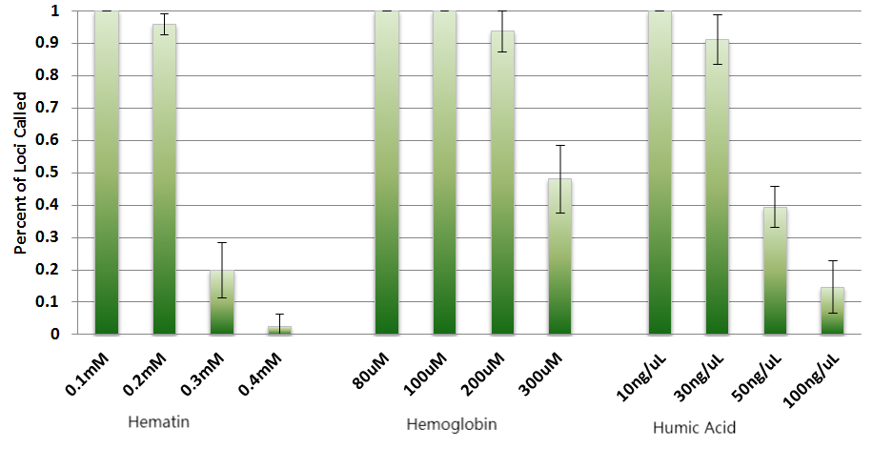
4.3 Inhibition Test
30 cycles
25μL amplification system
3130xl (3kV, 10sec sampling time)
Baseline threshold 50RFU

Slide 33
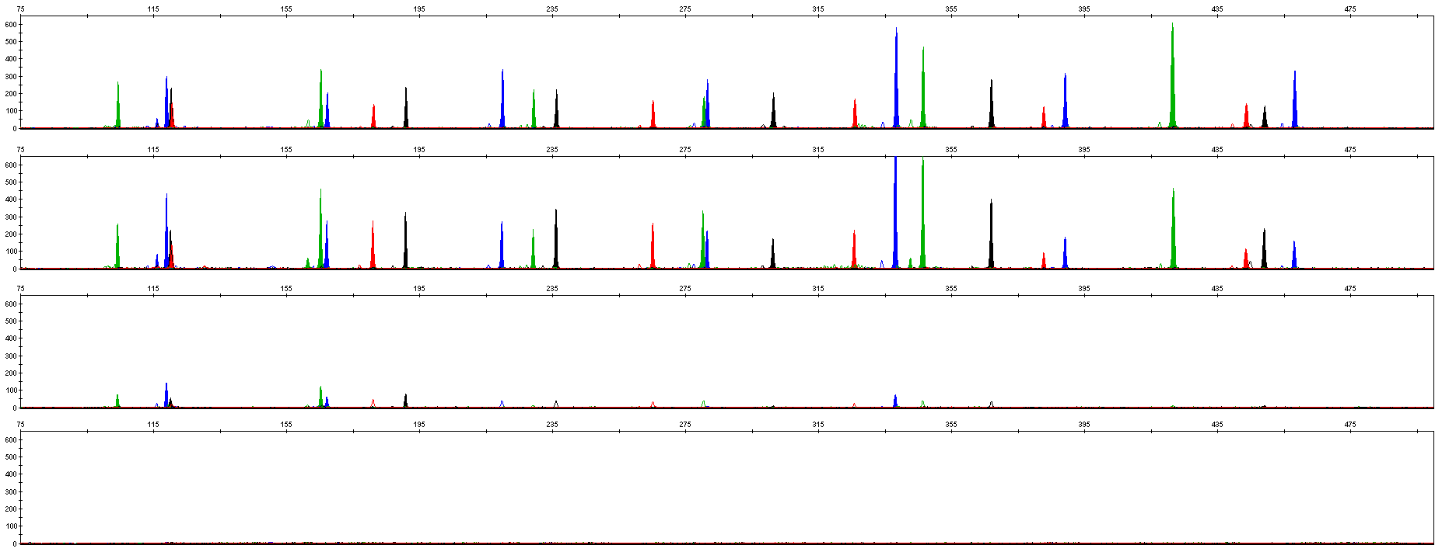
4.3.1 Hematin
0.1 mM
0.2 mM
0.3 mM
0.4 mM

Slide 34
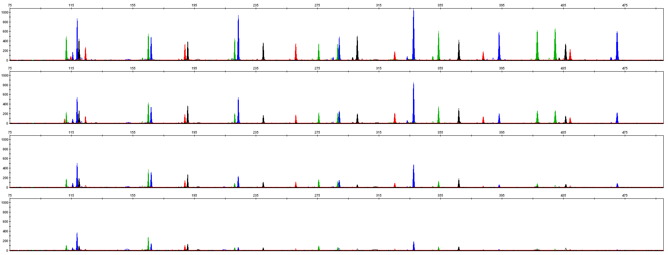
4.3.2 Hemoglobin
60 μM
100 μM
200 μM
300 μM

Slide 35
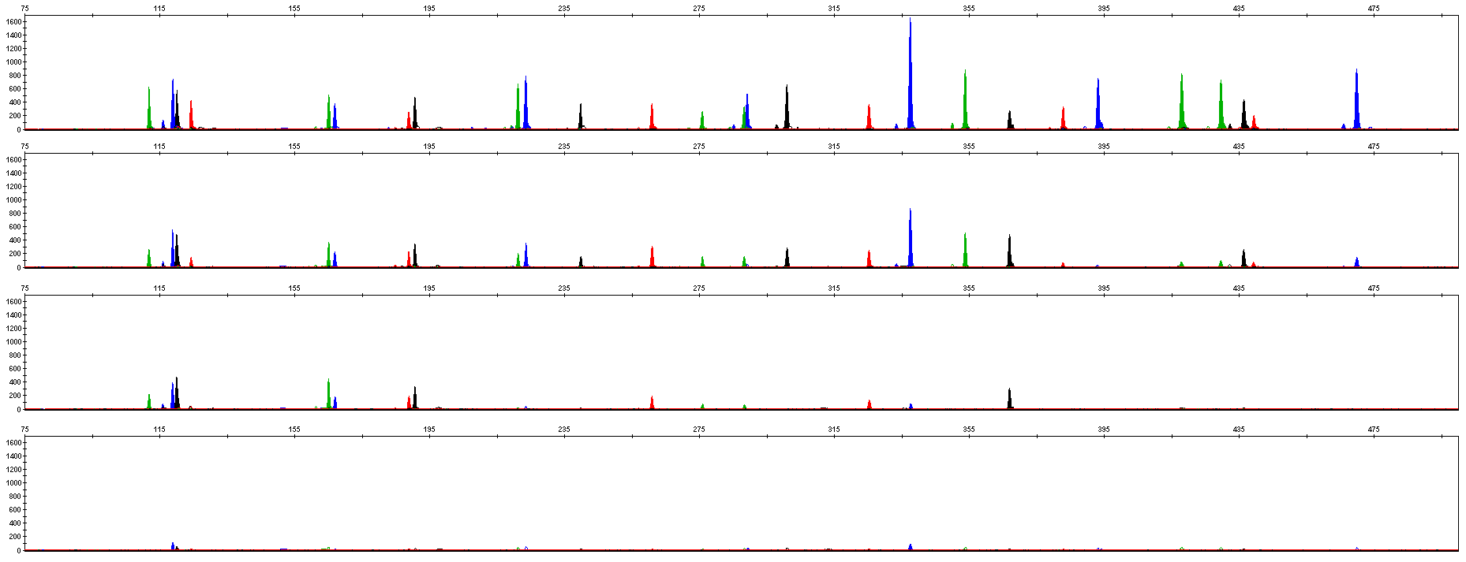
4.3.3 Humic Acid
10 ng/μL
30 ng/μL
50 ng/μL
100 ng/μL

Slide 36
4.4 Summary
1. High sensitivity: Y27Plex showed good performance in the amplification of 0.25ng DNA samples. 1-3 pieces of FTA blood cards and/or FTA oral cards of 1.2 mm aperture were amplified normally.
2. Strong tolerance: Y27Plex amplified normally in Mix or Primer reaction systems of different concentrations. Y27Plex showed good performance at 55 - 61°C annealing temperature or 29 - 31 reaction cycles.
3. Strong resistance to multiple inhibitors: Y27Plex amplified normally under conditions of 0.2mM hematin, 200μM hemoglobin or 30ng/μL humic acid.

Slide 37
4.4 Summary
 | AB Yfiler | AB Yfilerplus | Goldeneye 27Y | Yesu 27Y | Data Y30 | PP Y23
DYS19
DYS389I
DYS389II
DYS390
DYS391
DYS392
DYS393
DYS385 a
DYS385 b
DYS438
DYS439
DYS437
DYS448
DYS456
DYS458
DYS635
GATA-H4
DYS533
DYS481
DYS460
DYS518
DYS570
DYF387S1a
DYF387S1b
DYS449
DYS576
DYS627
DYS527ab
DYS549
DYS643
DYS522
DYS444
DYS520
DYS557
DYS388
DYS447

Slide 38
4.4 Summary
Mb
DYS393
5
DYS456
AMEL Y
p
DYS458
DYS635
10
DYS19
DYS437
DYS391
DYS439
q
15
DYS390
DYS389Ⅰ/Ⅱ
GATA-H4
DYS438
DYS385a
20
DYS385b
DYS392
25
DYS448
30
9 small haplotype loci
2 SWGDAM recommended loci

Slide 39
Service & Cooperation

Slide 40
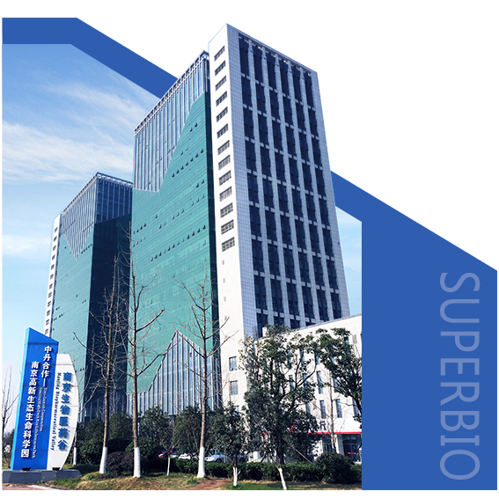
Service & Cooperation
Jiangsu Superbio Biomedical Co. Ltd., founded in 2011, is a cutting-edge technology enterprise owning the Practice License of Medical Institution, which specializes in the research and testing of gene sequencing industry, and integrates R&D, production and sales. The company's products and services cover forensic testing, medical testing, food/environment/medicine testing, instrumentation and software.
We are willing to provide clients with scientific research services related to forensic DNA testing, such as research projects and papers publication, solving all the difficulties encountered in the experiment for you.
We sincerely look forward to cooperate with you in developing products and researching projects.

Slide 41
THANKS!
Contact Us
Address: Sino-Danish Ecological Life Science Industrial Park, No.3-1 Xinjinxhu Road, Pukou District, Nanjing
Tel: 400-616-2676
Website: http://www.superbio.cn/

