Slide 1
Brief Introduction of
A33Plex (Lyophilized Microspheres)
STR Detection Kit
May 2023
Jiangsu Superbio Biomedical (Nanjing) Co.,Ltd.

Slide 2
Features of A33Plex (Lyophilized Microspheres)

Slide 3
1.1 Features of A33Plex (Lyophilized Microspheres) STR Detection Kit
1. A33Plex is a 6-color fluorescence detection kit which is applicable for detecting 33 autosomal STR loci, 1 Y chromosome STR locus, 1 Y-indel, and 1 Amelogenin, including anti-trafficking loci D8S1132, D6S477, D19S253, D3S3045, D15S659 and D10S1435, as well as highly polymorphic loci such as SE33, Penta D, Penta E, FGA and D6S1043.
2. As A33Plex has strong discrimination power (DP), it is applicable for anti-trafficing database building. A33Plex contains 12 mini STRs (loci within 220bp of amplification length), which facilitates typing and alignment of difficult specimens such as highly degraded specimens.
3. A33Plex uses FRET primers for higher sensitivity. The provided internal positive control (IPC) helps to judge sample quality and if PCR program is successful.
4. Good specimen compatibility. A33Plex can directly amplify a variety of test materials and extracted template DNA.

Slide 4
1.1 Features of A33Plex (Lyophilized Microspheres) STR Detection Kit
5. A33Plex (Lyophilized Microspheres) STR Detection Kit a full system freeze-drying microsphere thermostatic amplification product, prepared using microsphere freeze-drying technologies. This product features: (1)uniform in type and not fragile. (2) long storage time at room temperature. (3) can be transported over long distances at room temperature, greatly saving transportation costs.
6. Lyophilized microspheres contain reaction buffer, Taq DNA polymerase, dNTP、Mg²⁺ and primer mix for thermostatic amplification. When used, PCR amplification can be carried out by simply adding water and templates, exempting from the preparation process of amplification system, reducing the risk of manual errors and contamination, thereby improving work efficiency.
7. After the mixture system is freeze-dried into microspheres, there is no difference in amplification efficiency, amplification equilibrium, sensitivity, and anti-inhibitor ability.
8. Rapid amplification.The whole PCR process using A33Plex takes 70min.

Slide 5
1.2 Advantages of A33Plex (Lyophilized Microspheres)
1. More advanced technology
2. Longer validity period
Innovative lyophilized Microsphere design reduces storage requirements and enables transportation at room temperature.
The shelf life has been extended from 2 years to 3-5 years.
3. More stable performance
4. Easier to use
Avoid repeated freeze-thaw of reagents to ensure higher stability.
Each reaction is individually packaged for easier access.
5. Higher efficiency
6. Better performance
By reducing the preparation process of the amplification system, the risk of manual errors and contamination is reduced, and work efficiency is improved.
Increase the detection rate of thimbleful samples by full-volume sample addition.

Slide 6
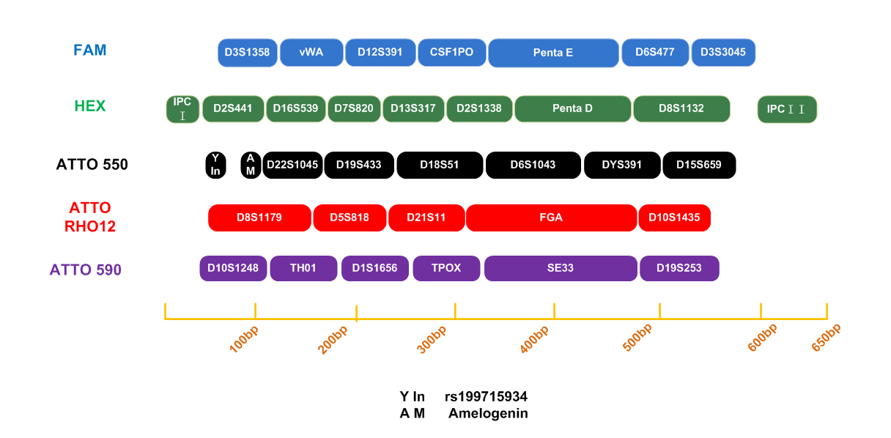
1.3 Loci Arrangement Diagram of A33Plex (Lyophilized Microspheres)

Slide 7
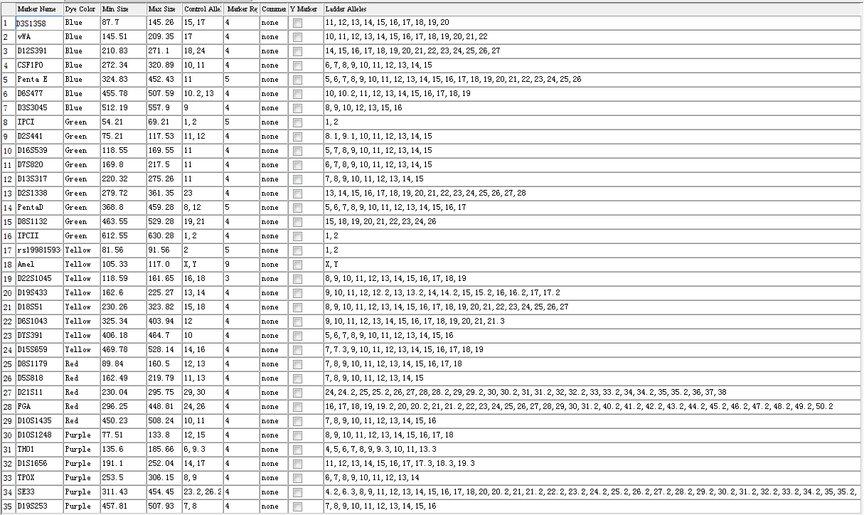
1.4 Analysis Software Loci Information Table of A33Plex (Lyophilized Microspheres)

Slide 8
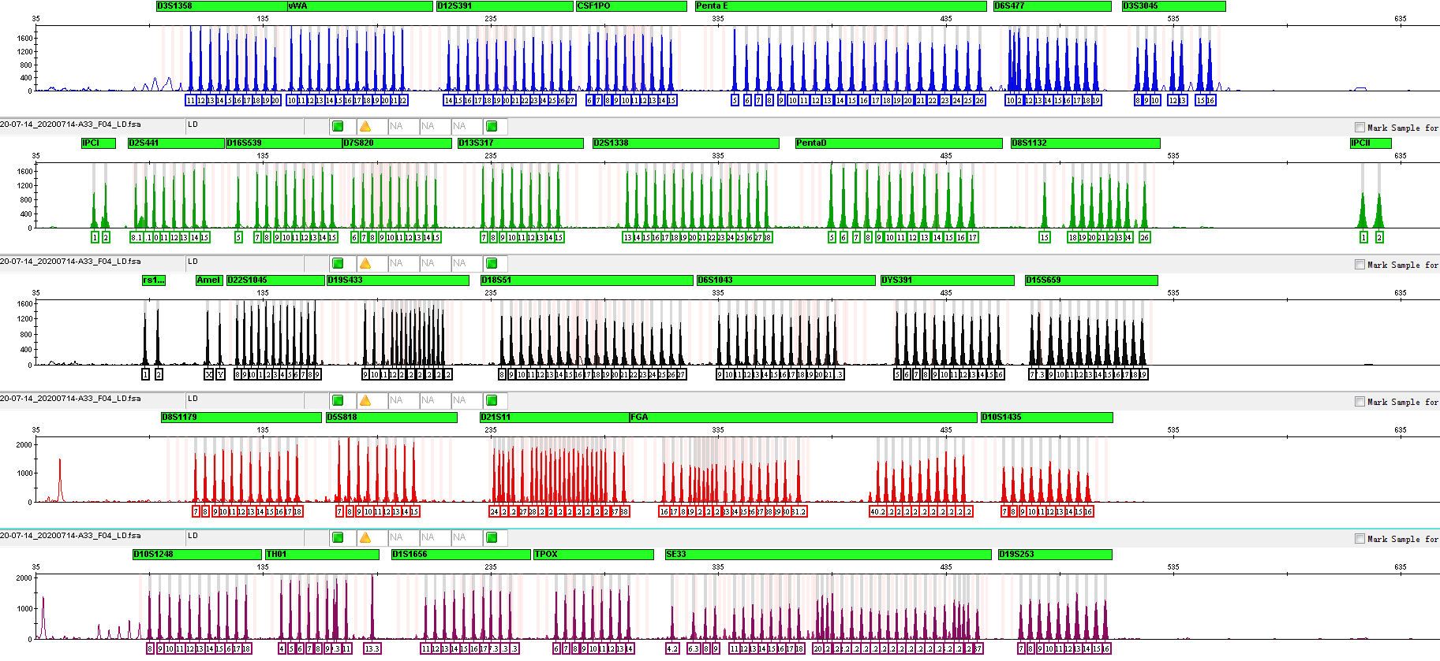
1.5 Electrophoretic Diagram of A33Plex (Lyophilized Microspheres) Allelic Ladder

Slide 9
General Information of A33Plex (Lyophilized Microspheres)

Slide 10
2.1 A33Plex (Lyophilized Microspheres) STR Detection Kit (100 RXN/Kit)
Pre-amplification Kit | 100 RXN | Dissolved volume with water
Lyophilized Microspheres (containing PCR Buffer, Taq DNA polymerase, A33 primer mix, dNTP and Mg²⁺ for thermostatic amplification) | 100×1 | Dissolve each reaction in 9 µL of water
Control DNA 9948 Lyophilized Microspheres (1ng/µL) | × 1 | 20 µL
Post-amplification Kit | 100 RXN | Dissolved volume with water
Allelic Ladder Lyophilized Microspheres | × 1 | 20 µL
Orange-640 Lyophilized Microspheres | × 1 | 30 µL
6 Dye Plus Matrix (FRET) Lyophilized Microspheres | × 1 | 36 µL

Slide 11
2.2 Reaction System and Procedures of A33Plex (Lyophilized Microspheres) STR Detection Kit
Component | 10µL System
Lyophilized Microspheres | 1 reaction
PCR Grade Water | 9
Control DNA 9948 (1ng/µL) | 1.0
Total Volume | 10.0
A33Plex
95℃/3min 94℃/10sec 60℃/1.5min 60℃/20min
Reaction time: ~70min
∗The number of cycles in the reaction program depends on the actual situation
28-30 cycles
Quickly centrifuge the lyophilized microspheres to the bottom of the EP reaction tube, dissolve them in water, and mix well before adding samples.

Slide 12
Amplification Results of A33Plex (Lyophilized Microspheres)

Slide 13
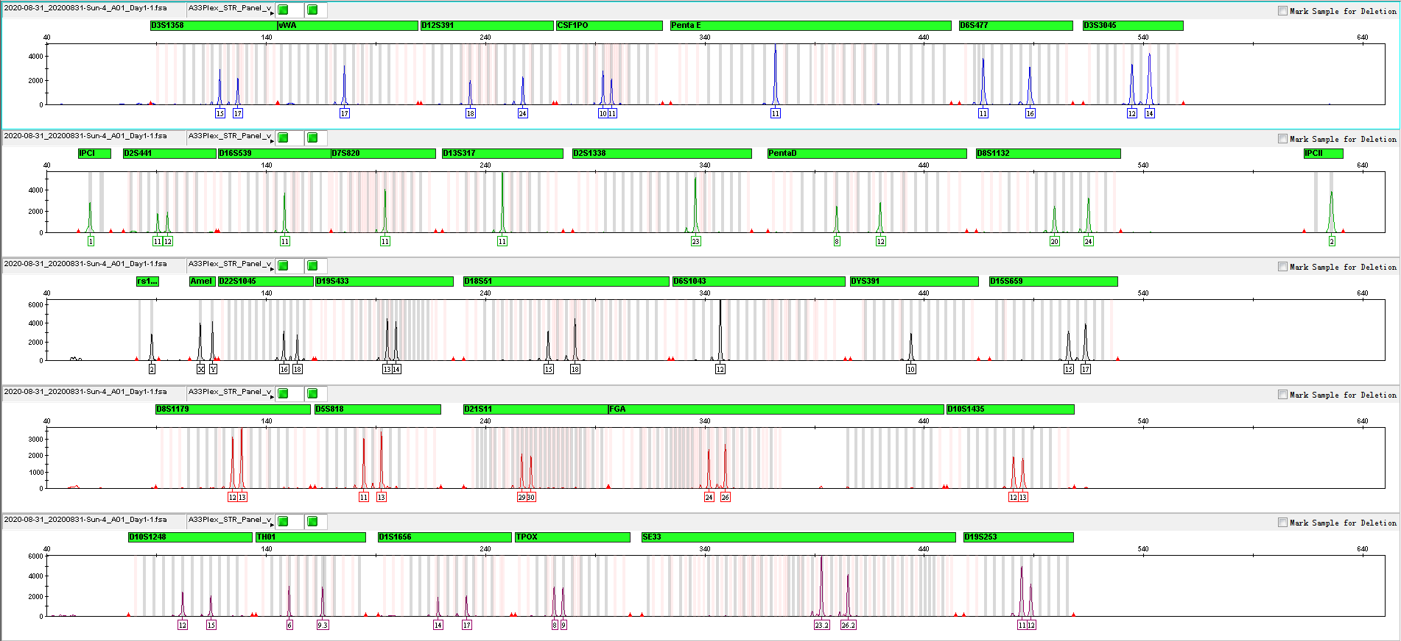
3.1 Amplification Results of Positive Control 9948 Analyzed on 3130xl

Slide 14
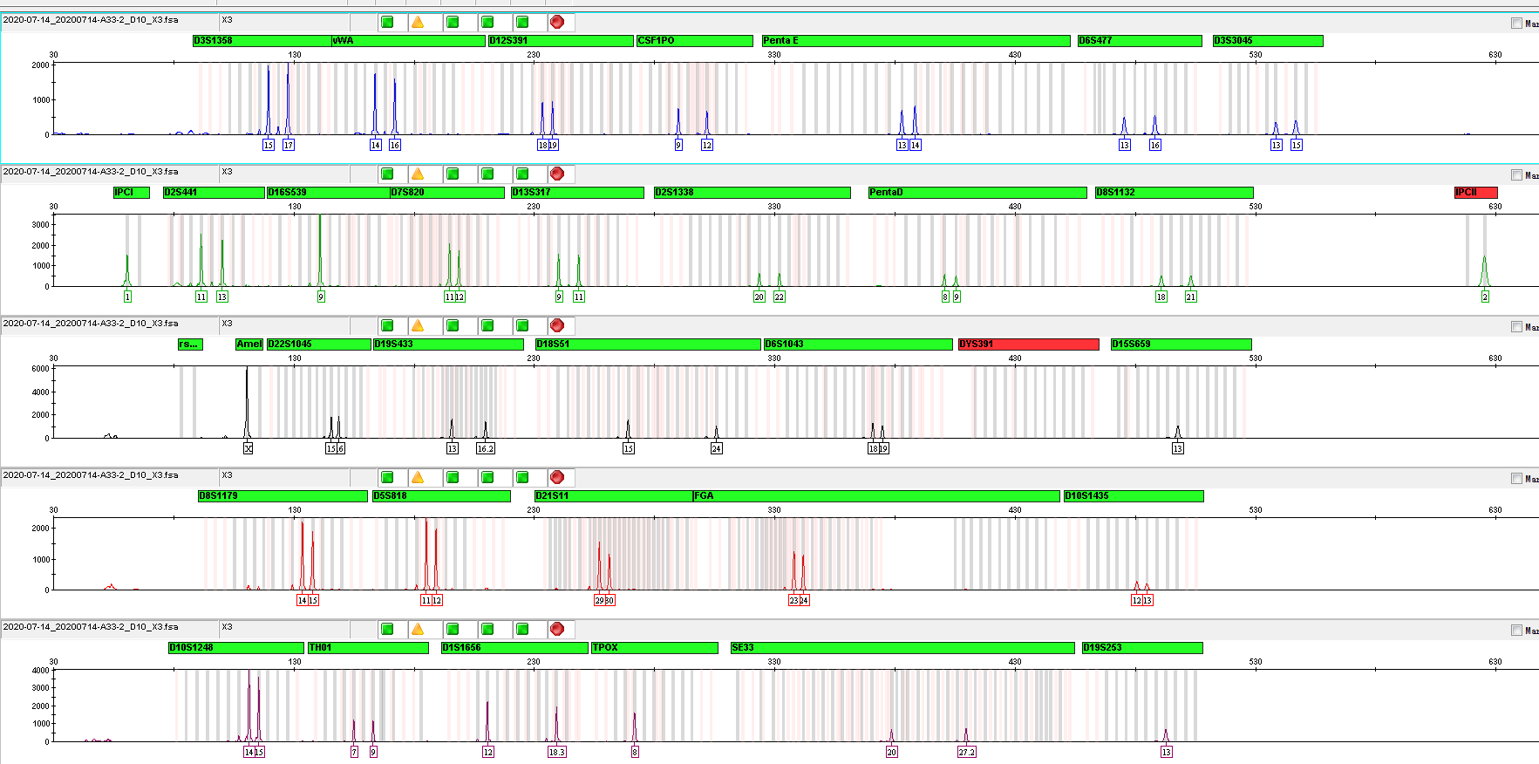
3.2 Amplification Results of Blood on FTA Analyzed on 3130xl

Slide 15
Service & Cooperation

Slide 16
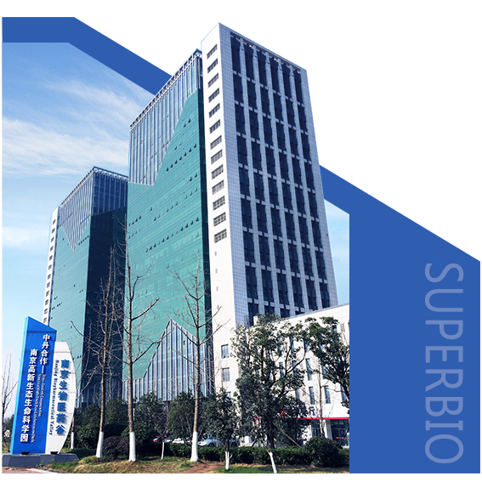
Service & Cooperation
Jiangsu Superbio Biomedical Co. Ltd., founded in 2011, is a cutting-edge technology enterprise owning the Practice License of Medical Institution, which specializes in the research and testing of gene sequencing industry, and integrates R&D, production and sales. The company's products and services cover forensic testing, medical testing, food/environment/medicine testing, instrumentation and software.
We are willing to provide clients with scientific research services related to forensic DNA testing, such as research projects and papers publication, solving all the difficulties encountered in the experiment for you.
We sincerely look forward to cooperate with you in developing products and researching projects.

Slide 17
THANKS!
Contact Us
Address: Sino-Danish Ecological Life Science Industrial Park, No.3-1 Xinjinxhu Road, Pukou District, Nanjing
Tel: 400-616-2676
Website: http://www.superbio.cn/

