Slide 1
Brief Introduction of
21Plex STR Detection Kit
May 2023
Jiangsu Superbio Biomedical (Nanjing) Co.,Ltd.

Slide 2
Features of 21Plex

Slide 3
1.1 Features of 21Plex STR Detection Kit
1. 21Plex is a 5-color fluorescence detection product which is capable of amplifying 21 autosomal STR loci simultaneously.
2. 21Plex features better compatibility and higher accuracy. The detected loci include 13 CODIS loci, 7 non-consensus loci, and 1 gender marker locus Amelogenin.
3. 21Plex has high discrimination power (DP) and paternity probability exclusion (PE).
4. 21Plex has high sensitivity and strong anti-inhibitor ability.
5. 21Plex supports extraction-free amplification, suitable for FTA® card, filter paper, cotton swabs, etc.
6. Rapid amplification. The whole process takes less than 1 hour.
7. 21Plex is applicable for forensic analysis, genetic relationship testing, scientific research and other human genetic identification applications.

Slide 4
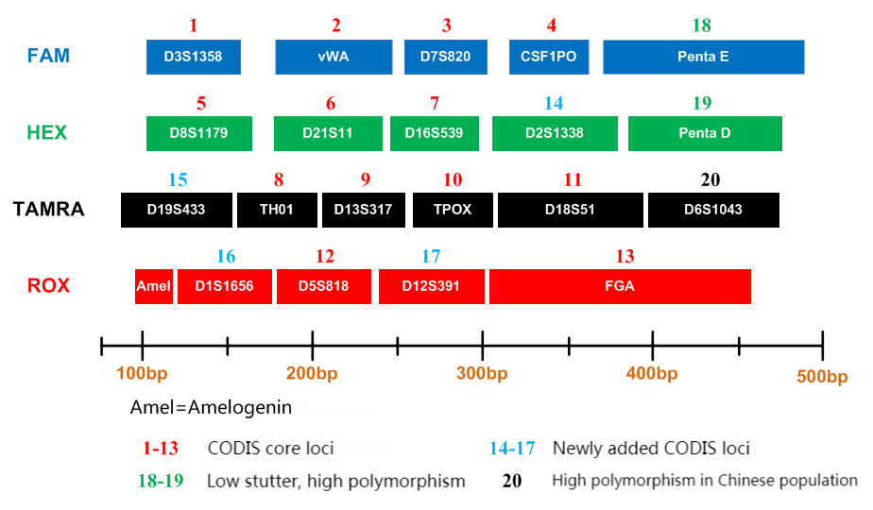
1.2 Loci Arrangement Diagram of 21Plex

Slide 5
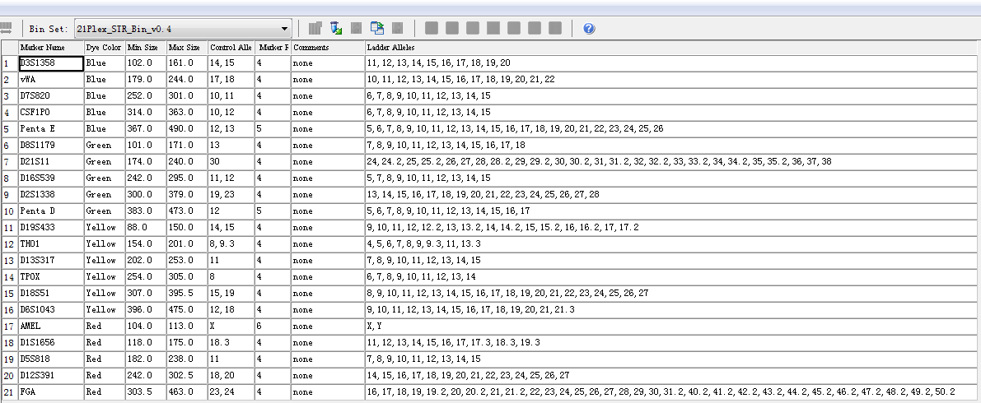
1.3 Analysis Software Loci Information Table of 21Plex
GeneMapper ID-X version 1.3

Slide 6
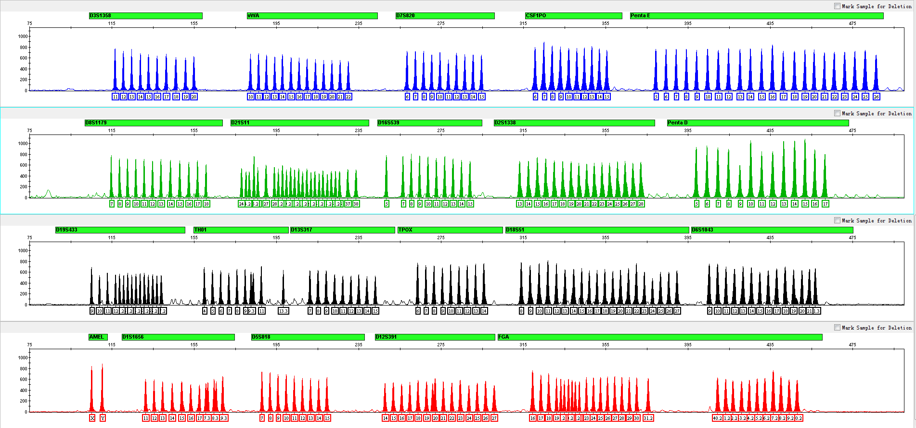
1.4 Electrophoretic Diagram of 21Plex Allelic Ladder
21Plex Allelic Ladder contains 282 alleles

Slide 7
General Information of 21Plex

Slide 8
2.1 Components of A27Plex STR Detection Kit (25µL× 200 RXN/Kit)
 |  | Component
 | Pre-amplification Kit | 2.5× PCR Mix | Buffer containing anti-inhibition components such as MgCl₂
 |  | 21Plex Primers | Primer mixtures for amplifying 21 loci
 |  | PCR Grade Water | Nuclease-free deionized ultrapure water
 |  | Control DNA 9947A (0.5ng/µL) | Standard positive control
 |  | Taq DNA Polymerase | Hot-start DNA Polymerase
 | Post-amplification Kit | 21Plex Allelic Ladder | Standard reference material for allele genotyping
 |  | Orange-500 | Internal lane standards with fluorescent markers
 | Matrix Kit | 5 Dye Matrix | Used for spectral calibration

Slide 9
2.2 Components and Contents of 21Plex STR Detection Kit
Component | Pre-amplification Kit (200RXN)
2.5× PCR Mix | 1,000× 2
21Plex Primers | 1,000× 1
PCR Grade Water | 1,000× 2
Control DNA 9947A (0.5ng/µL) | 20× 1
Taq DNA Polymerase | 200× 1
Component | Post-amplification Kit (200RXN)
21Plex Allelic Ladder | 20× 1
Orange-500 | 75× 1
Component | Matrix Kits (200RXN)
5 Dye Matrix | 50× 1

Slide 10
2.3 Reaction System and Procedures of 21Plex STR Detection Kit
Component | 25µL System (µL)
2.5× PCR Mix | 10.0
21Plex Primers | 5.0
PCR Grade Water | 8.0
Control DNA 9947A (0.5ng/µL) | 1.0
Taq DNA Polymerase | 1.0
Total Volume | 25.0
95℃
94℃
2min
72℃
20sec
59℃
1min
60℃
1min
30min
30 Cycles
16℃
∞

Slide 11
Amplification Results of 21Plex

Slide 12
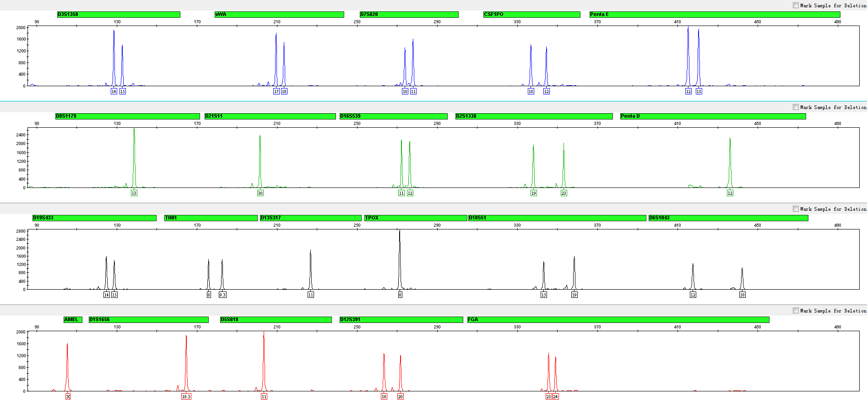
3.1 Amplification Results of Positive Control 9947A Analyzed on 3130xl

Slide 13
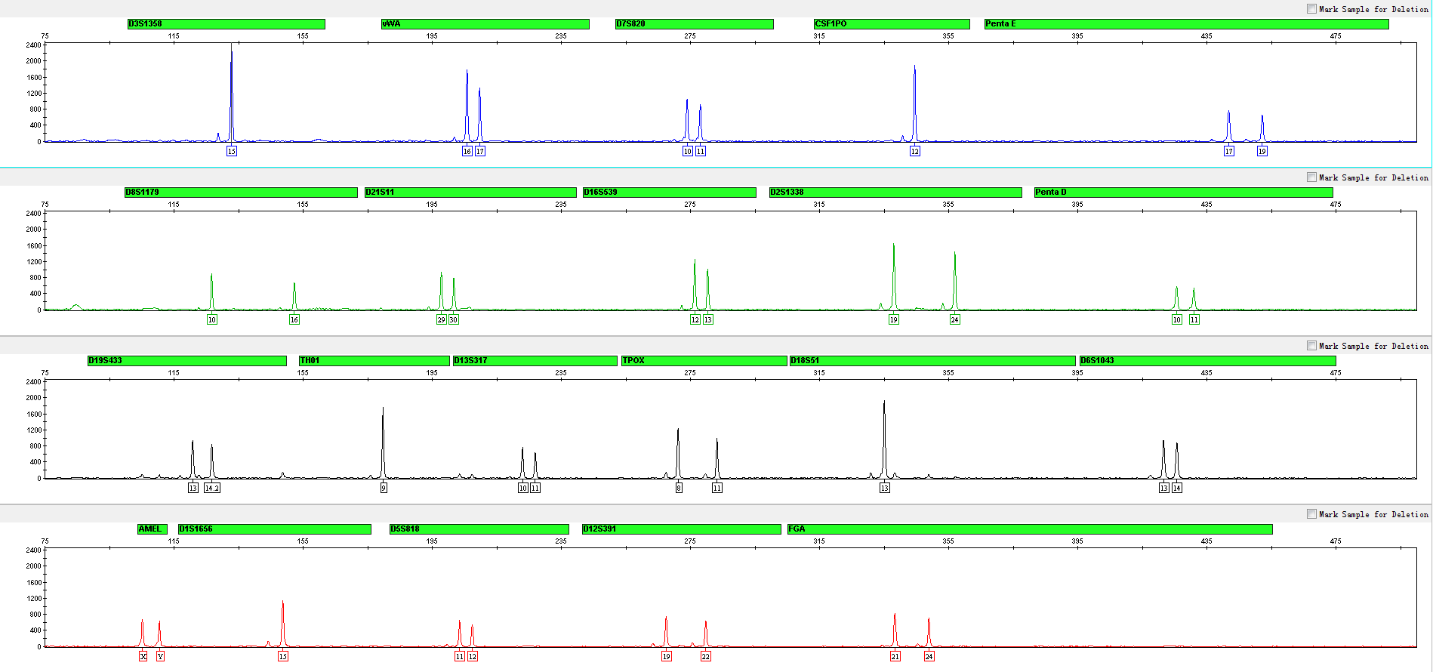
3.2 Amplification Results of Blood on FTA Analyzed on 3130xl

Slide 14
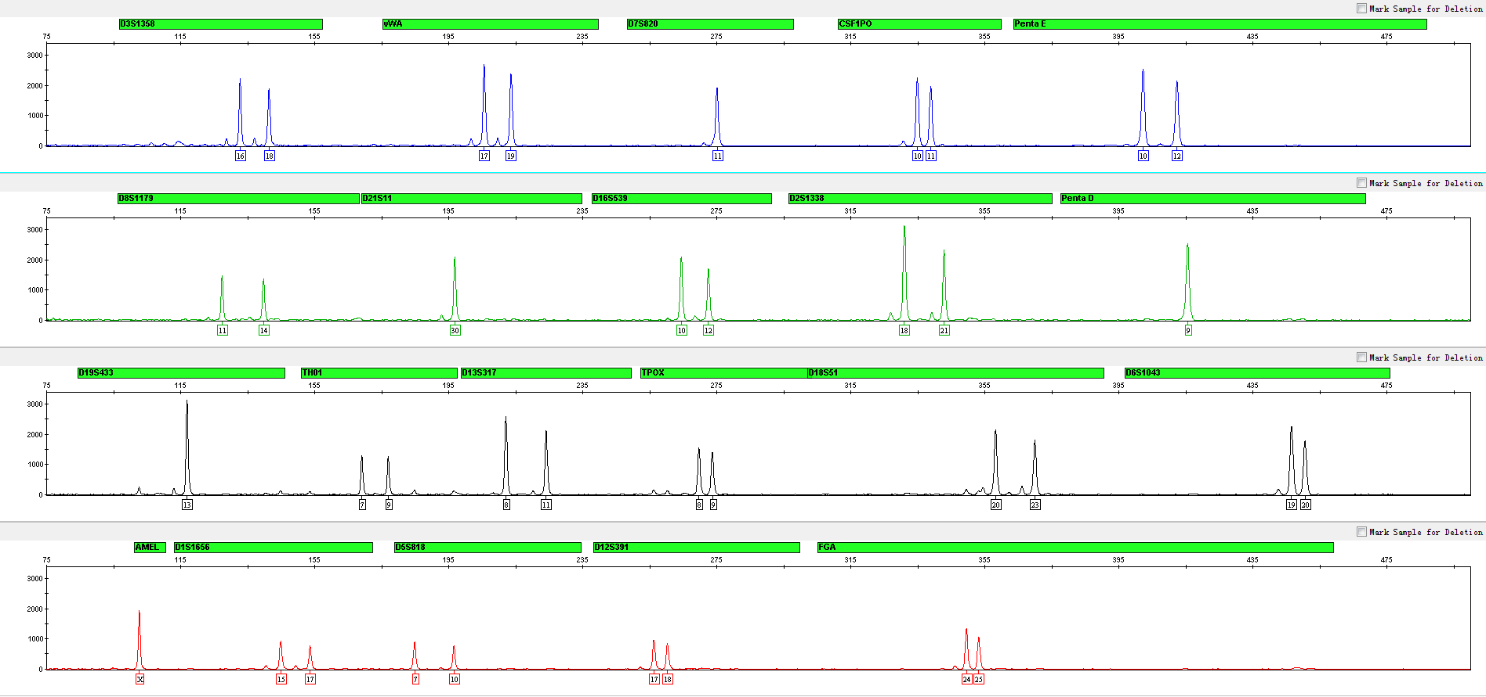
3.3 Amplification Results of Blood on Filter Paper Analyzed on 3130xl

Slide 15
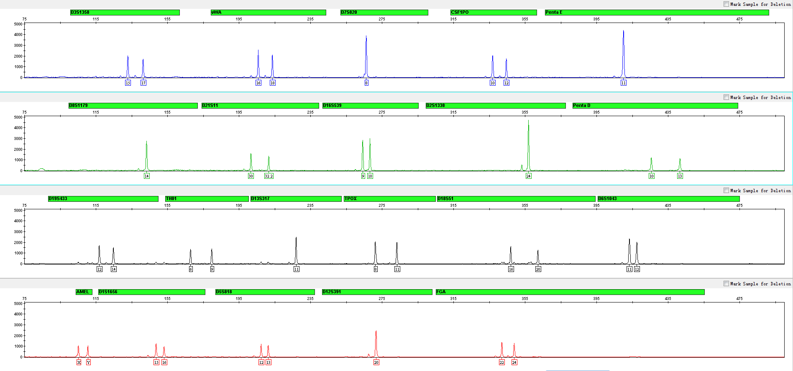
3.4 Amplification Results of Saliva on FTA Analyzed on 3130xl

Slide 16
Performance Measurement of 21Plex

Slide 17
4.1 Sensitivity Test
4.1.1 Content of Extracted DNA
• 500pg, 250pg, 125pg, 62.5pg, 31.25pg
• Repeat the experiment 3 times for all samples
4.1.2 Number of Direct Amplification Samples
FTA Blood Card
• 1, 2 or 3 slices - 1.2mm aperture
• Repeat the experiment 3 times for all samples
FTA Saliva Card
• 1, 2 or 3 slices - 1.2mm aperture
• Repeat the experiment 3 times for all samples

Slide 18
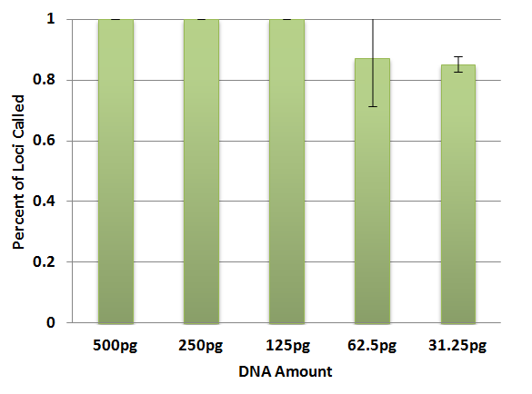
4.1.1 Extracted DNA
30 cycles
25μL amplification system
3130xl (3kV, 10sec sampling time)
Baseline threshold 50RFU

Slide 19
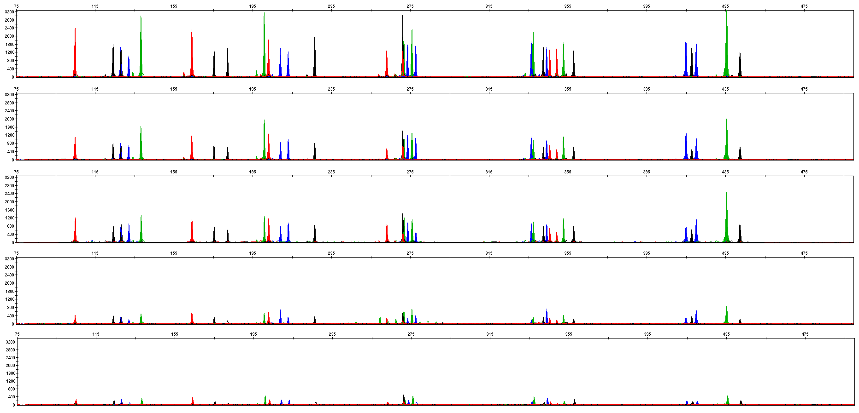
4.1.1 Extracted DNA
500pg
250pg
125pg
62.5pg
31.25pg

Slide 20
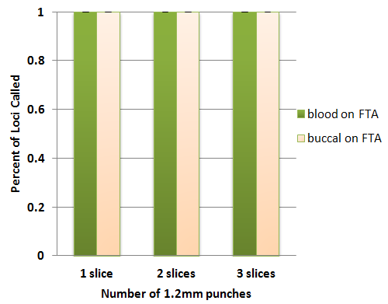
4.1.2 Number of Direct Amplified Samples -- FTA Blood Card & FTA Saliva Card
30 cycles
25μL amplification system
3130xl (3kV, 10sec sampling time)
Baseline threshold 50RFU

Slide 21
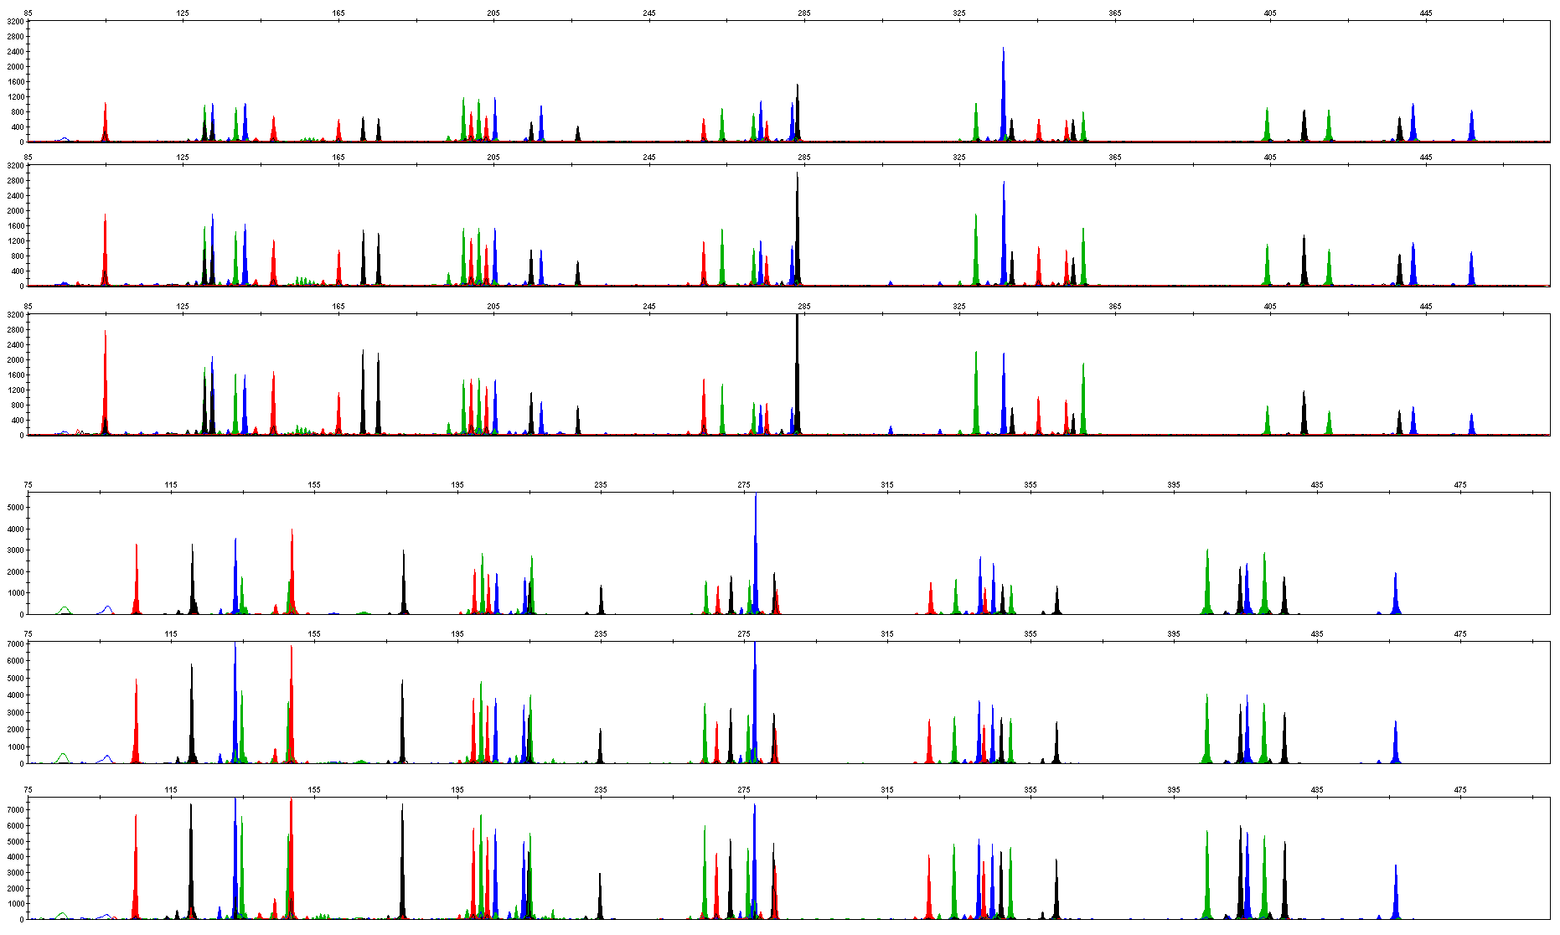
4.1.2 Number of Direct Amplified Samples -- FTA Blood Card & FTA Saliva Card
1 – 1.2mm punch, Blood
2 – 1.2mm punches, Blood
3 – 1.2mm punches, Blood
1 – 1.2mm punch, Buccal
2 – 1.2mm punches, Buccal
3 – 1.2mm punches, Buccal

Slide 22
4.2 Tolerance Test
4.2.1 Mix Concentration
• 0.75 x, 1 x, 1.25 x
4.2.2 Primer Concentration
• 0.75 x, 1 x, 1.25 x
4.2.3 Annealing Temperature
• 55℃, 57 ℃, 59 ℃, 61 ℃, 63 ℃
4.2.4 Cycles Number
• 28, 29, 30, 31
4.2.5 Reaction Volume
• 25µl and 10µl

Slide 23
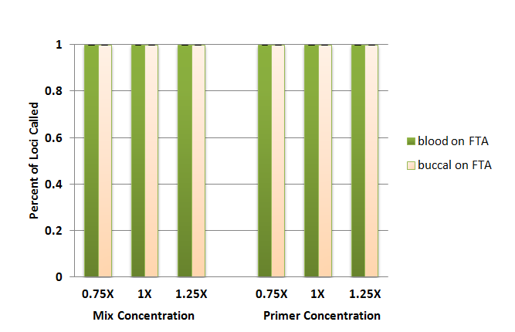
4.2.1 Concentrations of Mix and Primer
30 cycles
25μL amplification system
3130xl (3kV, 10sec sampling time)
Baseline threshold 50RFU

Slide 24
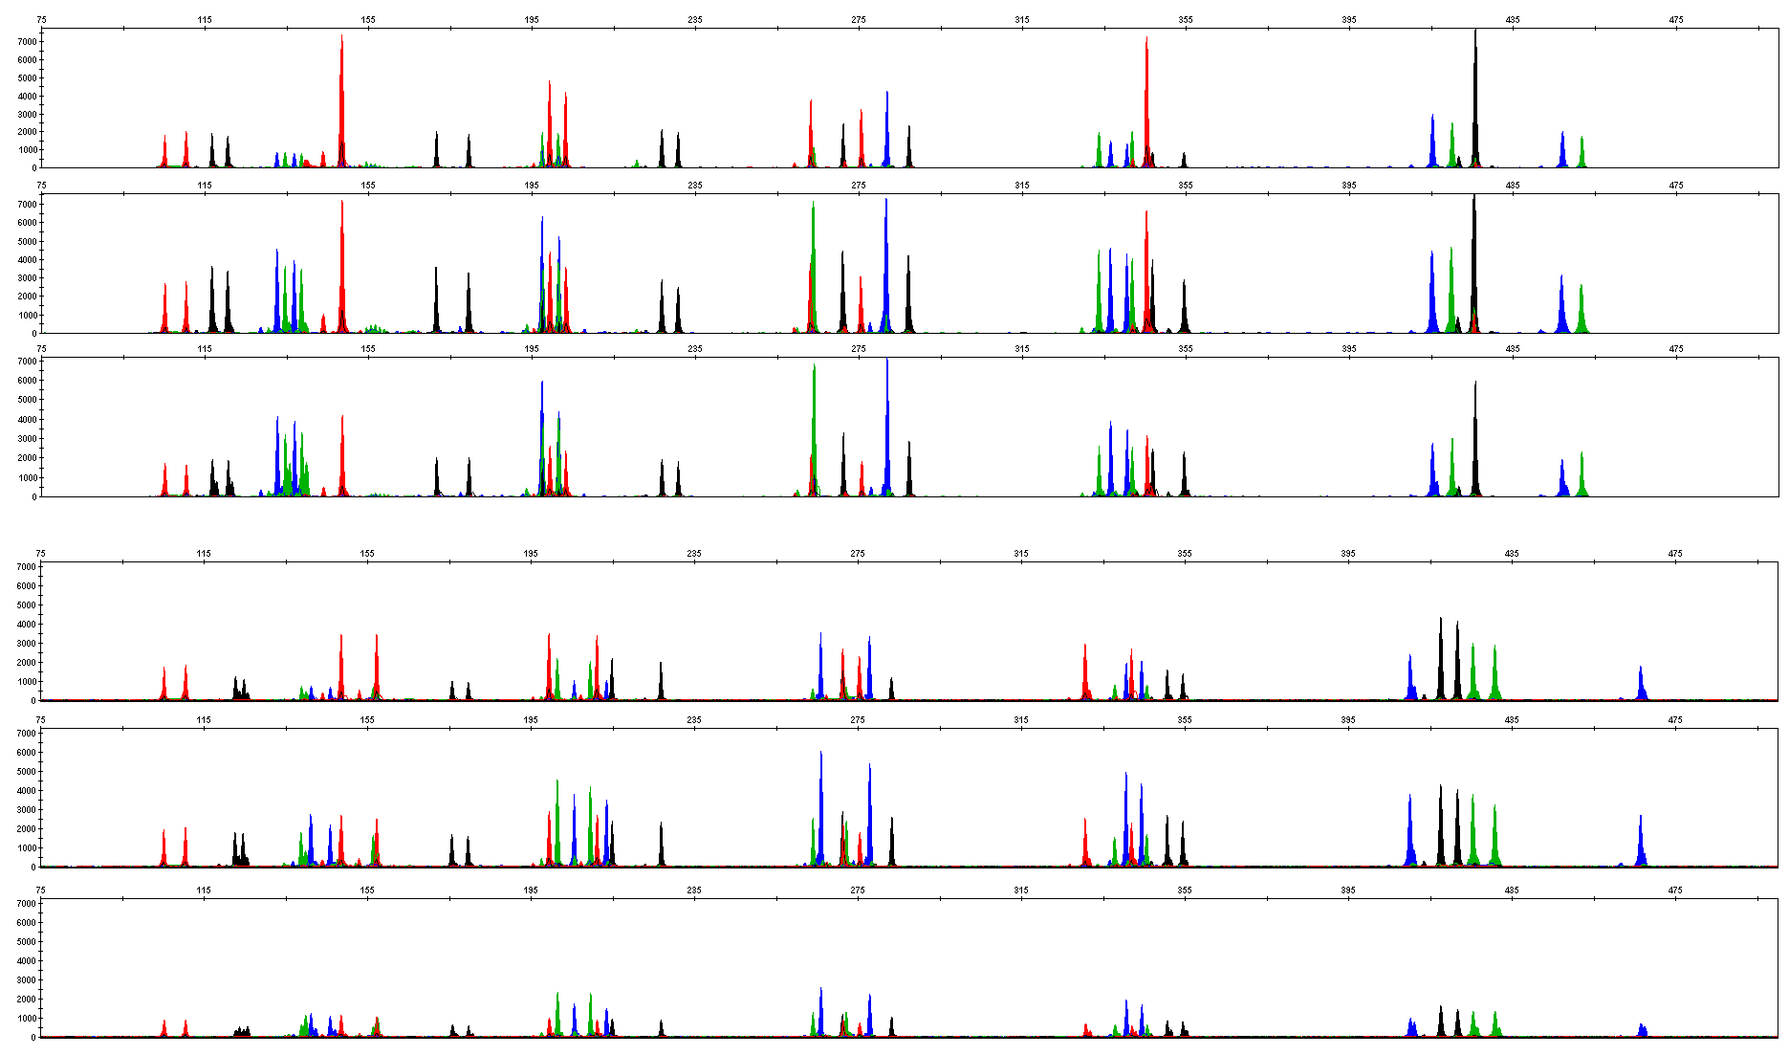
4.2.1 Mix Concentration
0.75 X, Blood
1.00 X, Blood
1.25 X, Blood
0.75 X, Buccal
1.00 X, Buccal
1.25 X, Buccal

Slide 25
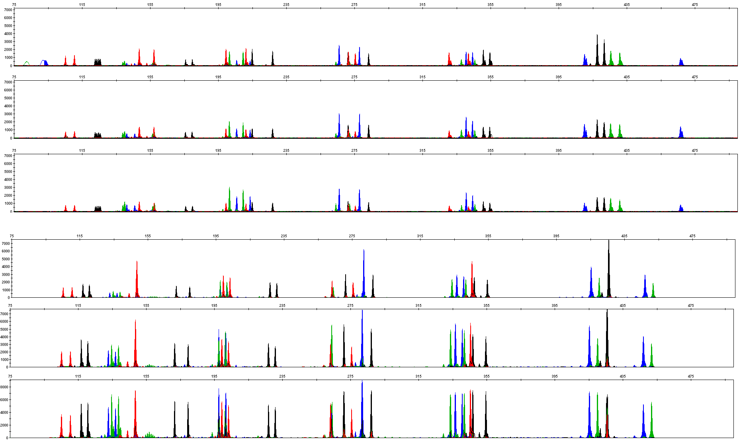
4.2.2 Primer Concentration
0.75 X, Blood
1.00 X, Blood
1.25 X, Blood
0.75 X, Buccal
1.00 X, Buccal
1.25 X, Buccal

Slide 26
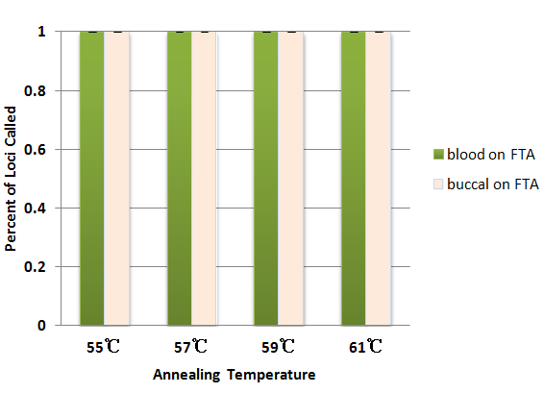
4.2.3 Annealing Temperature
30 cycles
25μL amplification system
3130xl (3kV, 10sec sampling time)
Baseline threshold 50RFU

Slide 27
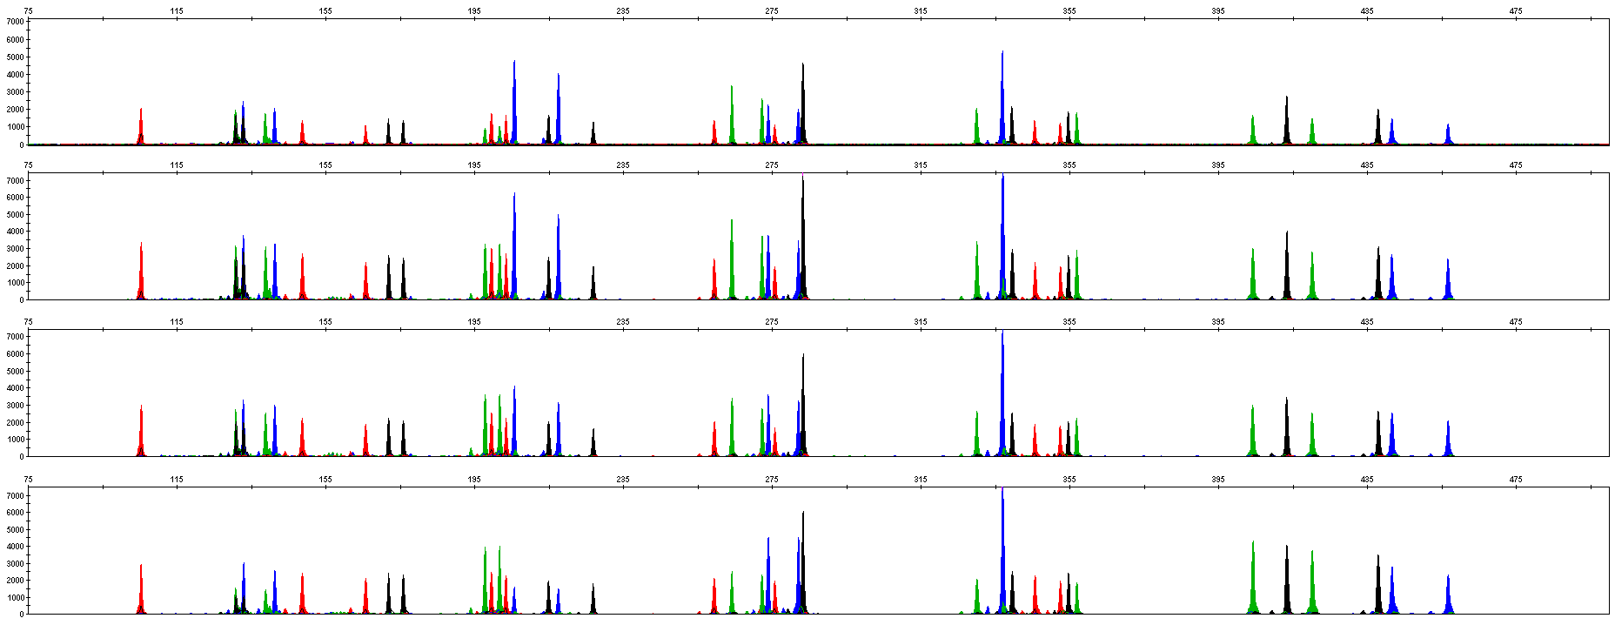
4.2.3 Annealing Temperature — FTA Blood Card
55℃, Blood
57 ℃, Blood
59℃, Blood
61 ℃, Blood

Slide 28
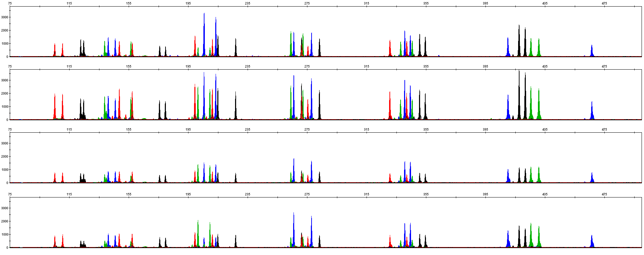
4.2.3 Annealing Temperature — FTA Saliva Card
55℃, Buccal
57 ℃, Buccal
59℃, Buccal
61 ℃, Buccal

Slide 29
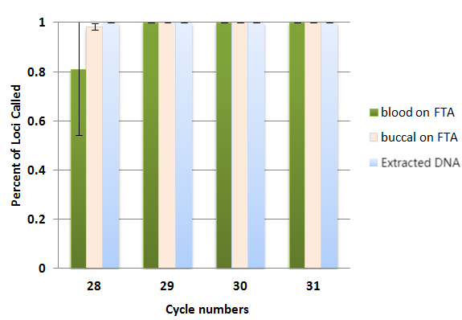
4.2.4 Cycles Number — 28-31 (25 μL)
25μL Reaction Volume

Slide 30
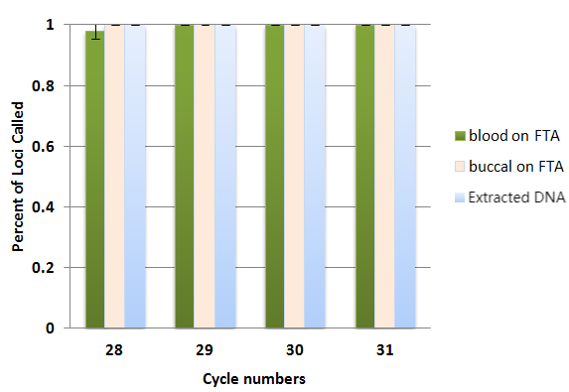
4.2.4 Cycles Number — 28-31 (10 μL)
10μL Reaction Volume

Slide 31
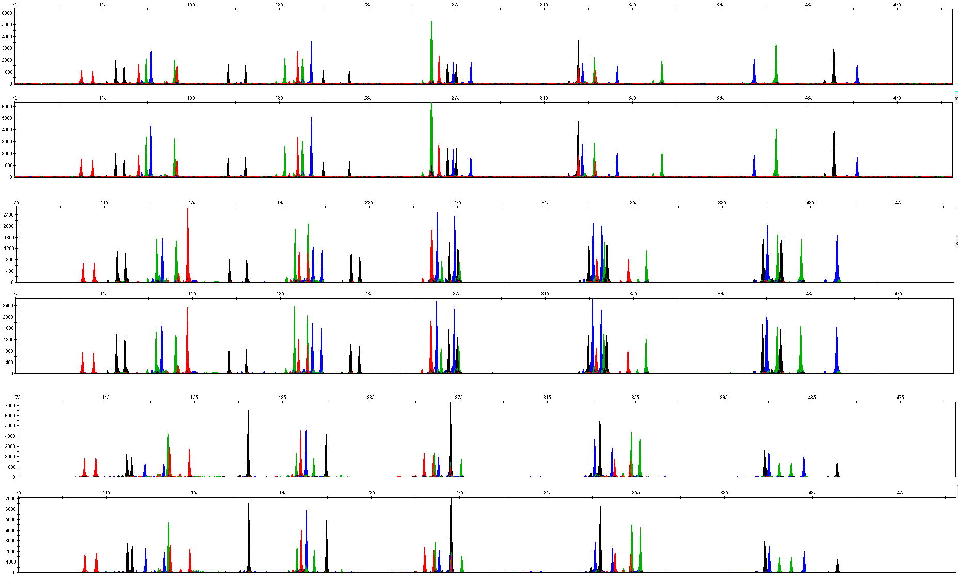
4.2.5 Reaction Volume
25μL, extracted DNA
10μL, extracted DNA
25μL, Blood
10μL, Blood
25μL, Buccal
10μL, Buccal

Slide 32
4.3 Inhibition Test
Three kinds of inhibitors:
4.3.1 Hematin
• 0.1, 0.2, 0.3 and 0.4mM
4.3.2 Hemoglobin
• 60, 100, 200 and 300µM
4.3.3 Humic Acid
• 10, 30, 50 and 100ng/µL

Slide 33
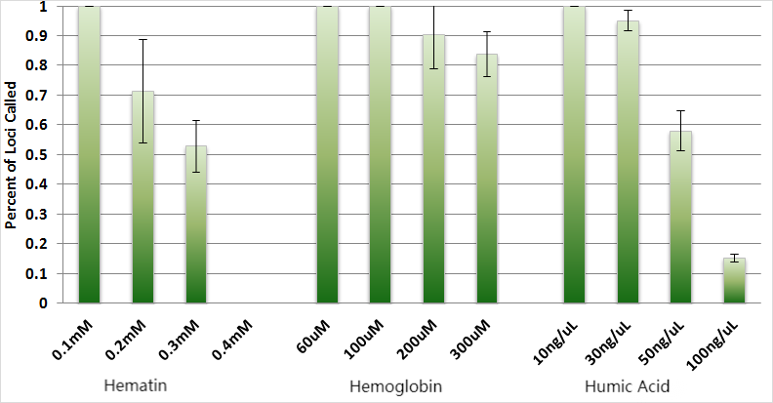
4.3 Inhibition Test
30 cycles
25μL amplification system
3130xl (3kV, 10sec sampling time)
Baseline threshold 50RFU

Slide 34
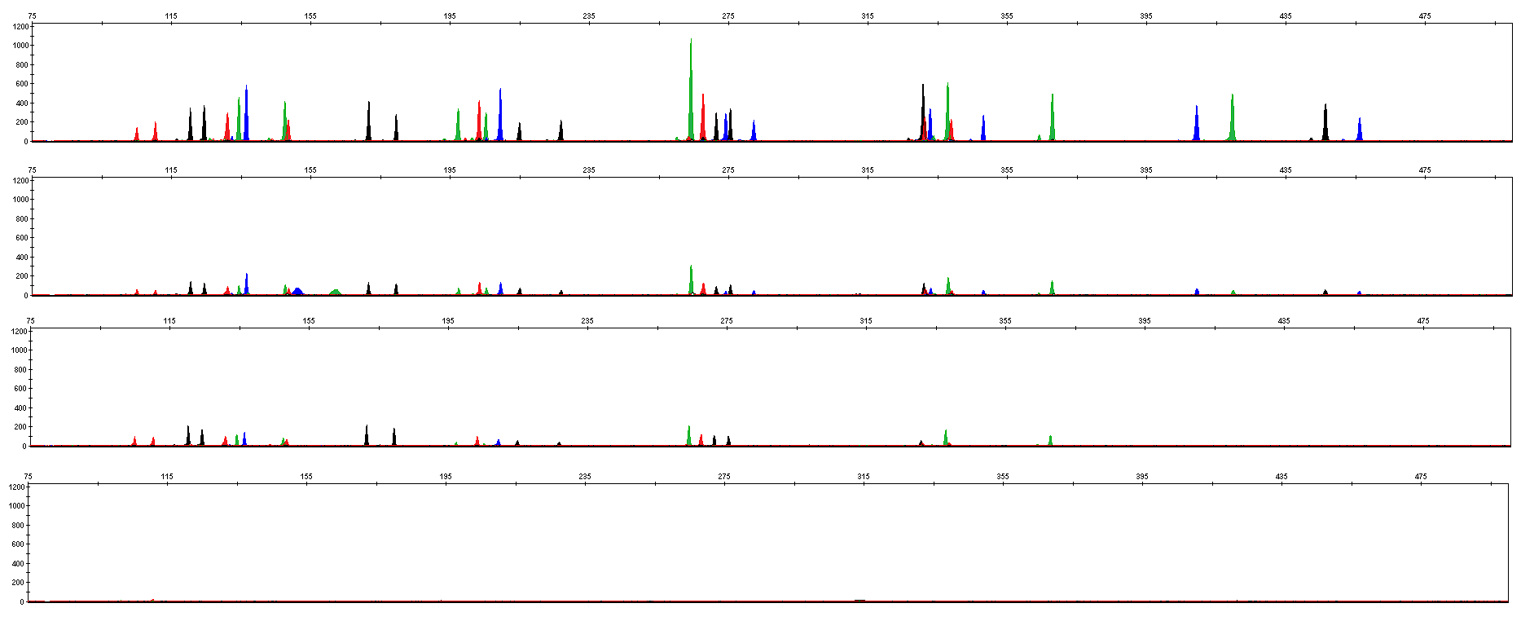
4.3.1 Hematin
0.1 mM
0.2 mM
0.3 mM
0.4 mM

Slide 35
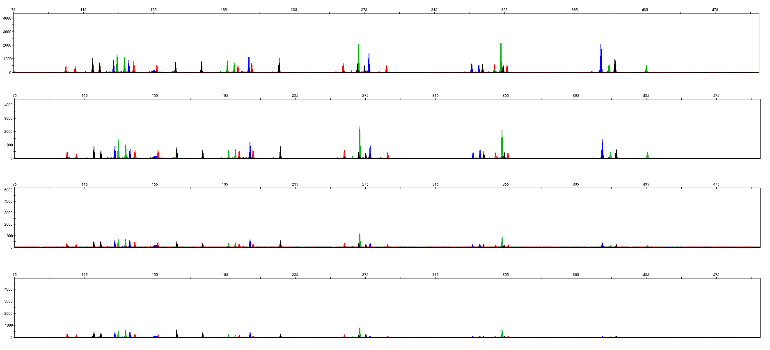
4.3.2 Hemoglobin
60 μM
100 μM
200 μM
300 μM

Slide 36
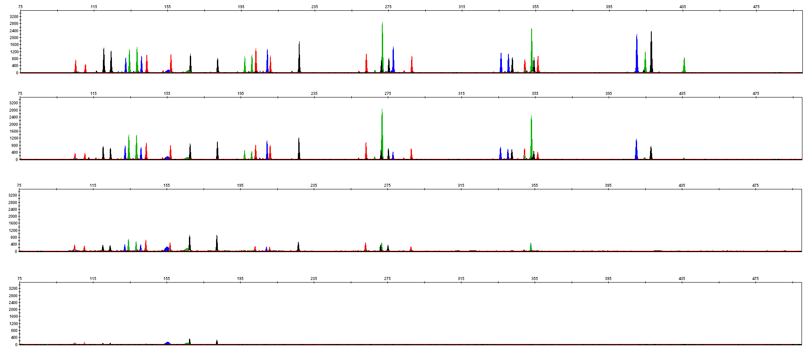
4.3.3 Humic Acid
10 ng/μL
30 ng/μL
50 ng/μL
100 ng/μL

Slide 37
4.4 Summary
1. High sensitivity: 21Plex showed good performance in the amplification of 125pg DNA samples. 1-3 pieces of FTA blood cards and/or FTA oral cards of 1.2 mm aperture were amplified normally.
2. Strong tolerance: 21Plex amplified normally in Mix or Primer reaction systems of different concentrations. 21Plex showed good performance at 55 - 61°C annealing temperature or 29 - 31 reaction cycles.
3. Strong resistance to multiple inhibitors: 21Plex amplified normally under conditions of 0.1mM hematin, 100μM hemoglobin or 30ng/μL humic acid.

Slide 38
Service & Cooperation

Slide 39
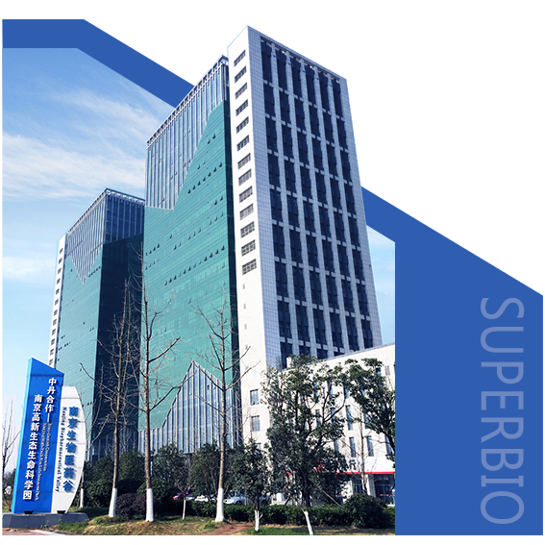
Service & Cooperation
Jiangsu Superbio Biomedical Co. Ltd., founded in 2011, is a cutting-edge technology enterprise owning the Practice License of Medical Institution, which specializes in the research and testing of gene sequencing industry, and integrates R&D, production and sales. The company's products and services cover forensic testing, medical testing, food/environment/medicine testing, instrumentation and software.
We are willing to provide clients with scientific research services related to forensic DNA testing, such as research projects and papers publication, solving all the difficulties encountered in the experiment for you.
We sincerely look forward to cooperate with you in developing products and researching projects.

Slide 40
THANKS!
Contact Us
Address: Sino-Danish Ecological Life Science Industrial Park, No.3-1 Xinjinxhu Road, Pukou District, Nanjing
Tel: 400-616-2676
Website: http://www.superbio.cn/

