Slide 1

Brief Introduction of
Y-COM STR Detection Kit
May 2023
Jiangsu Superbio Biomedical (Nanjing) Co.,Ltd.

Slide 2
Features of Y-COM

Slide 3
1.1 Features of Y-COM STR Detection Kit
1. Y-COM is a 5-color fluorescence detection kit which is applicable for detecting 29 Y-STR loci.
2. Y-COM is a supplementary kit for Y-STR library building, which can detect all 60 loci in the Y-library building standard when combined with Y34SE or Y41SE.
3. Good specimen compatibility. Y-COM can directly amplify a variety of test materials and extracted template DNA.
4. Rapid amplification.The whole PCR process using Y-COM takes 90min.

Slide 4
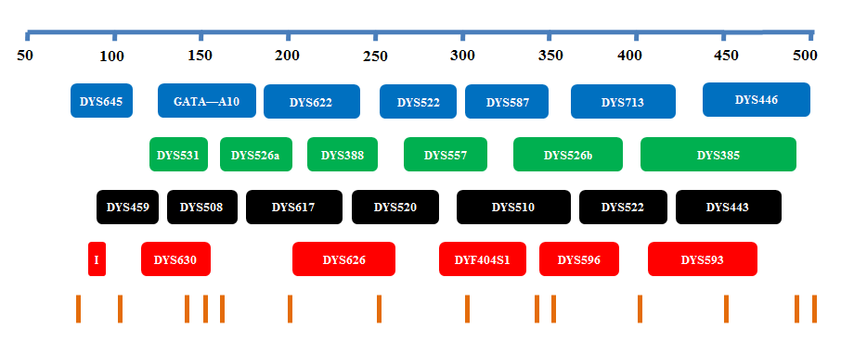
1.2 Loci Arrangement Diagram of Y-COM

Slide 5
General Information of Y-COM

Slide 6
2.1 Y-COM STR Detection Kit (100 RXN/Kit)
Pre-amplification Kit | 100 RXN
2.5× PCR Mix | 1000µL× 1
5× Primers | 500µL× 1
PCR Grade Water | 1000µL× 1
Control DNA 9948 (0.5ng/µL) | 20µL× 1
Taq DNA Polymerase | 100µL× 1
Post-amplification Kit | 100 RXN
Allelic Ladder | 25µL× 1
Orange-500 | 120µL× 1
Matrix Kit | Free for first use
5 Dye Matrix | 50µL× 1

Slide 7
2.2 Reaction System and Procedures of Y-COM STR Detection Kit
Component | 25µL System | 10µL System
2.5× PCR Mix | 10.0 | 4.0
5×Primers | 5.0 | 2.0
PCR Grade Water | 8.0 | 2.6
Control DNA 9948 (0.5ng/µL) | 1.0 | 1.0
Taq DNA Polymerase | 1.0 | 0.4
Total Volume | 25.0 | 10.0
Y-COM
95℃/5min 95℃/5sec 60℃/1.5min 60℃/20min
Reaction time: ~90min
∗The number of cycles in the reaction program depends on the actual situation
28-30
cycles

Slide 8
Service & Cooperation

Slide 9
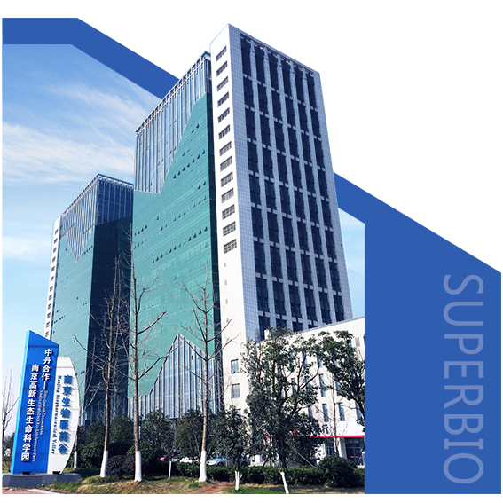
Service & Cooperation
Jiangsu Superbio Biomedical Co. Ltd., founded in 2011, is a cutting-edge technology enterprise owning the Practice License of Medical Institution, which specializes in the research and testing of gene sequencing industry, and integrates R&D, production and sales. The company's products and services cover forensic testing, medical testing, food/environment/medicine testing, instrumentation and software.
We are willing to provide clients with scientific research services related to forensic DNA testing, such as research projects and papers publication, solving all the difficulties encountered in the experiment for you.
We sincerely look forward to cooperate with you in developing products and researching projects.

Slide 10

THANKS!
Contact Us
Address: Sino-Danish Ecological Life Science Industrial Park, No.3-1 Xinjinxhu Road, Pukou District, Nanjing
Tel: 400-616-2676
Website: http://www.superbio.cn/

