Slide 1
Brief Introduction of
NC22Plex STR Detection Kit
May 2023
Jiangsu Superbio Biomedical (Nanjing) Co.,Ltd.

Slide 2
Features of NC22Plex

Slide 3
1.1 Features of NC22Plex STR Detection Kit
1. NC22Plex is a 5-color fluorescence detection product which is applicable for performing multiple amplification and detection on 20 supplemental loci, 1 CODIS locus and 1 sex locus specified in the Standard of Judicial Identification.
2. NC22Plex features super high resolution, sensitivity and anti-inhibitor ability.
3. Rapid amplification. The amplification time is less than 1.5 hours.
4. Combined with 21Plex STR Detection Kit, the number of detected loci reaches 40.
5. Meet the "Code for the Implementation of the Identification of Full Biological Syndrome" published by the Judicial Administration of Justice of the Ministry of Justice of PRC in 2014, it recommends to increase the number of detected loci from 19 to 29 or 39.
6. Strong compatibility. NC22Plex is compatible with the direct amplification of various samples and the amplification of purified DNA.
7. Applicable for forensic analysis, kinship detection and scientific research for human genetic identification.

Slide 4
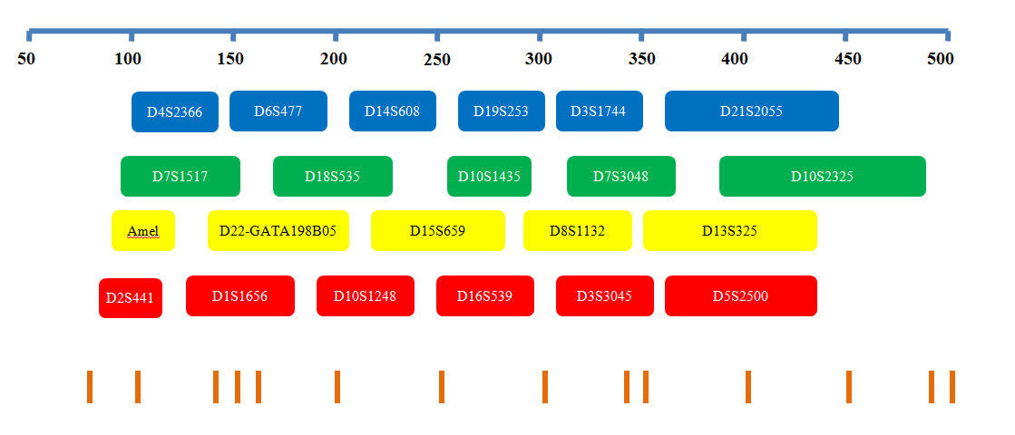
1.2 Loci Arrangement Diagram of NC22Plex

Slide 5
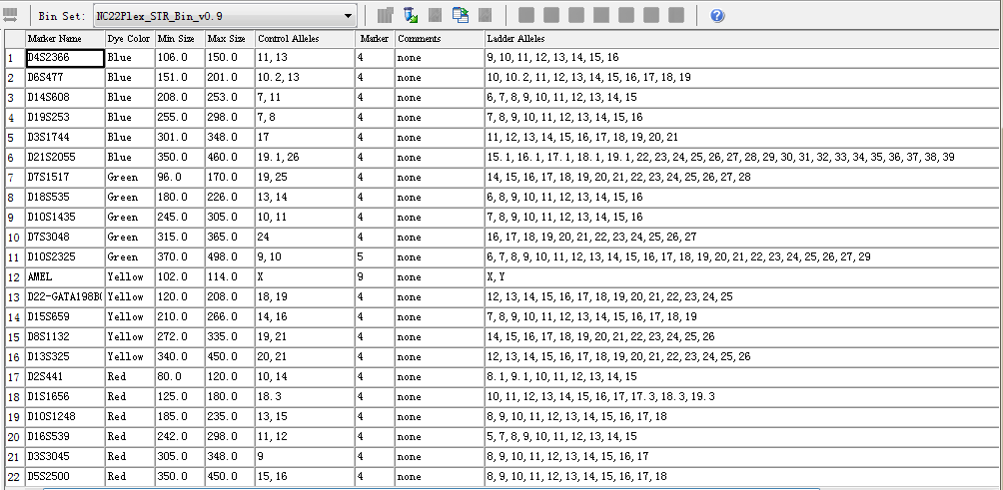
1.3 Analysis Software Loci Information Table of NC22Plex
GeneMapper ID-X

Slide 6
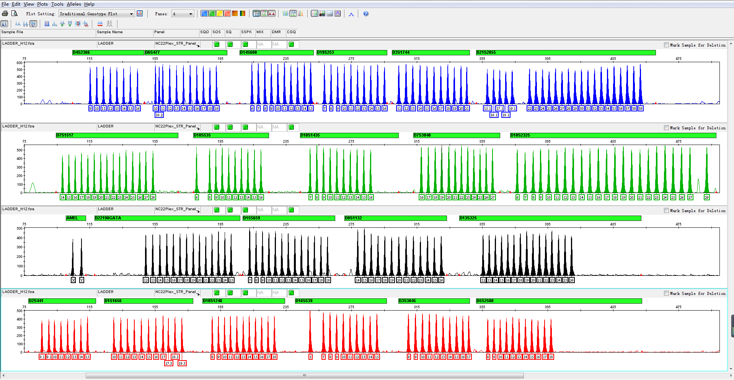
1.4 Electrophoretic Diagram of NC22Plex Allelic Ladder
NC22Plex Allelic Ladder contains 261 alleles

Slide 7
General Information of NC22Plex

Slide 8
2.1 NC22Plex STR Detection Kit (25µL×100 RXN/Kit)
 |  | Component
 | Pre-amplification Kit | 2.5× PCR Mix | Buffer containing anti-inhibition components such as MgCl₂
 |  | NC22Plex Primers | Primer mixtures for amplifying 22 loci
 |  | PCR Grade Water | Nuclease-free deionized ultrapure water
 |  | Control DNA 9947A (0.5ng/µL) | Standard positive control
 |  | Taq DNA Polymerase | Hot-start DNA Polymerase
 | Post-amplification Kit | NC22Plex Allelic Ladder | Standard reference material for allele genotyping
 |  | Orange-500 | Internal lane standards with fluorescent markers
 | Matrix Kit | 5 Dye Matrix | Used for spectral calibration

Slide 9
2.2 Components and Contents of NC22Plex STR Detection Kit
Component | Pre-amplification Kit
2.5× PCR Mix | 1,000× 1
NC22Plex Primers | 500× 1
PCR Grade Water | 1,000× 1
Control DNA 9947A (0.5ng/µL) | 20× 1
Taq DNA Polymerase | 100× 1
Component | Post-amplification Kit
NC22Plex Allelic Ladder | 20× 1
Orange-500 | 120× 1
Component | Matrix Kit
5 Dye Matrix | 50× 1

Slide 10
2.3 Reaction System and Procedures of NC22Plex STR Detection Kit
Component | 25µL System (µL)
2.5× PCR Mix | 10.0
NC22Plex Primers | 5.0
PCR Grade Water | 8.0
Control DNA 9947 (0.5ng/µL) | 1.0
Taq DNA Polymerase | 1.0
Total Volume | 25.0
95℃
94℃
3min
15sec
60℃
60℃
1min
30min
30 Cycles
4℃
∞

Slide 11
Amplification Results of NC22Plex

Slide 12
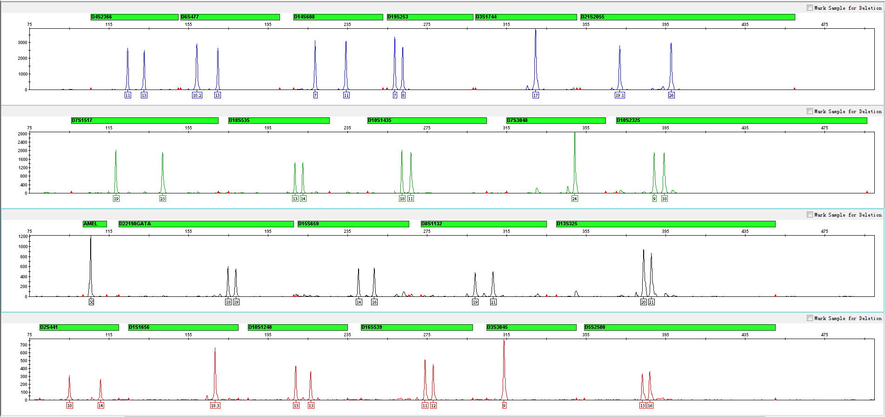
3.1 Amplification Results of Positive Control 9947A Analyzed on 3130xl

Slide 13
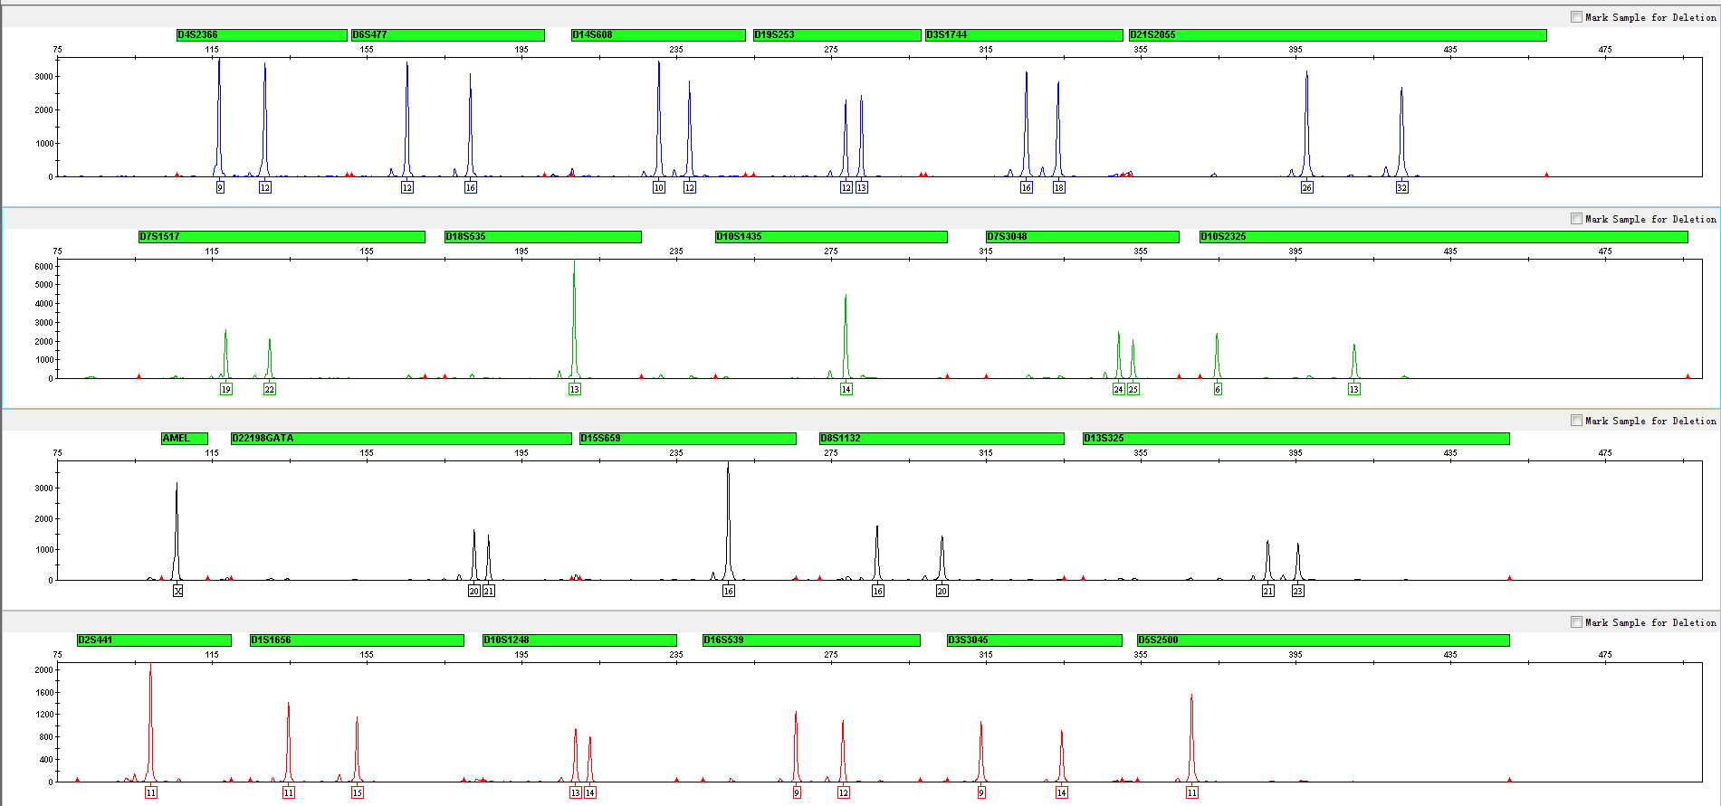
3.2 Amplification Results of Blood on FTA Analyzed on 3130xl

Slide 14
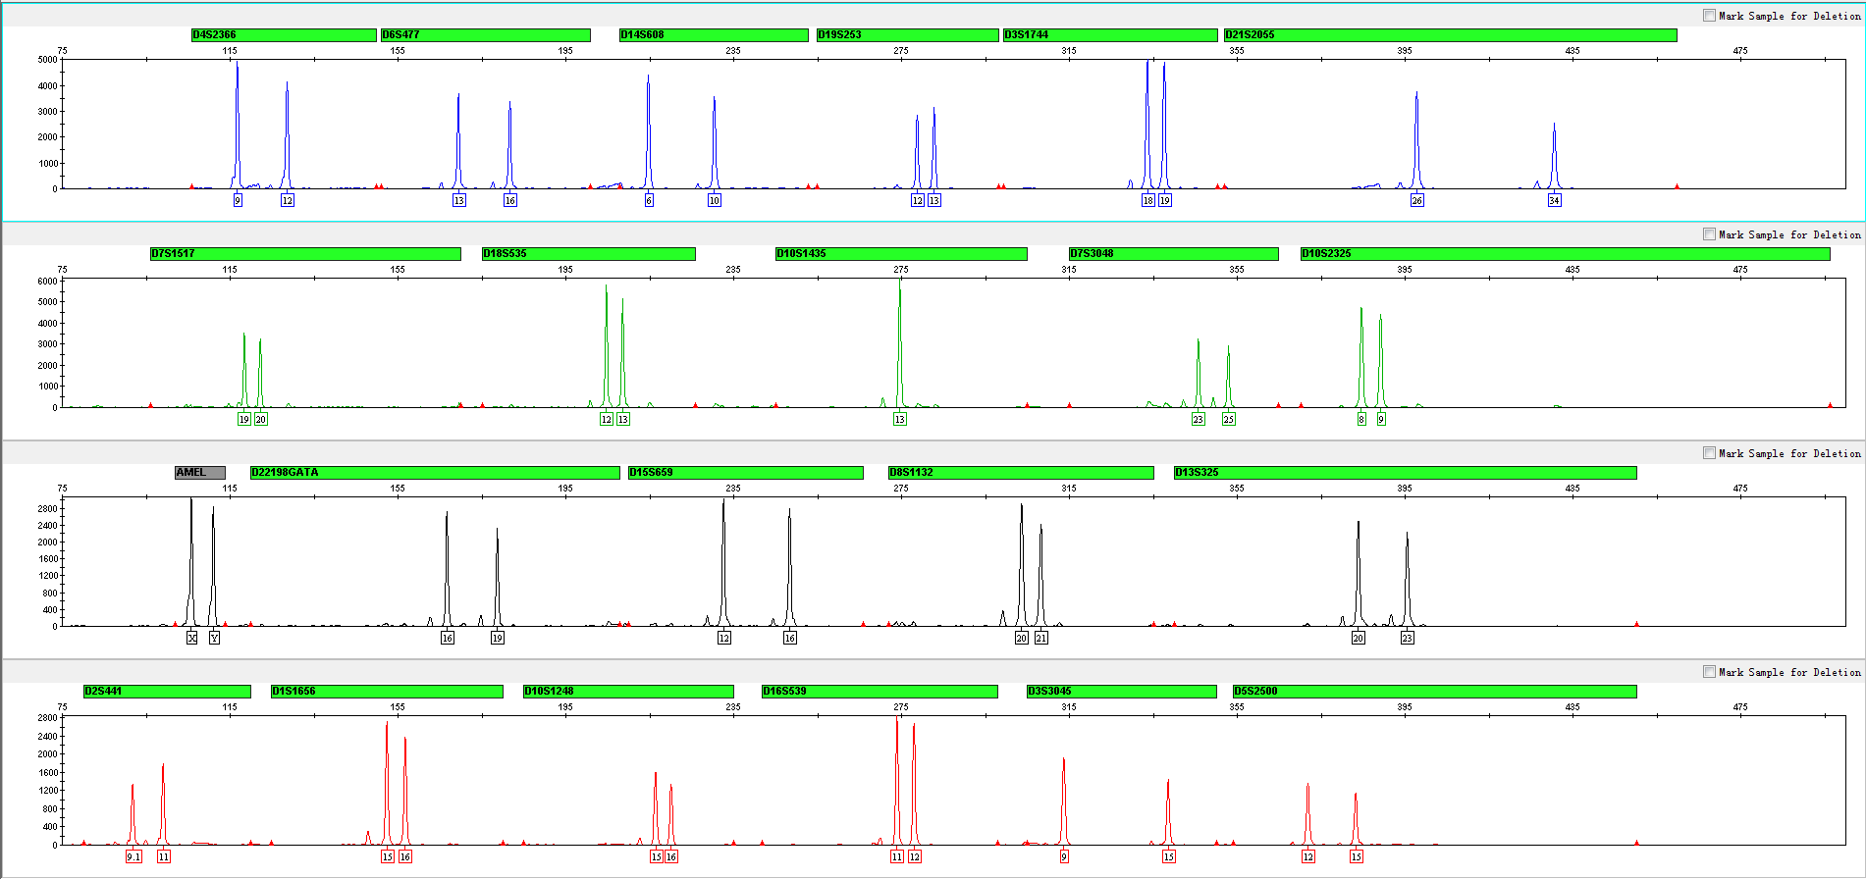
3.3 Amplification Results of Blood on Filter Paper Analyzed on 3130xl

Slide 15
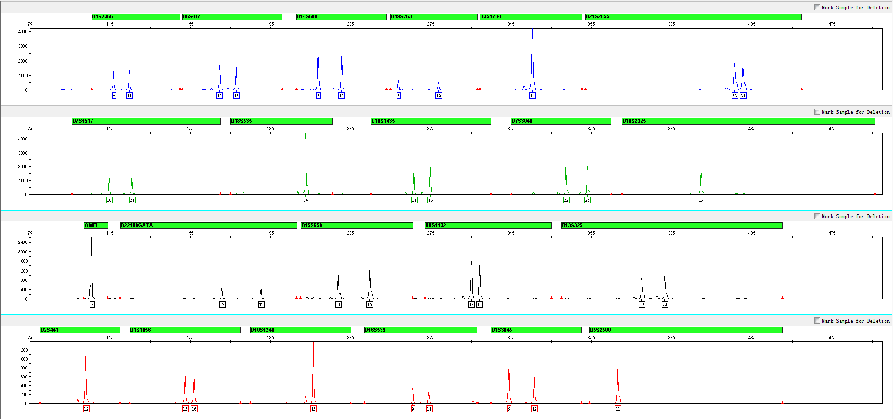
3.4 Amplification Results of Saliva on FTA Analyzed on 3130xl

Slide 16
Summary

Slide 17
4. Summary
1. Fast: Optimized components of PCR Reaction System have shortened the PCR amplification time to less than 1.5 hours.
2. High resolution: Single-tube reaction allows for getting the correct typing of 22 loci at one time, which performs better than the other similar products in the market.
3. DNA extraction-free technology: Samples can be used for PCR amplification directly without extraction.
4. High discrimination power (DP) and paternity probability exclusion (PE). NC22Plex showed excellent performance in criminal investigation, judicial identification and paternity test no matter it is used exclusively or jointly with other kits.

Slide 18
Service & Cooperation

Slide 19
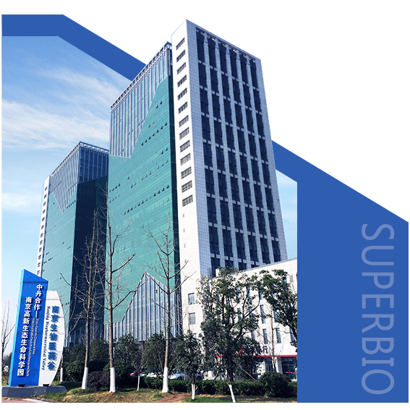
Service & Cooperation
Jiangsu Superbio Biomedical Co. Ltd., founded in 2011, is a cutting-edge technology enterprise owning the Practice License of Medical Institution, which specializes in the research and testing of gene sequencing industry, and integrates R&D, production and sales. The company's products and services cover forensic testing, medical testing, food/environment/medicine testing, instrumentation and software.
We are willing to provide clients with scientific research services related to forensic DNA testing, such as research projects and papers publication, solving all the difficulties encountered in the experiment for you.
We sincerely look forward to cooperate with you in developing products and researching projects.

Slide 20
THANKS!
Contact Us
Address: Sino-Danish Ecological Life Science Industrial Park, No.3-1 Xinjinxhu Road, Pukou District, Nanjing
Tel: 400-616-2676
Website: http://www.superbio.cn/

