Slide 1
Brief Introduction of
Y44SE Plus STR Detection Kit
May 2023
Jiangsu Superbio Biomedical (Nanjing) Co.,Ltd.

Slide 2
Features of Y44SE Plus

Slide 3
1.1 Features of Y44SE Plus STR Detection Kit
1. Y44SE Plus is a 6-color fluorescence detection kit which is applicable for detecting 41 Y-STR loci including 32 low mutating STR loci (mutation rate <1%) and 9 rapid mutating loci (mutation rate>1%), and 3 Y-indels.
2. Y44SE Plus is applicable for Y-STR library building, especially suitable for male family investigation. This kit has strong discrimination power (DP) and high accuracy. It includes all 35 loci that are required and selected in the Y library building standard.
3. Y44SE Plus contains 10 mini-STRs (loci within 220bp of amplification length), facilitating the acquisition of more DNA information from degraded specimens.
4. Strong compatibility. Y44SE Plus is compatible with the direct amplification of various samples and the amplification of purified DNA.
5. Rapid amplification.The whole PCR process using Y44SE Plus takes 70min.

Slide 4
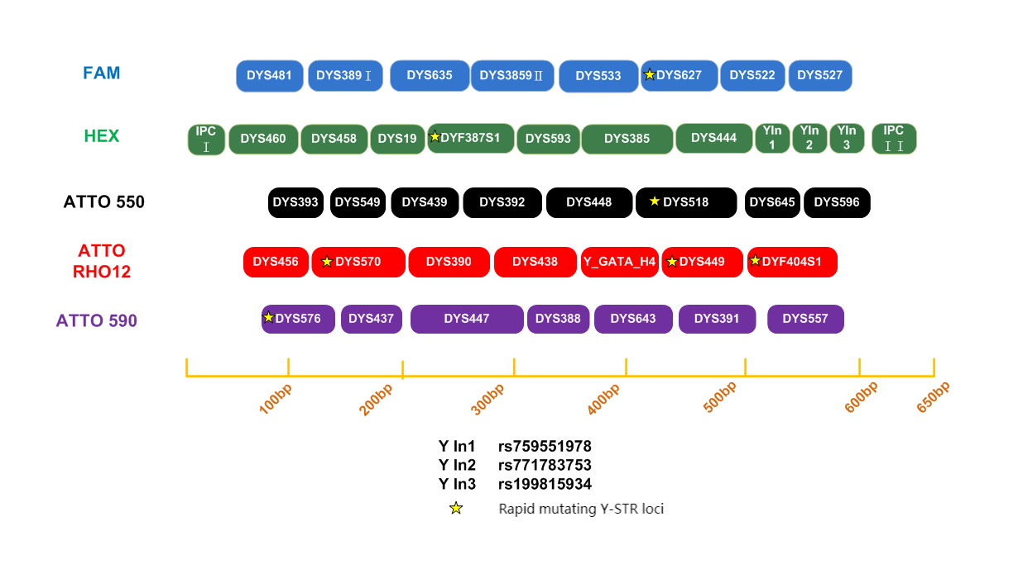
1.2 Loci Arrangement Diagram of Y44SE Plus

Slide 5
General Information of Y44SE Plus

Slide 6
2.1 Y44SE Plus STR Detection Kit (100 RXN/Kit)
Pre-amplification Kit | 100 RXN
2.5× PCR Mix | 1,000µL× 1
5× Primers | 500µL× 1
PCR Grade Water | 1,000µL× 1
Control DNA 9948 (0.5ng/µL) | 20µL× 1
Taq DNA Polymerase | 100µL× 1
Post-amplification Kit | 100 RXN
Allelic Ladder | 25µL× 1
Orange-640 | 120µL× 1
Matrix Kit | Free for first use
6 Dye Matrix | 50µL× 1

Slide 7
2.2 Reaction System and Procedures of Y44SE Plus STR Detection Kit
Component | 25µL System | 10µL System
2.5× PCR Mix | 10.0 | 4.0
5×Primers | 5.0 | 2.0
PCR Grade Water | 8.0 | 2.6
Control DNA 9948 (0.5ng/µL) | 1.0 | 1.0
Taq DNA Polymerase | 1.0 | 0.4
Total Volume | 25.0 | 10.0
Y44SE Plus
95℃/3min 95℃/5sec 60℃/1.5min 60℃/12min
Reaction time: ~70min
∗The number of cycles in the reaction program depends on the actual situation
28-30
cycles

Slide 8
Amplification Results of Y44SE Plus

Slide 9
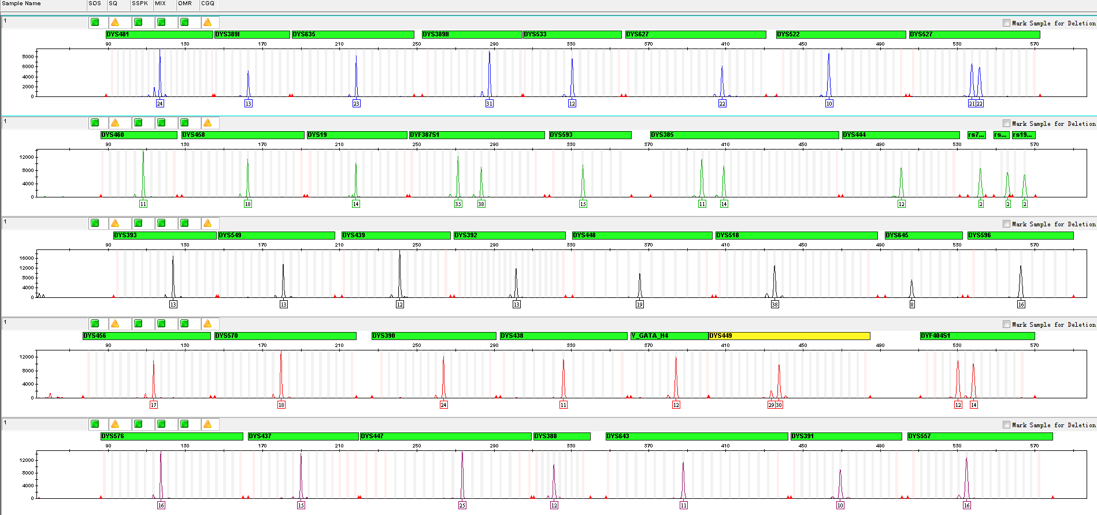
3.1 Amplification Results of Positive Control 9948 Analyzed on 3500

Slide 10
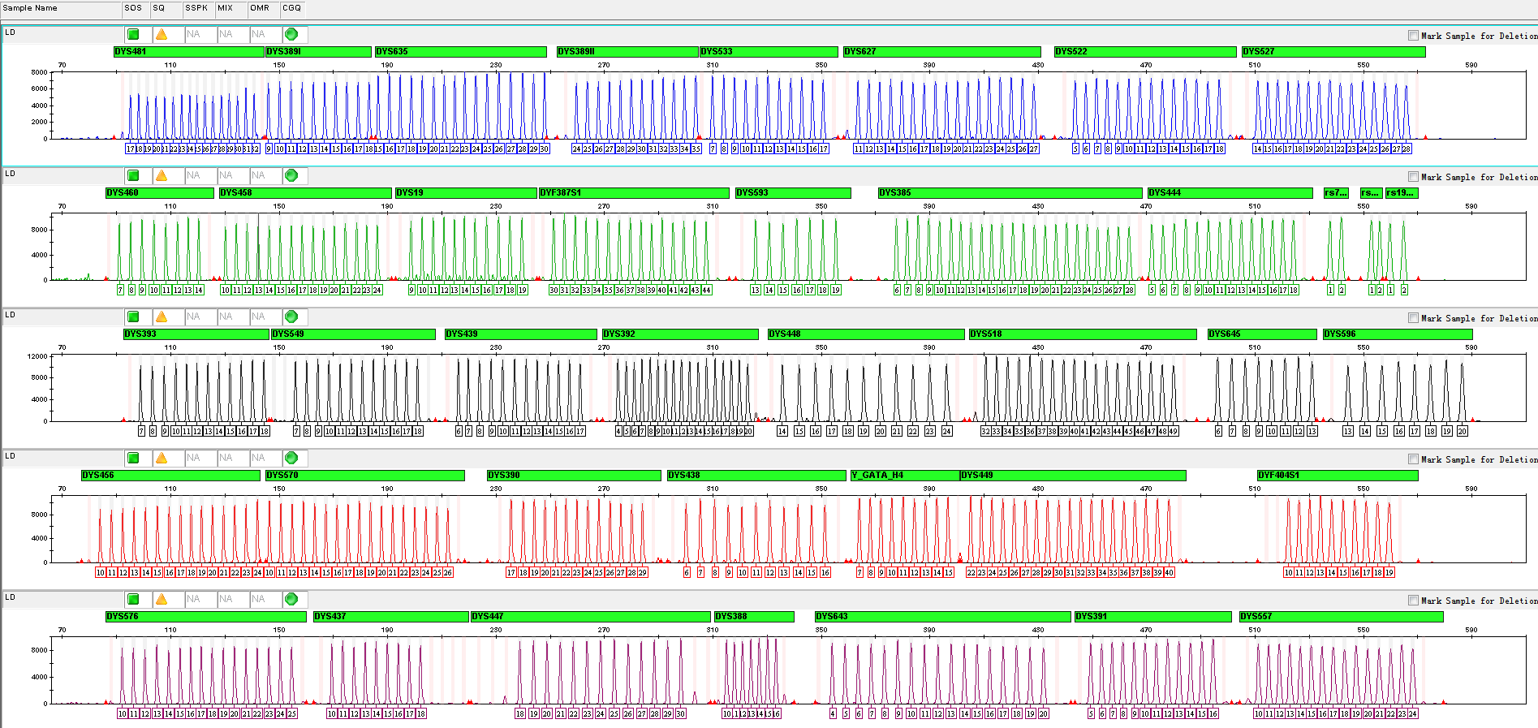
3.2 Amplification Results of LD Analyzed on 3500

Slide 11
Service & Cooperation

Slide 12
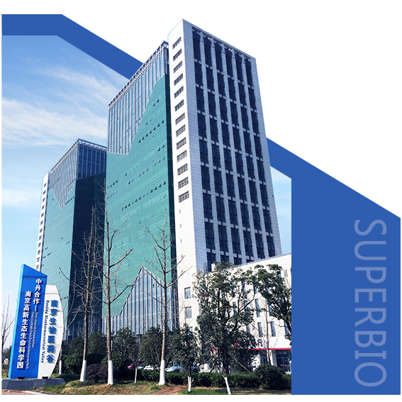
Service & Cooperation
Jiangsu Superbio Biomedical Co. Ltd., founded in 2011, is a cutting-edge technology enterprise owning the Practice License of Medical Institution, which specializes in the research and testing of gene sequencing industry, and integrates R&D, production and sales. The company's products and services cover forensic testing, medical testing, food/environment/medicine testing, instrumentation and software.
We are willing to provide clients with scientific research services related to forensic DNA testing, such as research projects and papers publication, solving all the difficulties encountered in the experiment for you.
We sincerely look forward to cooperate with you in developing products and researching projects.

Slide 13
THANKS!
Contact Us
Address: Sino-Danish Ecological Life Science Industrial Park, No.3-1 Xinjinxhu Road, Pukou District, Nanjing
Tel: 400-616-2676
Website: http://www.superbio.cn/

