Slide 1
Brief Introduction of
X18Plex STR Detection Kit
May 2023
Jiangsu Superbio Biomedical (Nanjing) Co.,Ltd.

Slide 2
Features of X18Plex

Slide 3
1.1 Features of X18Plex STR Detection Kit
1. X18Plex is a 5-color fluorescence detection kit which is applicable for performing multiplex amplification on 17 X chromosome STR loci and 1 Amelogenin.
2. X18Plex features super high resolution, sensitivity and anti-inhibitor ability.
3. X18Plex is compatible with the vast majority of loci of the current mainstream X chromosome kit at home and abroad.
4. Rapid amplification.The whole PCR process using X18Plex takes less than 90min.
5. Lower mutation rates (intergenerational mutation rate 2.3×10⁻⁹), and it is relatively stable and not easy to mutate again after occurrence.
6. Strong compatibility. X18Plex is compatible with the direct amplification of various samples and the amplification of purified DNA.
7. X18Plex is applicable to the identification of special paternity cases such as complex kinship, disputed father daughter relationship, half sister relationship, grandparent relationship, etc. It is an effective complement to autosomal and Y chromosome STR kits.

Slide 4
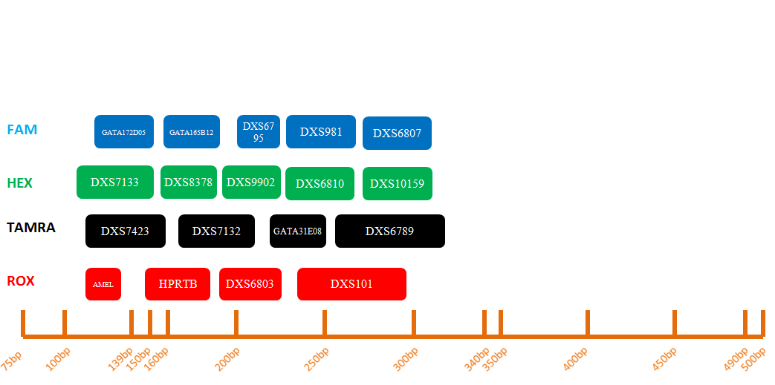
1.2 Loci Arrangement Diagram of X18Plex

Slide 5
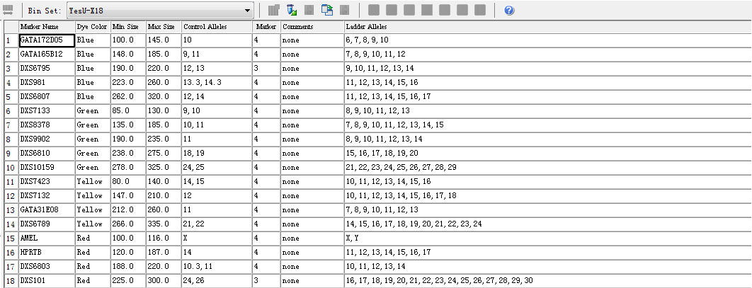
1.3 Analysis Software Loci Information Table of X18Plex
GeneMapper ID-X

Slide 6
General Information of X18Plex

Slide 7
2.1 X18Plex STR Detection Kit (10µL× 50 RXN/Kit)
 | Component | Content | Description
Pre-amplification Kit | 2.5× PCR Mix | 250μL× 1 | Buffer containing anti-inhibition components such as MgCl₂
 | X18Plex Primers | 100μL× 1 | Primer mixtures for amplifying 18 loci
 | PCR Grade Water | 200μL× 1 | Nuclease-free deionized ultrapure water
 | Control DNA 9947 (0.5ng/µL) | 10μL× 1 | Standard positive control
 | Taq DNA Polymerase | 20μL× 1 | Hot-start DNA Polymerase
Post-amplification Kit | X18Plex Allelic Ladder | 10μL× 1 | Standard reference material for allele genotyping
 | Orange-500 | 20μL× 1 | Internal lane standards with fluorescent markers
Matrix Kit | 5 Dye Matrix | 50μL×1 | Used for spectral calibration

Slide 8
2.2 Reaction System and Procedures of X18Plex STR Detection Kit
Component | 10µL System (µL)
2.5× PCR Mix | 5.0
X18Plex Primers | 2.0
PCR Grade Water | 1.6
Control DNA 9947A (0.5ng/µL) | 1.0
Taq DNA Polymerase | 0.4
Total Volume | 10.0
95℃
94℃
3min
15s
60℃
60℃
1min
10min
4℃
30 Cycles
∞

Slide 9
Amplification Results of X18Plex

Slide 10
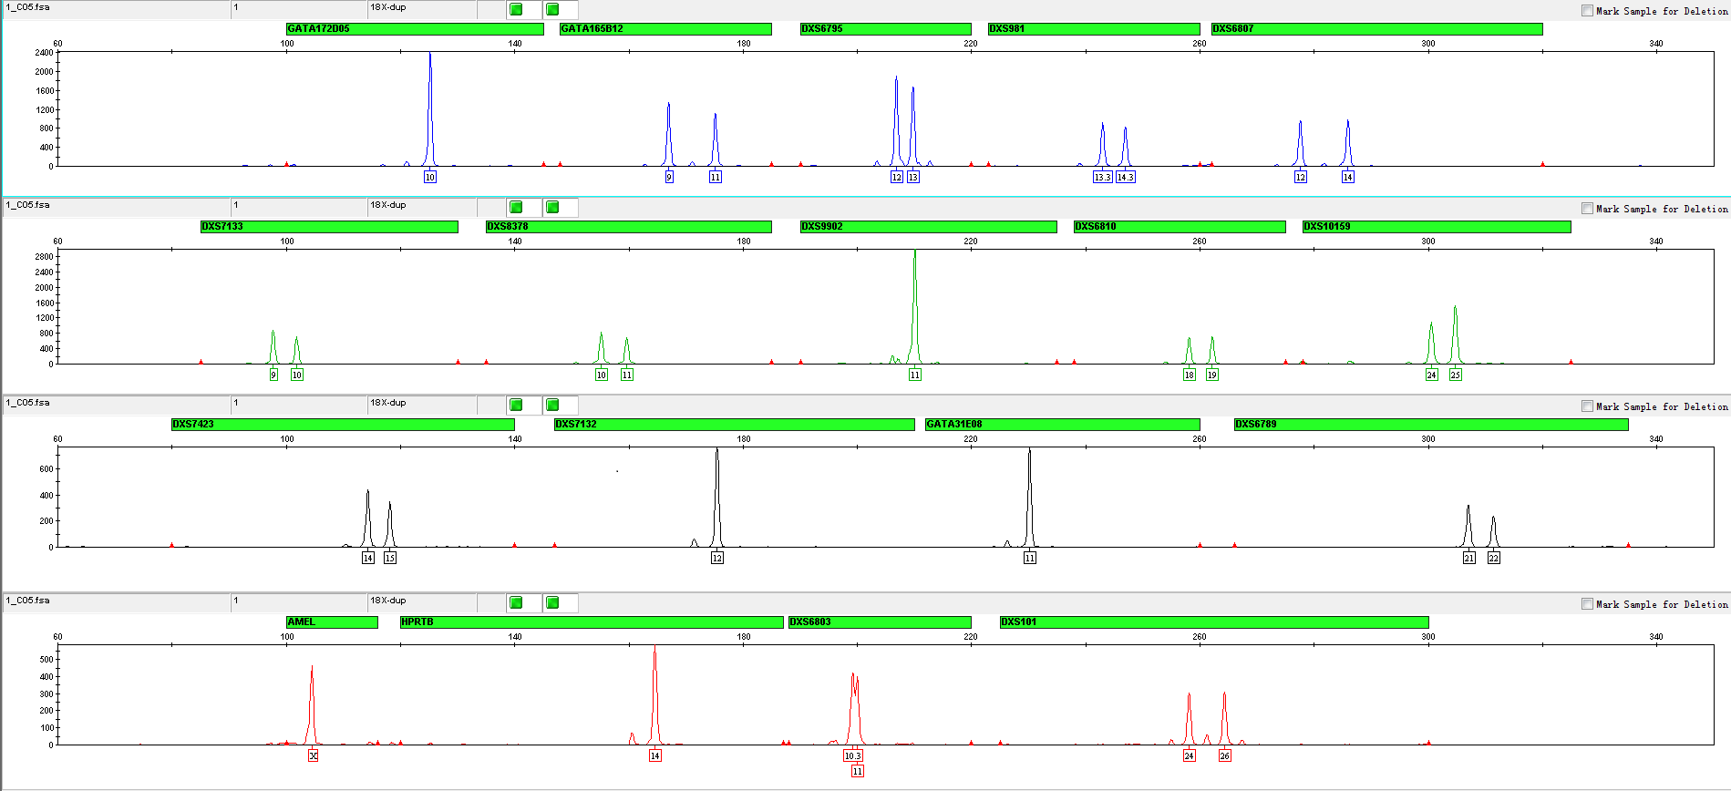
3.1 Amplification Results of Positive Control 9947 Analyzed on 3130xl

Slide 11
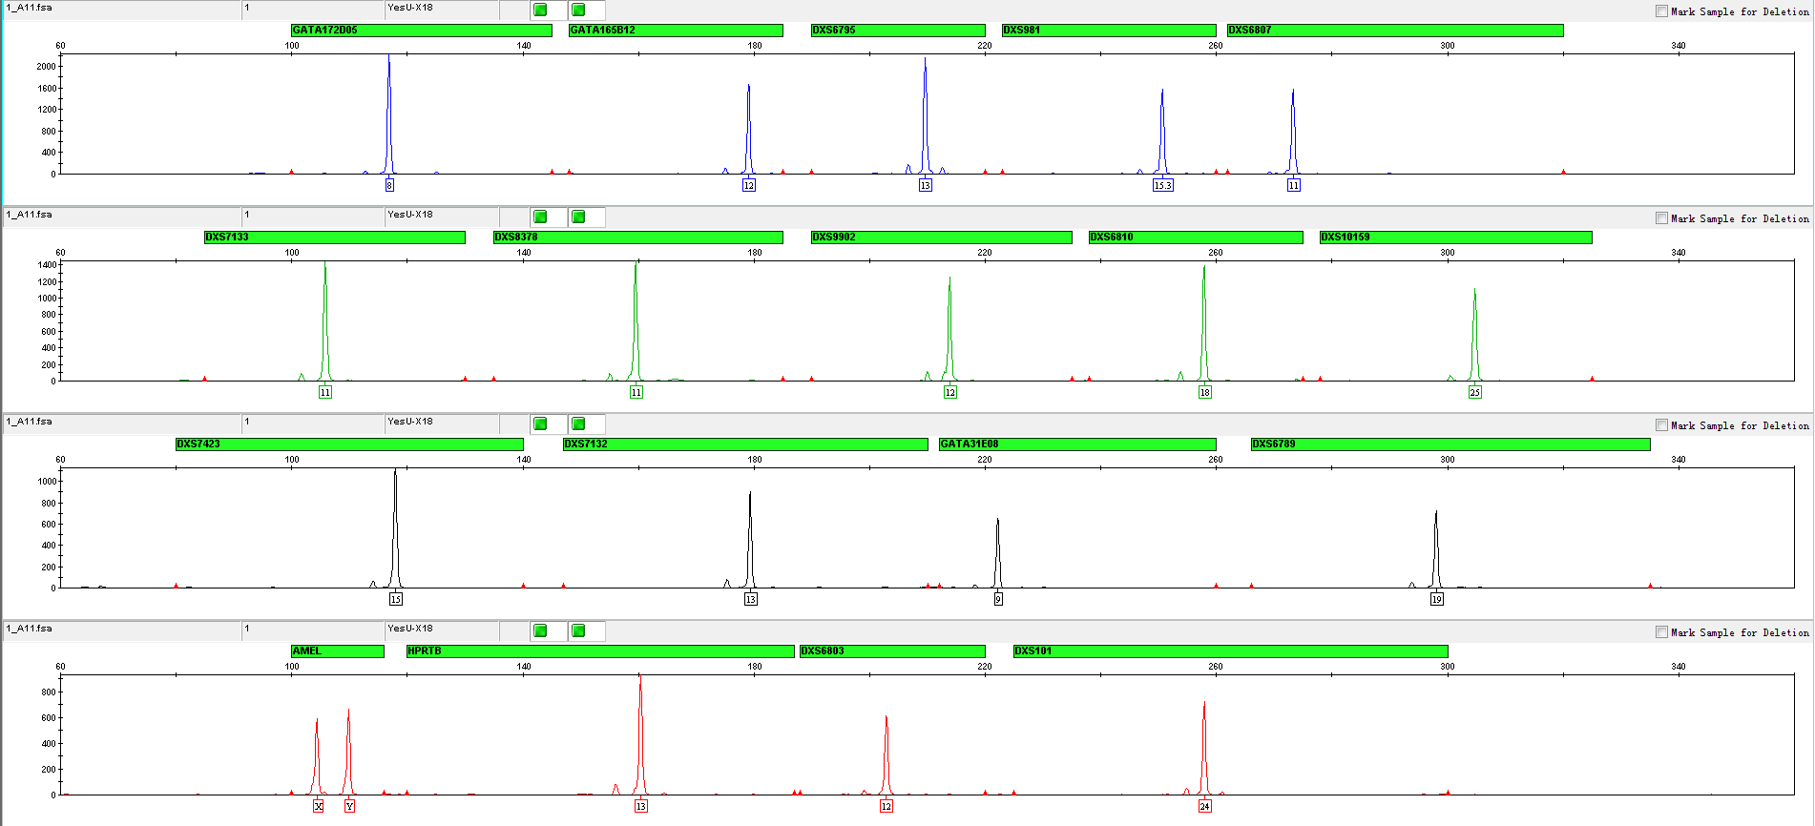
3.2 Amplification Results of Blood on FTA Analyzed on 3130xl

Slide 12
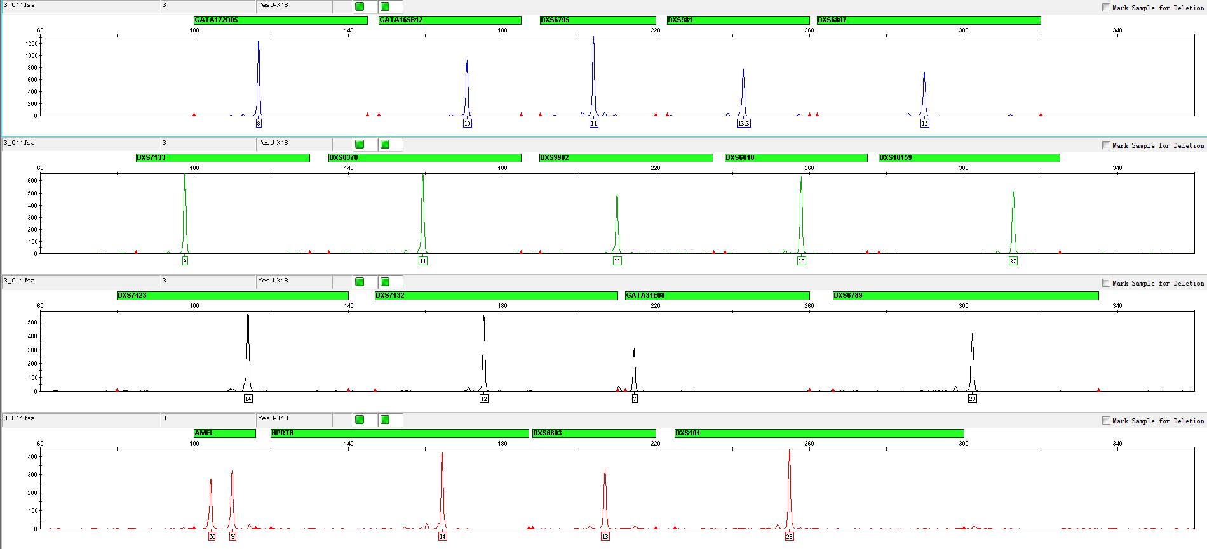
3.3 Amplification Results of Blood on Filter Paper Analyzed on 3130xl

Slide 13
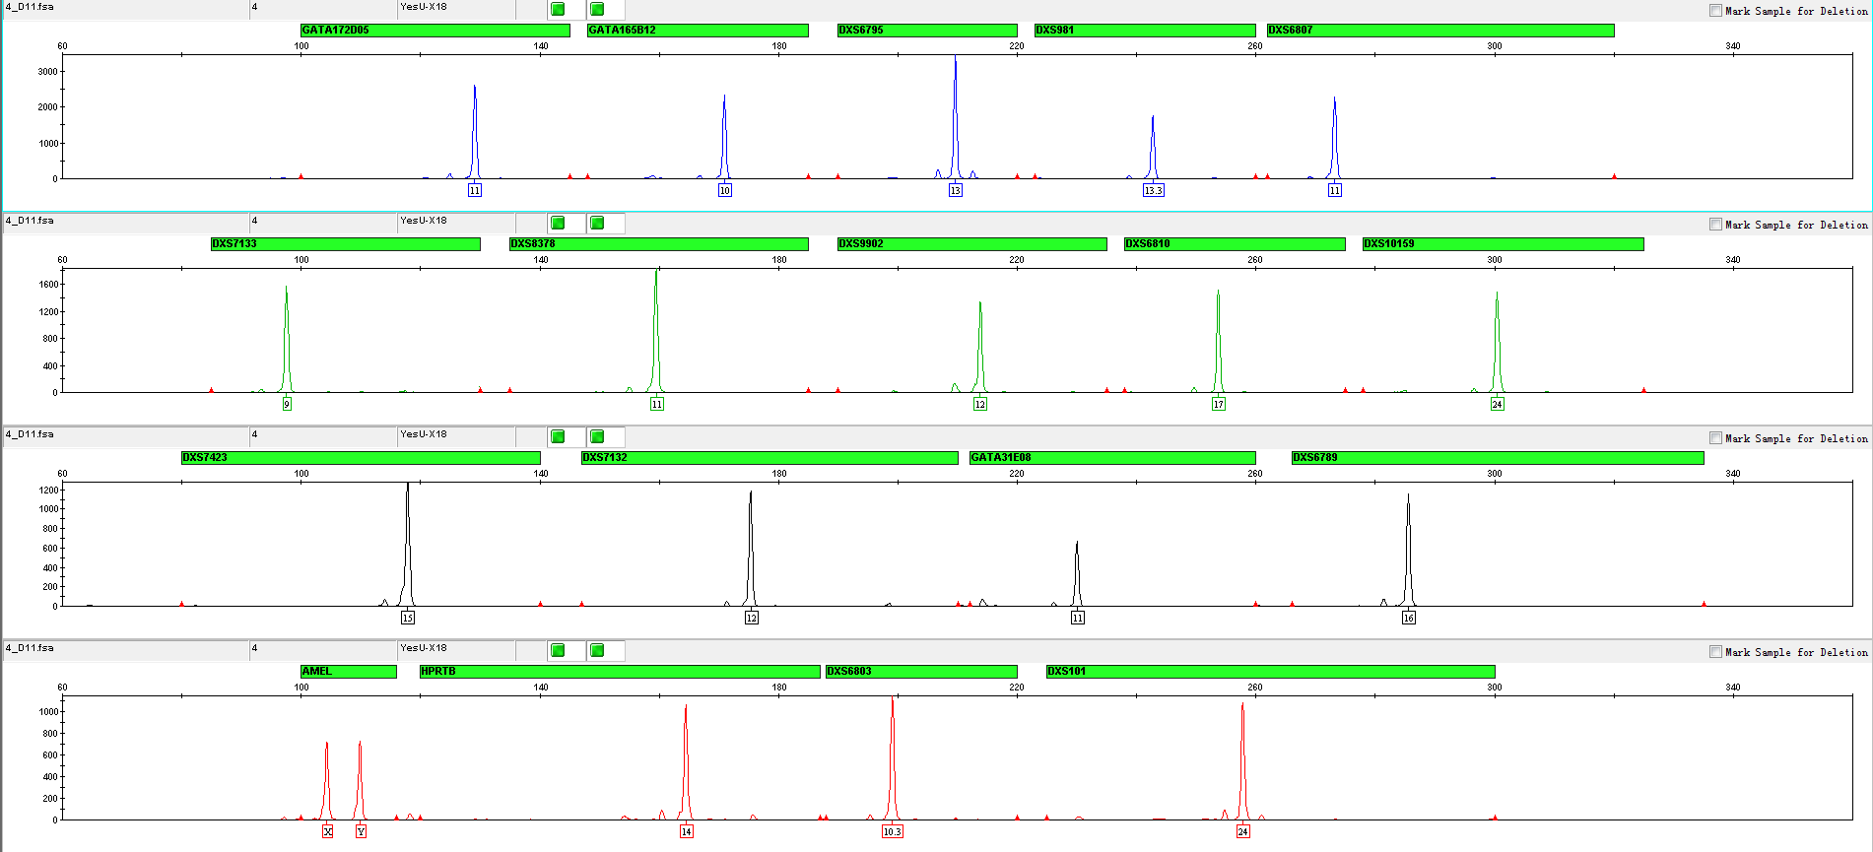
3.4 Amplification Results of Saliva on FTA Analyzed on 3130xl

Slide 14
Performance Measurement of X18Plex

Slide 15
4.1 Tolerance Test
4.1.1 Mix Concentration
• 0.75 x, 1 x, 1.25 x
4.1.2 Primer Concentration
• 0.75 x, 1 x, 1.25 x
4.1.3 Annealing Temperature
• 56℃, 58 ℃, 60℃, 62 ℃

Slide 16
4.1.1 Concentrations of Mix and Primer
30 cycles
10μL amplification system
3130xl (3kV, 10sec sampling time)
Baseline threshold 50RFU

Slide 17
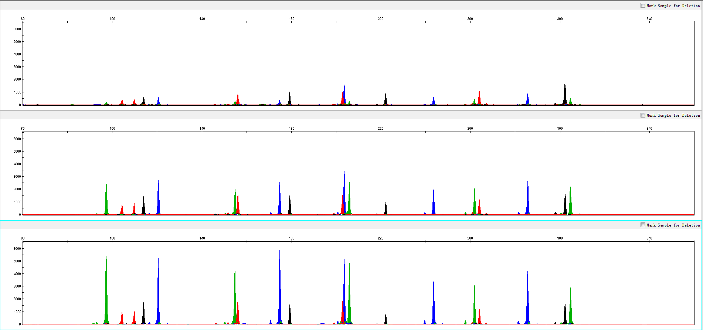
4.1.1 Mix Concentration
0.75X Blood
1.0X Blood
1.25X Blood

Slide 18
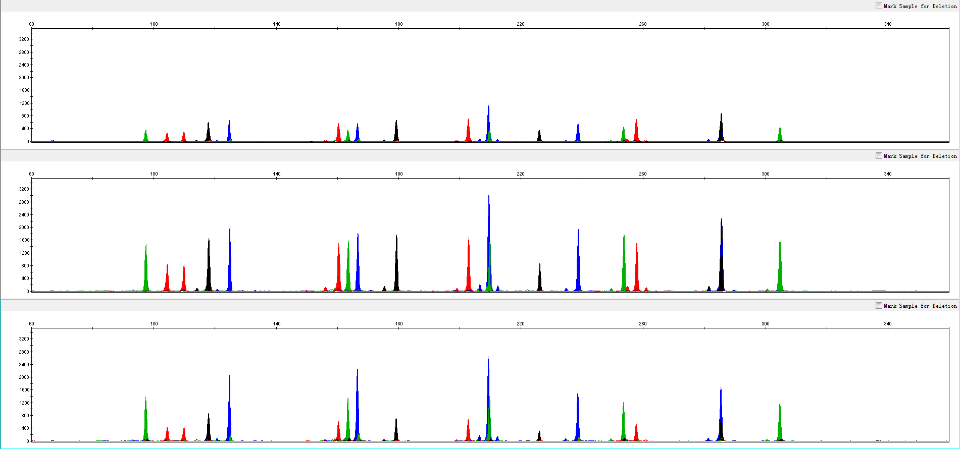
4.1.2 Primer Concentration
0.75X Blood
1.0X Blood
1.25X Blood

Slide 19
4.1.3 Annealing Temperature
30 cycles
10μL amplification system
3130xl (3kV, 10sec sampling time)
Baseline threshold 50RFU

Slide 20
4.2 Inhibition Test
Three kinds of inhibitors:
4.3.1 Hematin
• 0.1, 0.2, 0.3 and 0.4mM
4.3.2 Hemoglobin
• 80, 100, 200 and 300µM
4.3.3 Humic Acid
• 10, 30, 50 and 100ng/µL

Slide 21
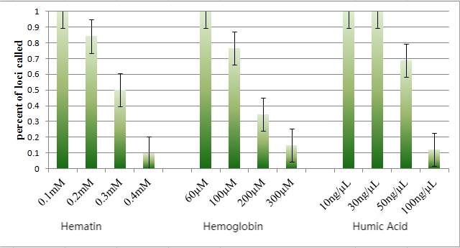
4.2 Inhibition Test
30 cycles
10μL amplification system
3130xl (3kV, 10sec sampling time)
Baseline threshold 50RFU

Slide 22
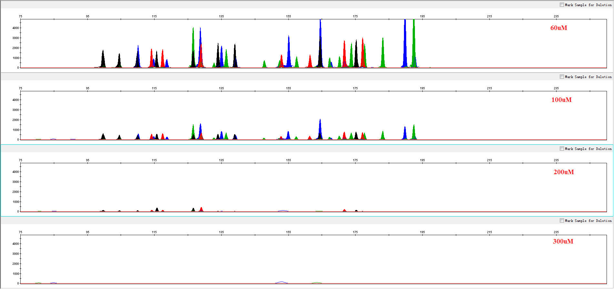
4.2.1 Hematin

Slide 23
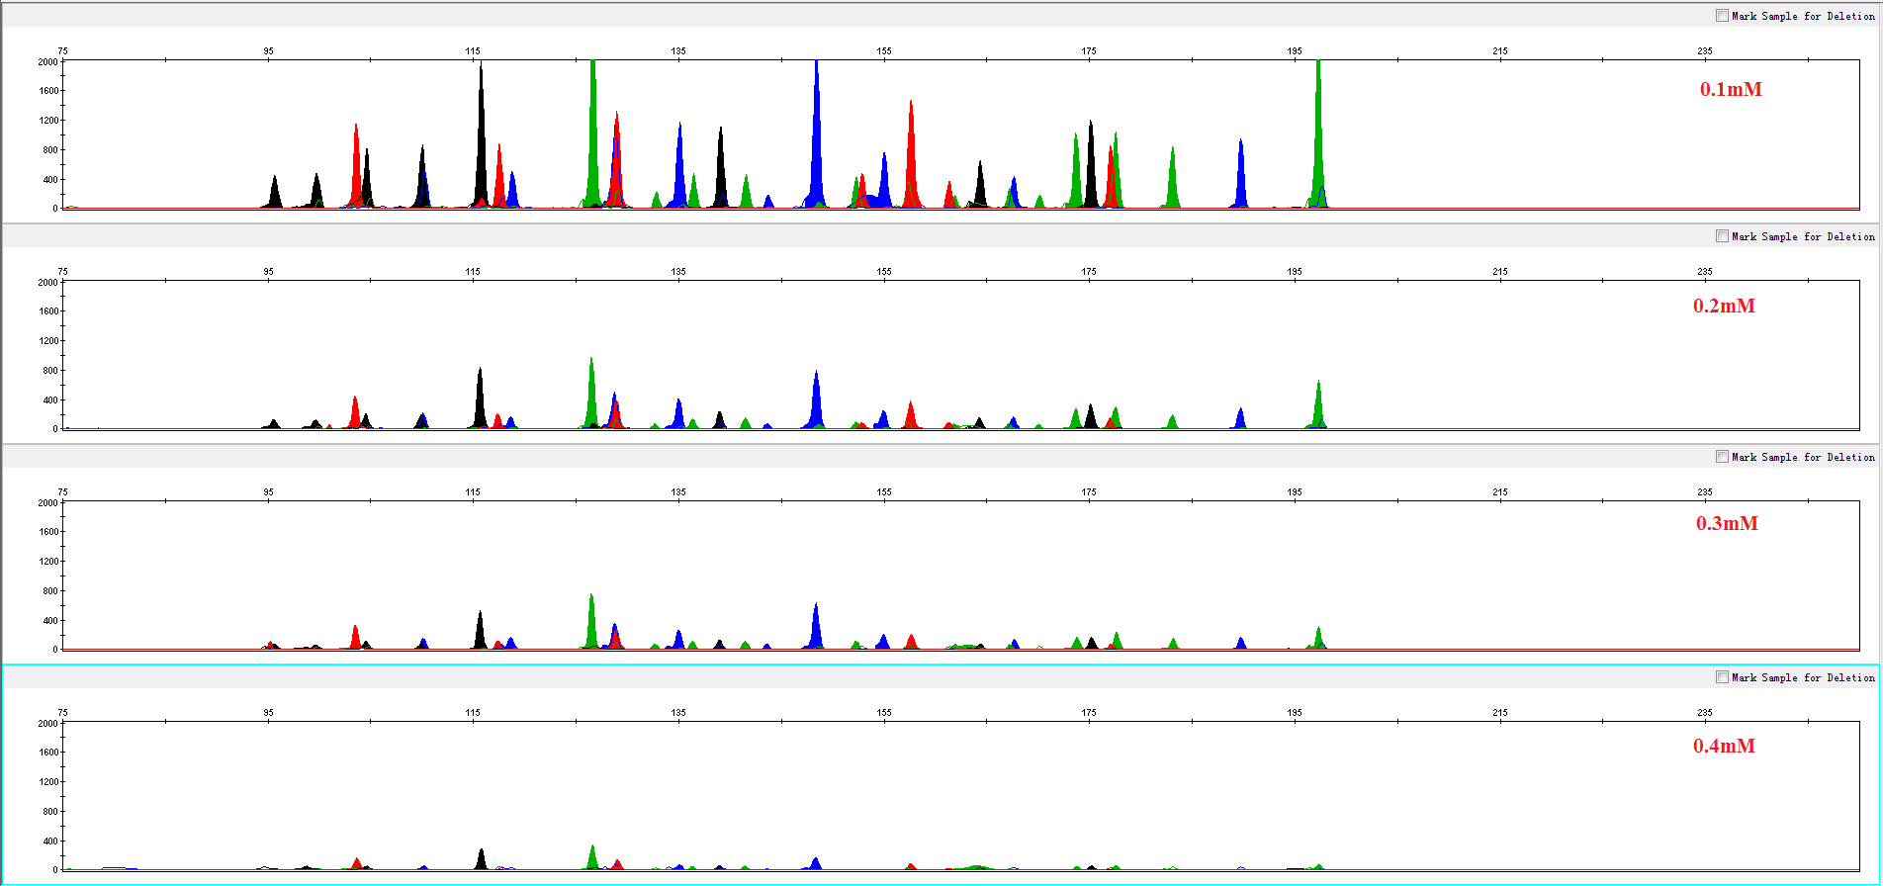
4.3.2 Hemoglobin

Slide 24
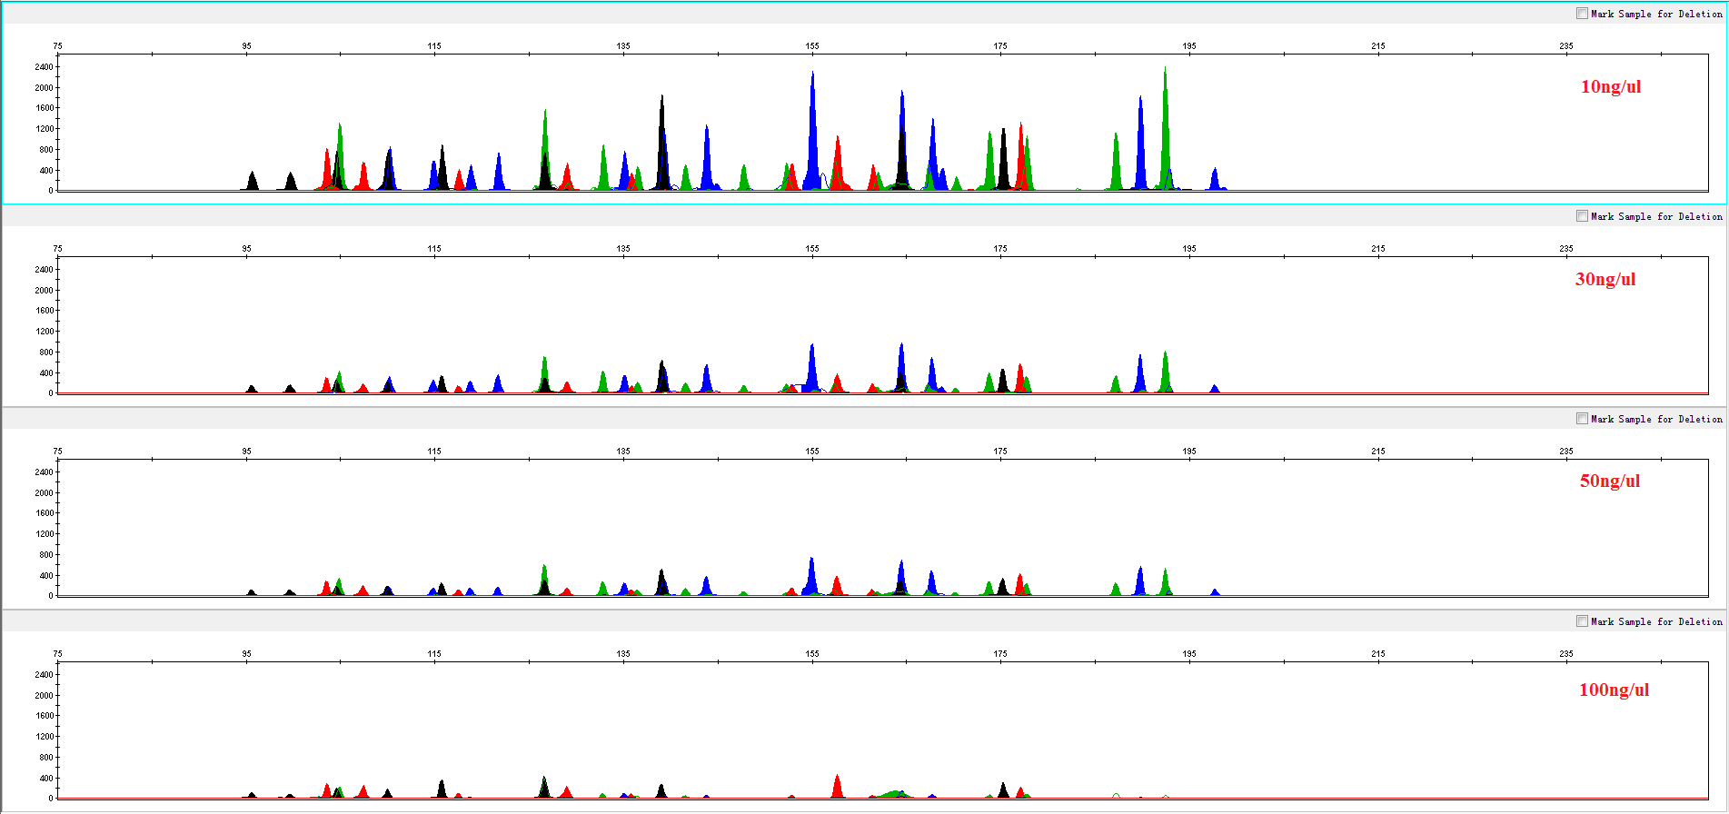
4.3.3 Humic Acid

Slide 25
4.4 Summary
1. Rapid amplification.The whole PCR process using X18Plex takes less than 90min.
2. High resolution: Correct genotyping of 18 loci were obtained via single tube reaction.
3. High sensitivity: X18Plex showed good performance in the amplification of 0.25ng DNA samples. 1-3 pieces of FTA blood cards and/or FTA oral cards of 1.2 mm aperture were amplified normally.
4. Strong tolerance: X18Plex amplified normally in Mix or Primer reaction systems of different concentrations.
5. Strong compatibility: X18Plex is compatible with the direct amplification of various samples and the amplification of purified DNA.
6. X18Plex is applicable to the identification of special paternity cases such as complex kinship, disputed father daughter relationship, half sister relationship, grandparent relationship, etc. It is an effective complement to autosomal and Y chromosome STR kits.

Slide 26
Service & Cooperation

Slide 27
Service & Cooperation
Jiangsu Superbio Biomedical Co. Ltd., founded in 2011, is a cutting-edge technology enterprise owning the Practice License of Medical Institution, which specializes in the research and testing of gene sequencing industry, and integrates R&D, production and sales. The company's products and services cover forensic testing, medical testing, food/environment/medicine testing, instrumentation and software.
We are willing to provide clients with scientific research services related to forensic DNA testing, such as research projects and papers publication, solving all the difficulties encountered in the experiment for you.
We sincerely look forward to cooperate with you in developing products and researching projects.

Slide 28
THANKS!
Contact Us
Address: Sino-Danish Ecological Life Science Industrial Park, No.3-1 Xinjinxhu Road, Pukou District, Nanjing
Tel: 400-616-2676
Website: http://www.superbio.cn/

